Slide 1

Commercial or “ethical fashion”?
2.1. The culture of fashion
The trends that shape the style of clothing and fashion are considered to come from three sources:
➢ High culture (art, literature, classical music, theater, etc.).
➢ Popular culture (television, music, cinema, culture of celebrities, etc.).
➢ Low culture (non-mainstream activities done by special interest groups, such as skateboarding, etc.).

Slide 2
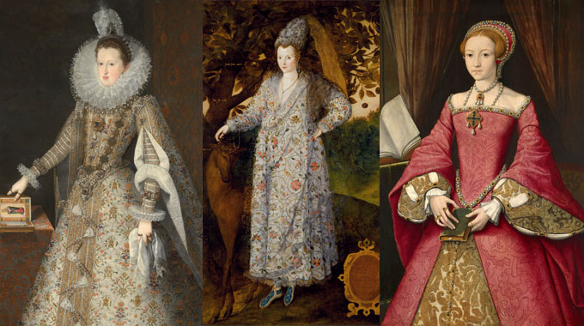
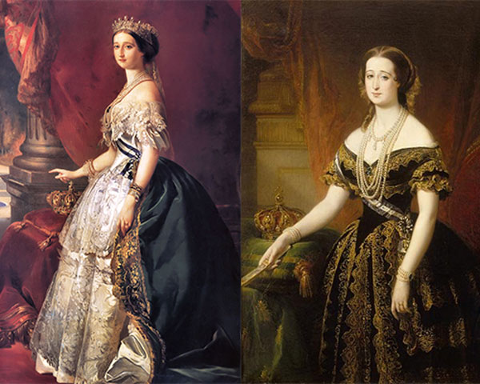
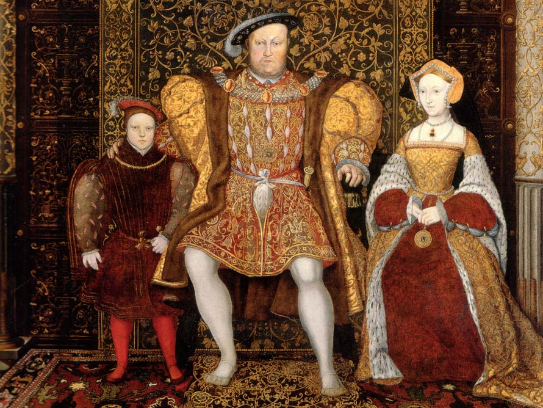

Commercial or “ethical fashion”?
2.1. The culture of fashion
2.1.1. High Fashion (Haute Couture)
Fashion nowadays operates in two different directions. On the one hand, mass production to meet the needs of people who have moved to the city and on the other, high culture (haute couture) for the elite of the middle class (bourgeoisie).
Worth set the rules and laid the foundations for a custom couture that would serve the need for personalization and the theatricality of the nobles’ lives.
Worth innovates in the history of clothing design, since he managed to upgrade the tailor to a fashion designer and the craftsman to an artist.

Slide 3
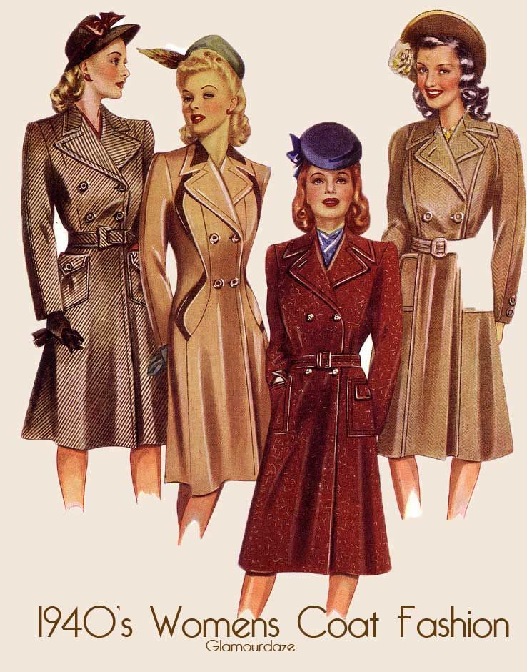

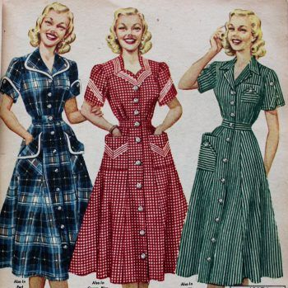
At the beginning of the 20th century, with the advancements in transportation, construction technology and communications, the creation of department stores selling large quantities of various products is made possible. Consequently, the new clothing trend, ready to wear, offers people the opportunity to follow the fast pace of everyday life, while being elegant at the same time. Modern youth constitute an important group of consumers who have left haute couture behind and demand cheap fashion, closer to their existentialism. Thus, fashion loses its elitist character and is transformed into a mass phenomenon.
Commercial or “ethical fashion”?
2.1. The culture of fashion
2.1.2. Ready-to-wear clothing (Prêt a porter)

Slide 4
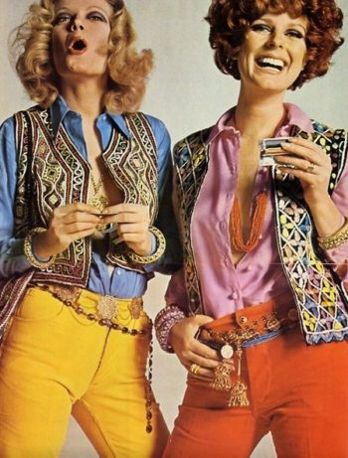
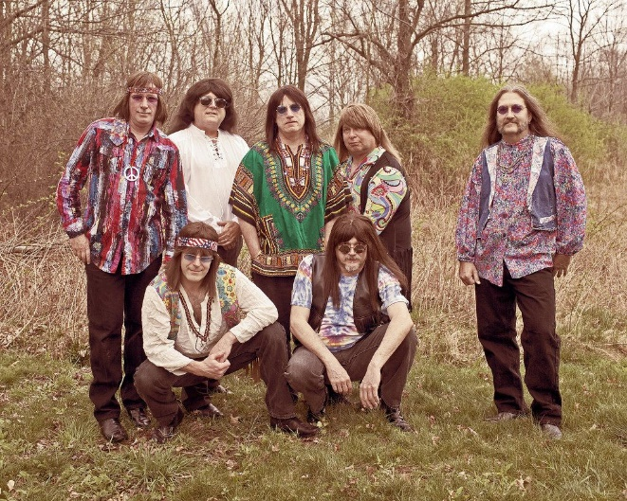
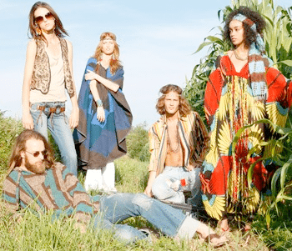
Commercial or “ethical fashion”?
2.1. The culture of fashion
2.1.3. Anti-fashion
Anti-fashion is the product of a perspective advocating the death of haute couture. "Haute couture is dead, I want to touch the street woman of everyday life," said Emmanuel Kahn (1964).
In order to show their reaction, young people adopt the hippie look. Men and women have long hair, wear sandals, jeans, etc. Their theory is that frugal living can replace the phenomenon of non-stop consumption.

Slide 5
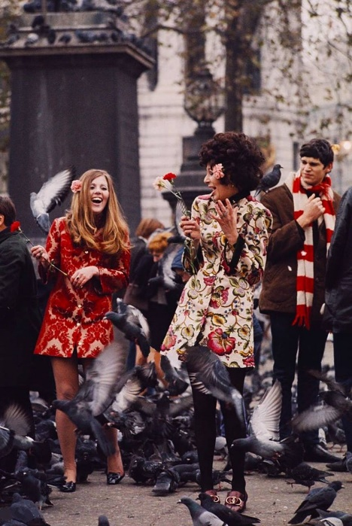
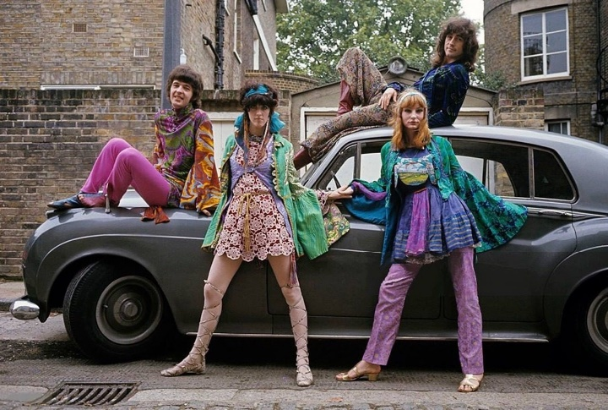
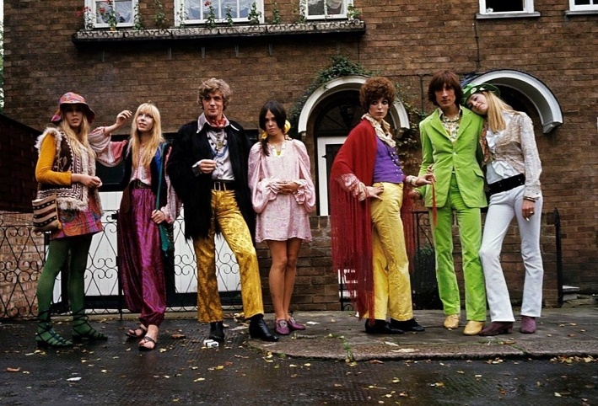
Commercial or “ethical fashion”?
2.1. The culture of fashion
2.1.4. Street fashion
Gradually, after the 1960s, the manufacture, transport and distribution of clothing become increasingly cheaper, leading young people to look for affordable clothes and reject creations sold at prohibitive prices.
In such a climate, big fashion houses are no longer the ones who define fashion. Youth culture will create its own fashion, street fashion, which will then be adopted by haute couture and ready-to-wear clothing.
In the 1960s, England begin to play an important role in spreading new trends. The heart of world fashion is located on a London street, Carnaby Street.

Slide 6
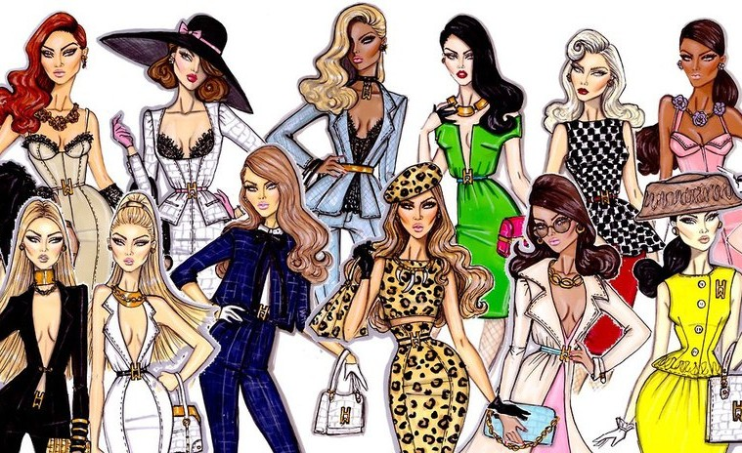
Commercial or “ethical fashion”?
3.1. How did music influence fashion?

Slide 7
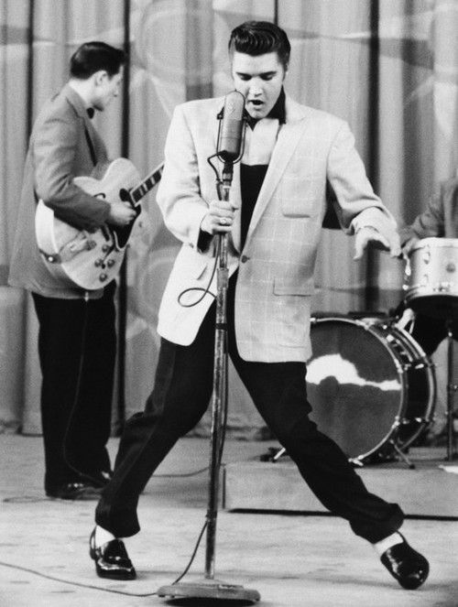
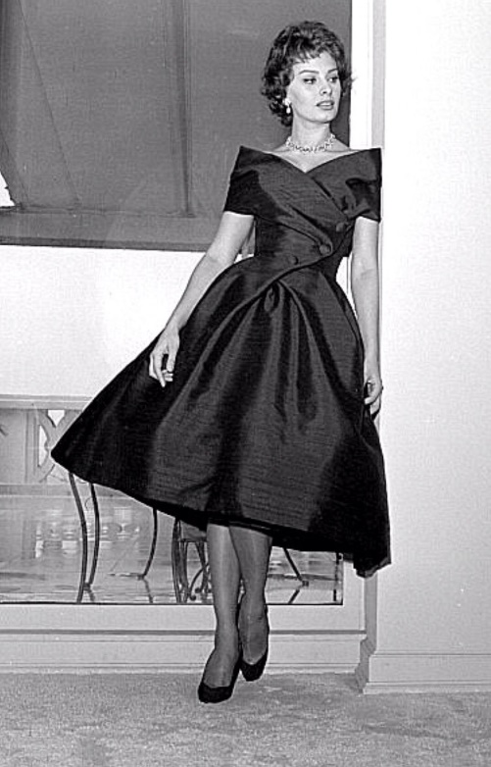
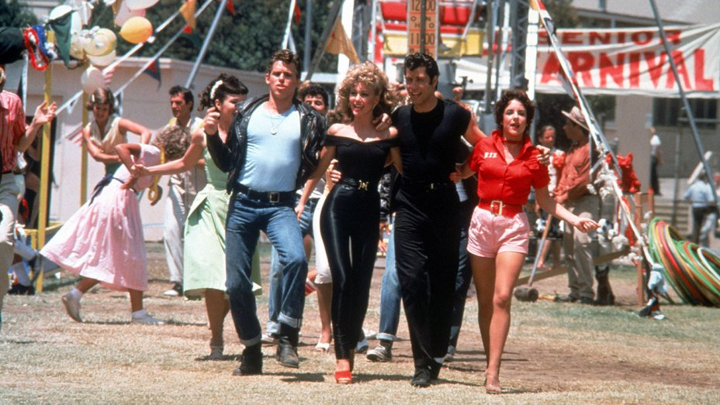
Commercial or “ethical fashion”?
3.1. How did music influence fashion?
3.1.1. Rock ’n’ Roll and fashion
Rock ‘n’ roll of the ’50s influenced fashion style.
Leather jackets, jeans, tight jackets and hair with a lot of gel for men.
Ballerina shoes and knee length clos skirts for women are representative examples of the fashion of the time.

Slide 8
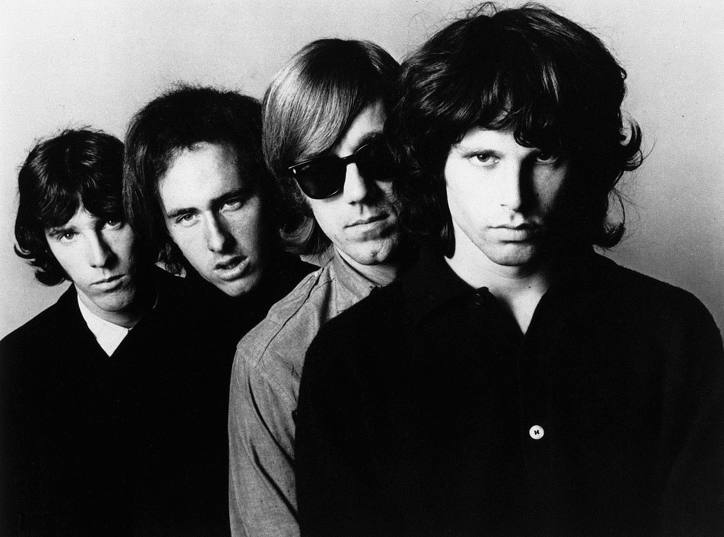
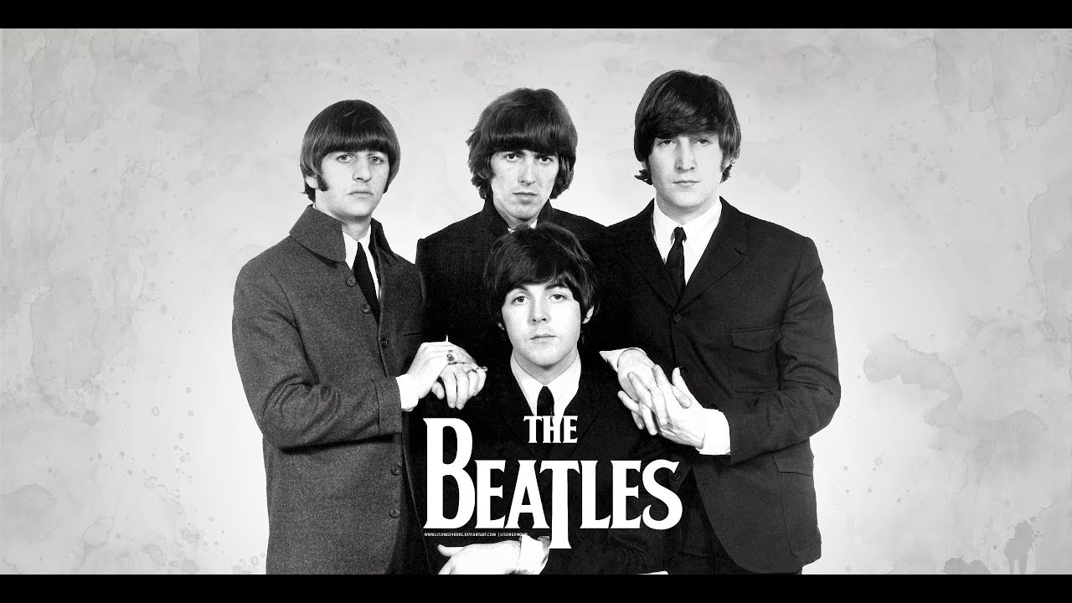
Commercial or “ethical fashion”?
3.1. How did music influence fashion?
3.1.2. Rock and fashion
The fashion style of rock music was simple, that is, short-sleeved blouses, jeans, leather jackets, glasses, necklaces, hair bands and long hair.

Slide 9
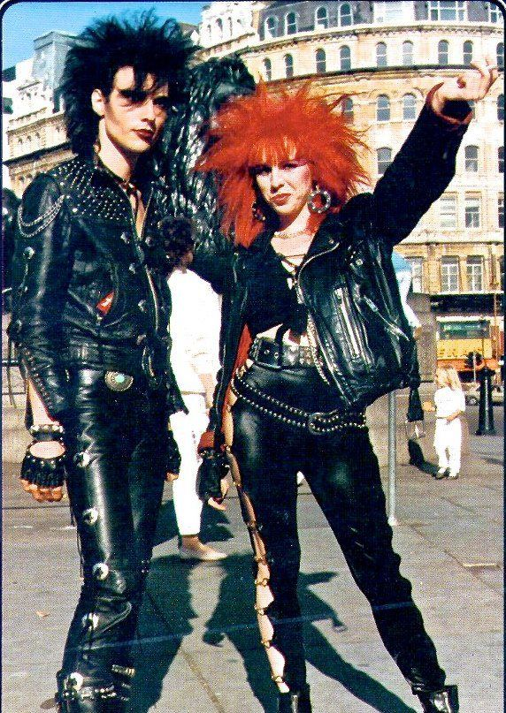
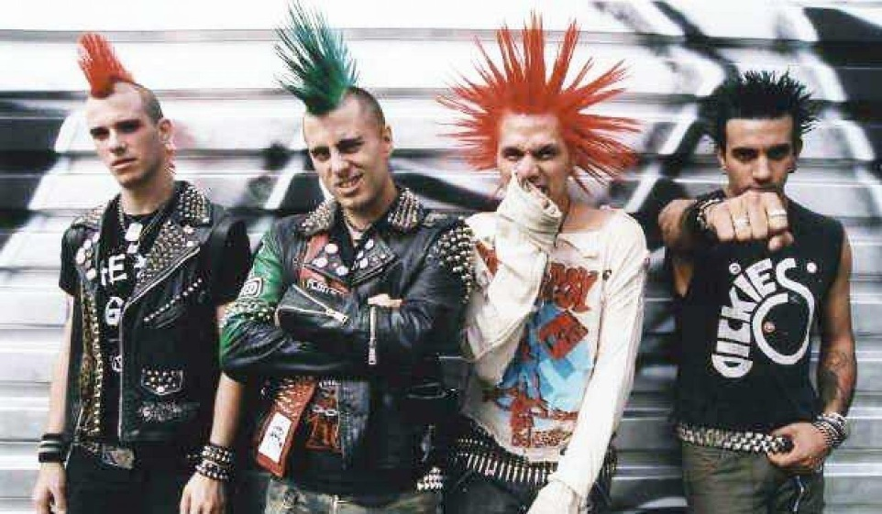
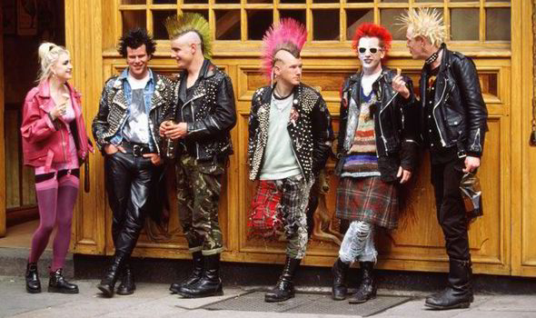
Commercial or “ethical fashion”?
3.1. How did music influence fashion?
3.1.3. Punk and fashion
Punk style, from the start, aimed to provoke public opinion.
T-shirts with offensive prints (eg crosses upside down, etc.), sloppy hair, dyed in unnatural colors (green, bright red, purple), fishnet stockings, spiked wristbands, etc.

Slide 10
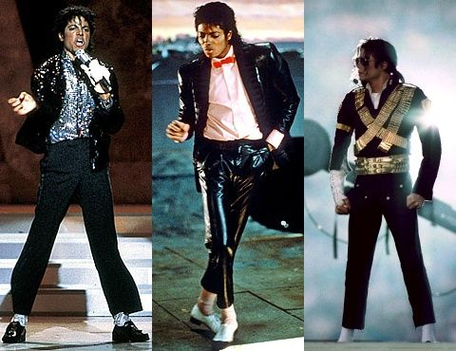
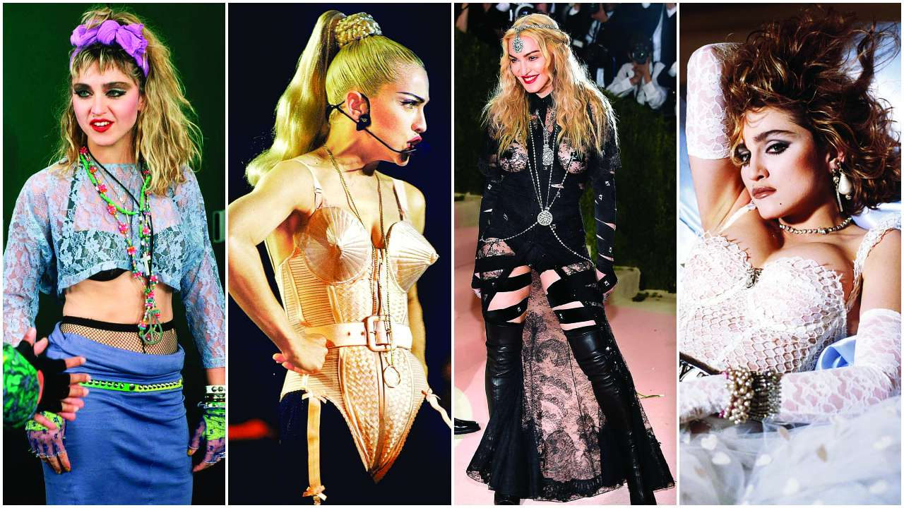
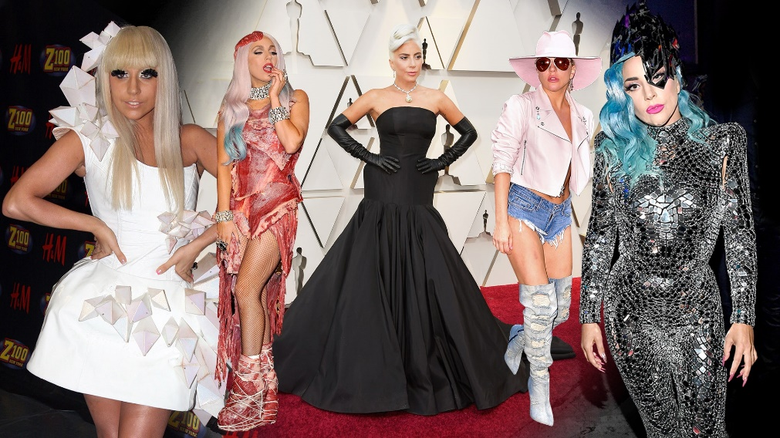
Commercial or “ethical fashion”?
3.1. How did music influence fashion?
3.1.4. Pop and fashion
Pop fashion includes impressive clothes and accessories, strange combinations and in general an image reminding theatrical costumes and stage sets.
The whole image is complete with intense make-up for women, but also for men.

Slide 11
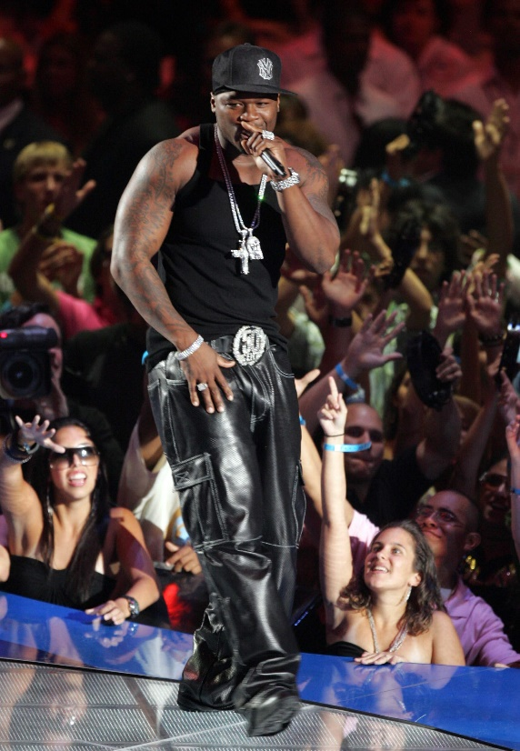
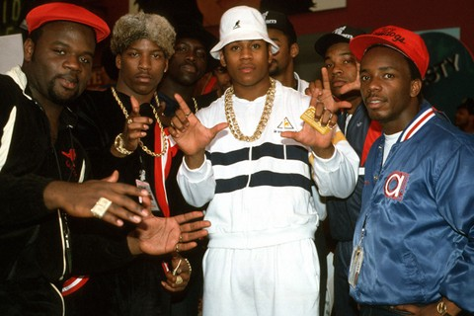
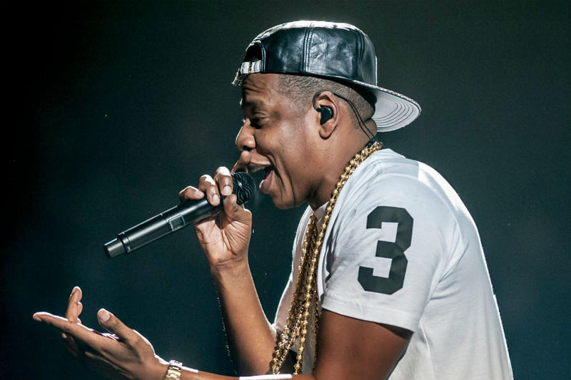
Commercial or “ethical fashion”?
3.1. How did music influence fashion?
3.1.5. Hip – pop/rap and fashion
The fashion style of people who follow this type of music, includes baggy shirts and sagging pants with many pockets, hats usually worn crooked, chains, sneakers, etc.

