Slide 1
in Science and Art
Light

Slide 2
Light
in Science
1st Teaching Period
Part I

Slide 3
Light makes objects visible!
(If there was no light, we could not see anything!)

Slide 4
do you see anything?

Slide 5
Objects are visible because
they reflect part of the radiation coming from a light source
(while they absorb the rest of it).
radiation
image I

Slide 6
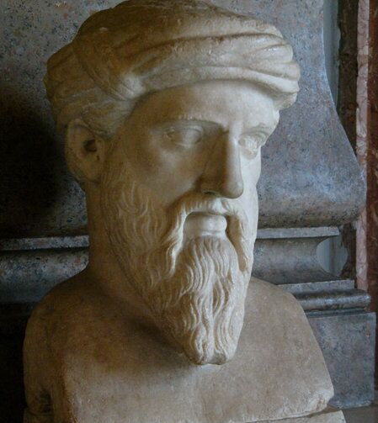
Pythagoras (c. 570 BC-c. 495 BC)
and his students (Pythagoreans),during the end of 5th century BC, believed that every visible object emits a constant current of particles.
5th c. BC
0

Slide 7
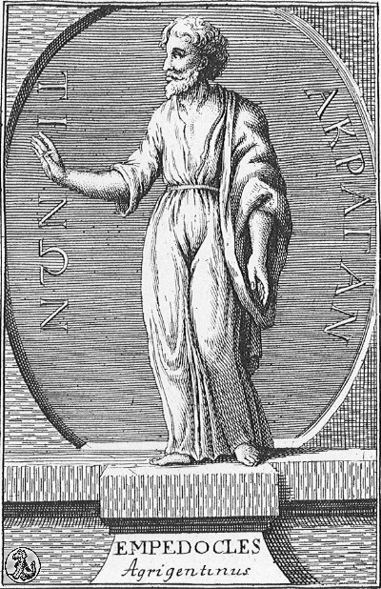
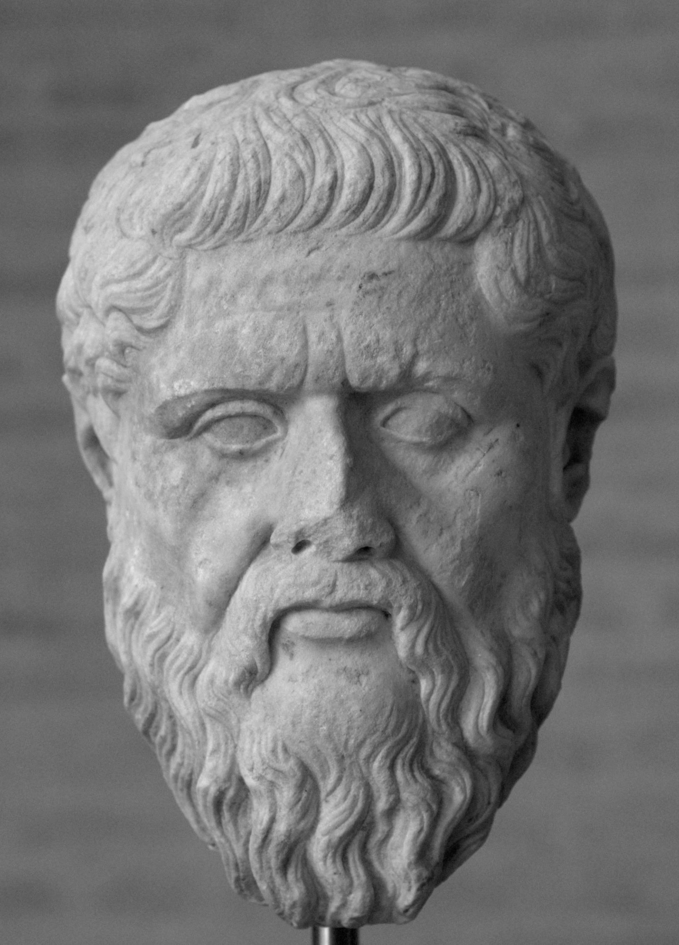
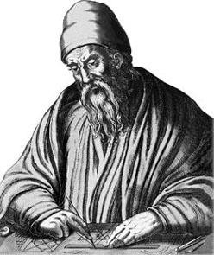
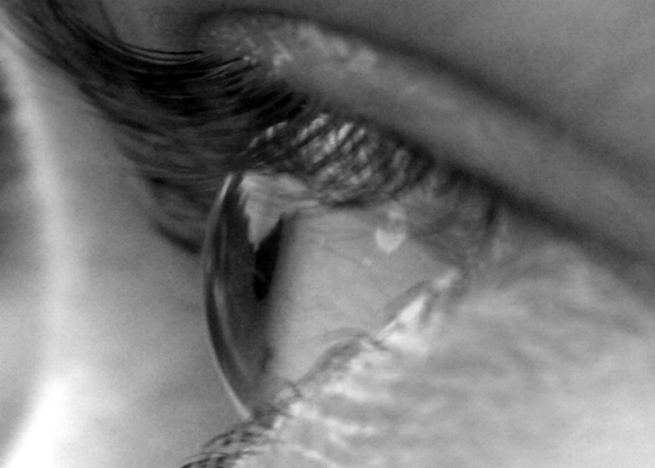
Pre-Socratic philosopher Empedocles, Plato and Euclid, believed that vision is caused by
rays of light, “divine fire” (in Greek: “Θείον Πυρ” ) which human eyes create and cast on objects.
This was actually the most popular theory during ancient times!
image 2
image 3
image 4
Empedocles
495-435 BC
Plato
427-347 BC
Euclid
325-270 BC
0

Slide 8
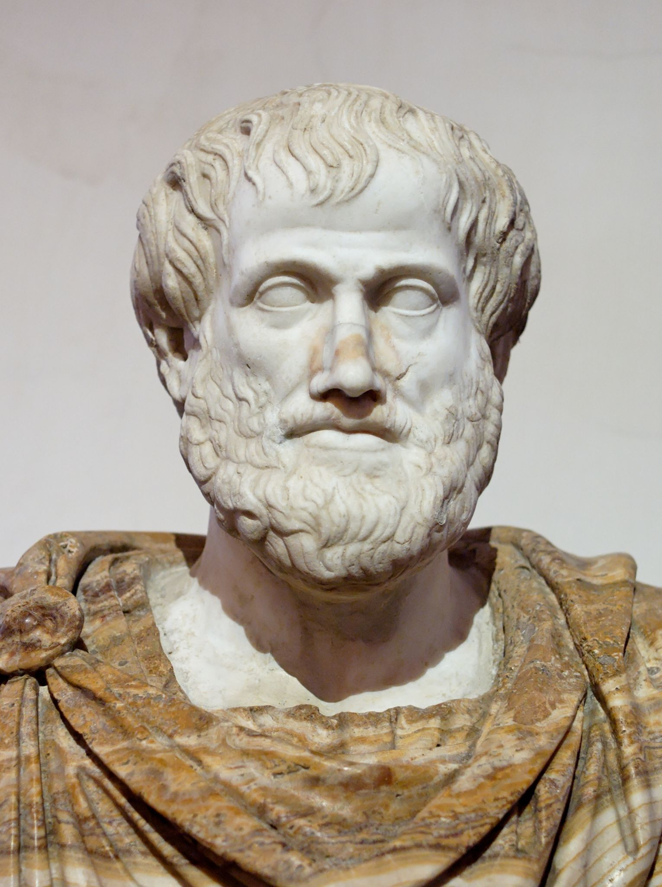
Aristotle (384-332 BC) believed that light propagates in some form of waves.
image 5
384 BC
0

Slide 9
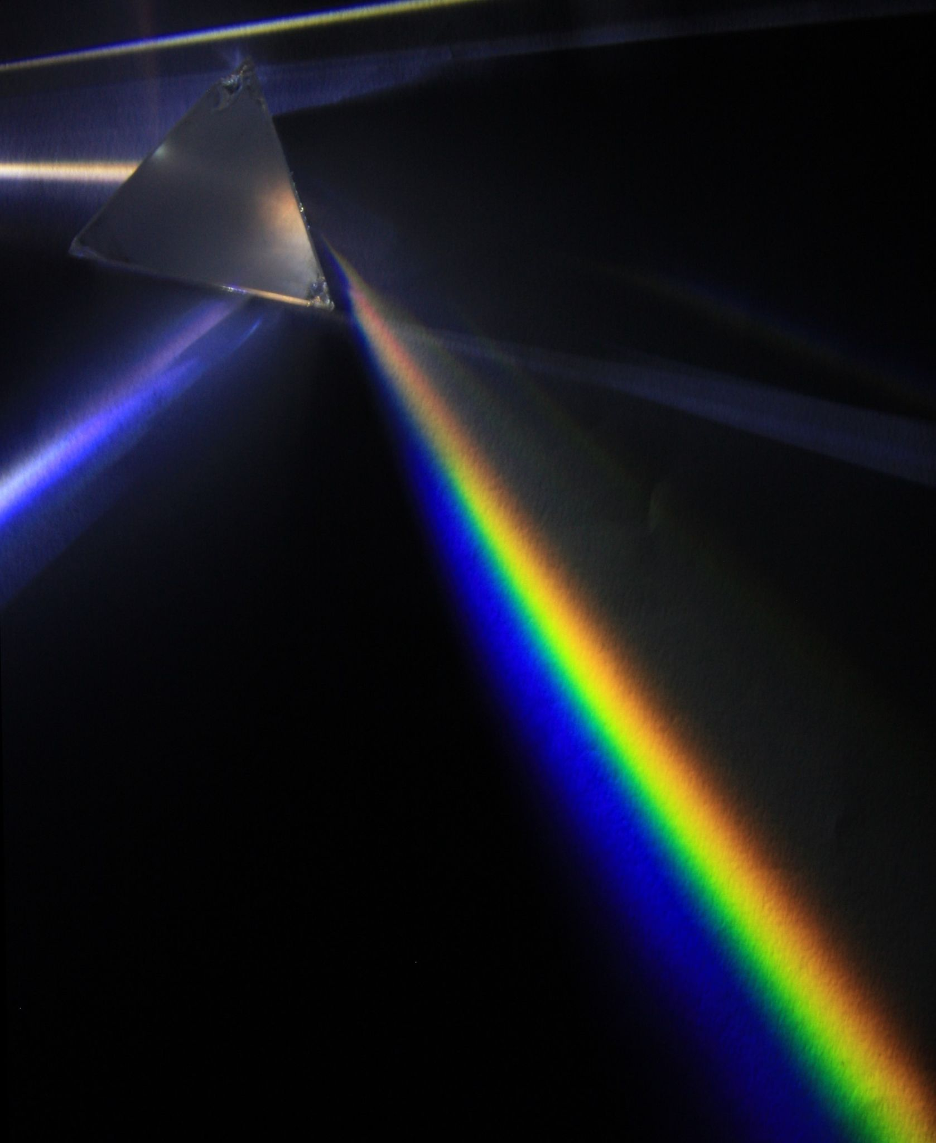
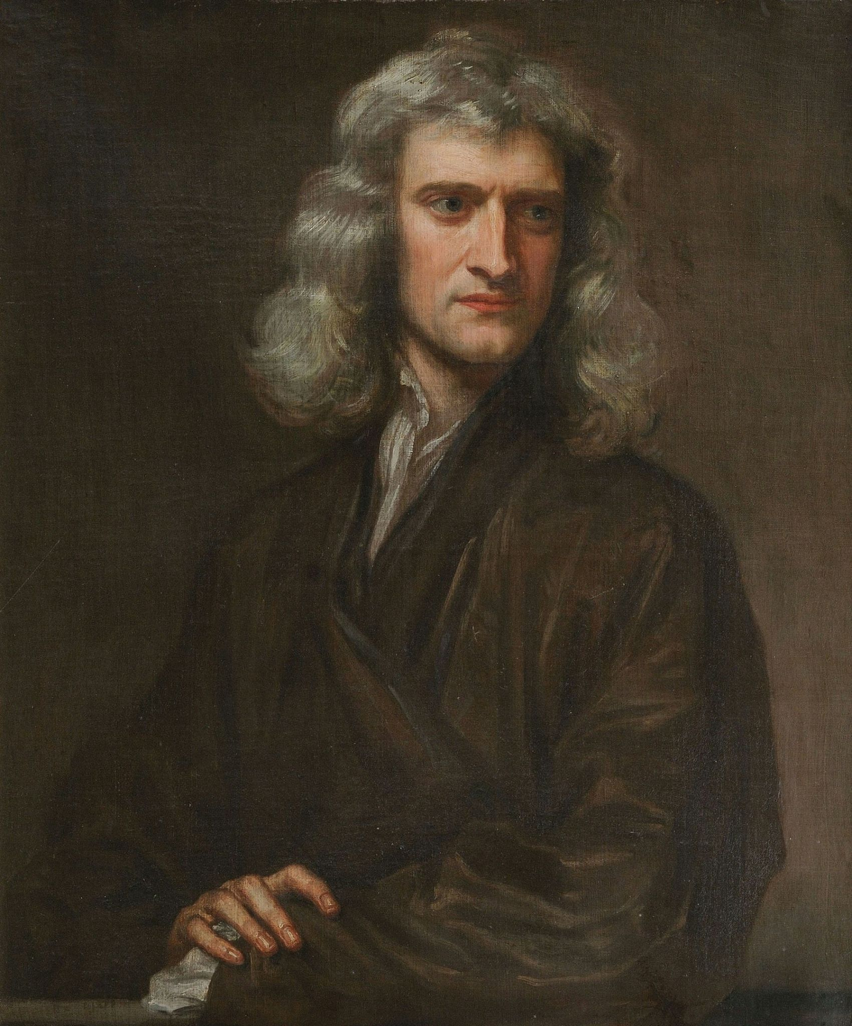
In 1666, Sir Isaac Newton, in England, discovered the color spectrum.
image 6
Isaac Newton’s Experiment:
In a dark room, he made a thin beam
of white sunlight pass through a prism.
image 7

Slide 10
image II
Casting the rays of light that came out of the prism on a white screen,
Newton saw the color spectrum:
red orange yellow green cyan blue violet
the 7 colors of the rainbow!

Slide 11
Then,
he let the colored beams pass
through another prism,
placed upside down,
and he witnessed the production of the original white light again.
image 7

Slide 12
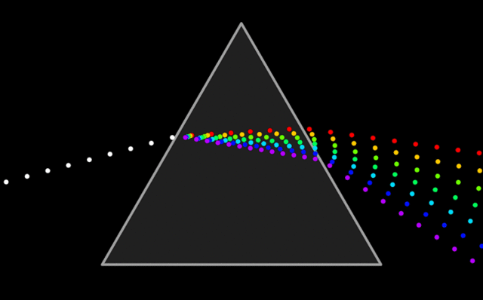
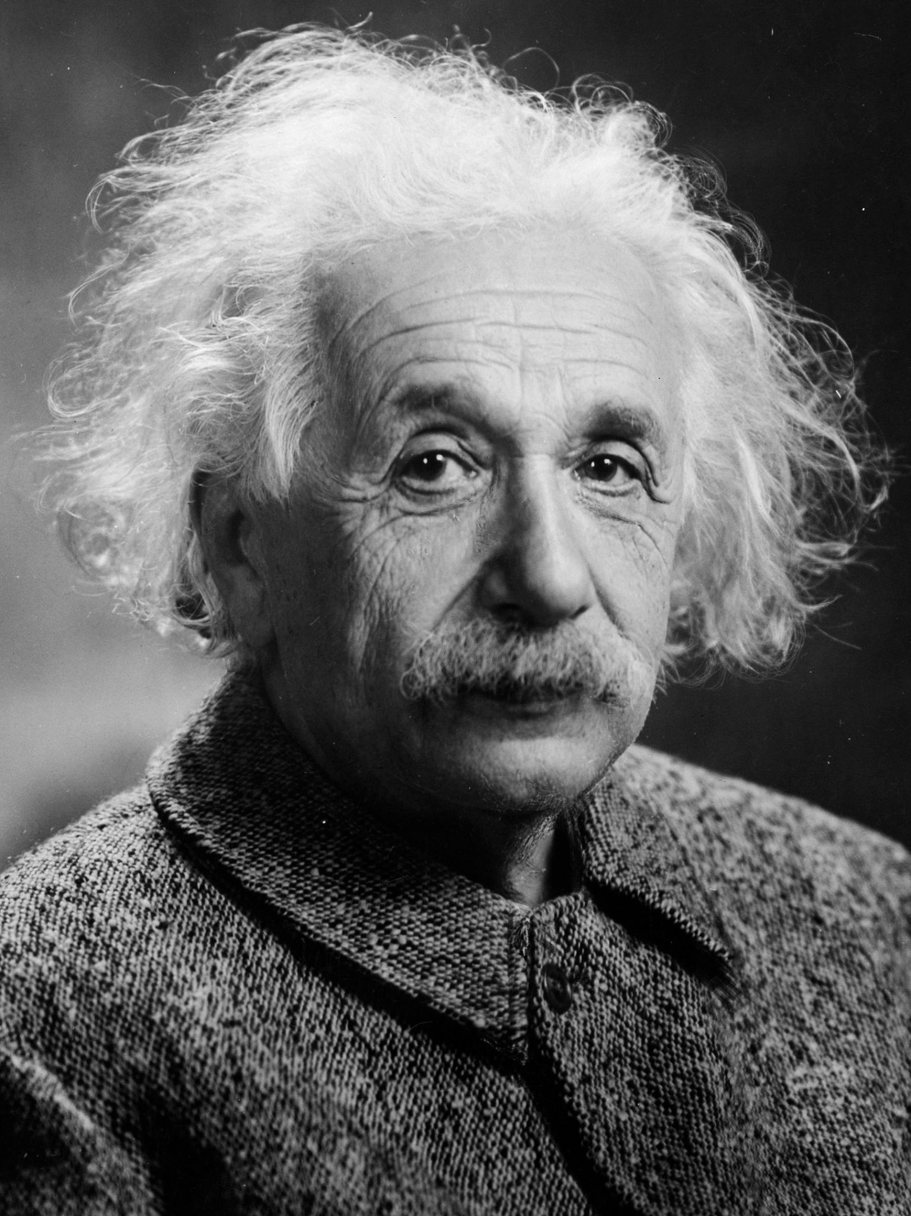
Albert Einstein, in 1905 proved that wave theory was incomplete and thought on photons, which are the elements that light is made of.
image 8
image 9
Introducing the elaborate theory of quantum mechanics, scientists proved that light is a small part of the electromagnetic spectrum, which has both particle and wave properties.

Slide 13
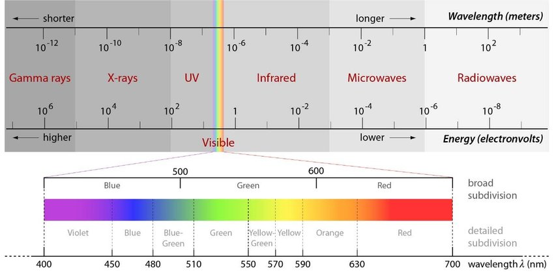
The Electromagnetic Spectrum
Only a very small part of the Electromagnetic spectrum is visible to humans
image 10. The complete electromagnetic spectrum with the spectral subdivisions of the visible waveband

Slide 14
Light
in ART

Slide 15
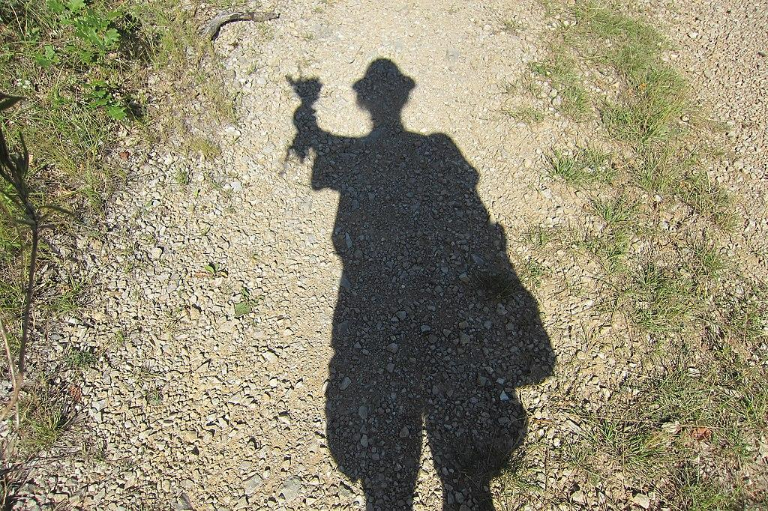
Light and shadow in nature and art
As we already saw, light makes figures, objects and surroundings visible.
But what is a shadow?
image 11

Slide 16

A shadow is just a “weak” , a lesser light. There are two kinds of shadows:
Primary shadows which are the shadows we observe on an object or a figure itself and
Cast shadows, the shadows that an object or figure creates on a surface under, or around it, when it is lit.
primary shadow
cast shadow
image 12

Slide 17
Experiment 1
Turn all the classroom’s lights off.
Place a simple object (an eraser, a sharpener, etc)
on a clean and empty surface (a desk!), preferably white,
and light it with a flashlight.
Observe the primary shadow and the cast shadow.
Experiment 2
Turn on the classroom’s lights and observe the changes of the shadows.
Change the light. Use more lighting sources(i.e. a second flashlight). Change the distance of the lighting source and observe the different shadows formed on and around the object.
Homework
Post your observations and thoughts on the experiments @Padlet. Answer the questions:
https://padlet.com/palla_eugenia/urv6iy7dbge3c8cd

Slide 18
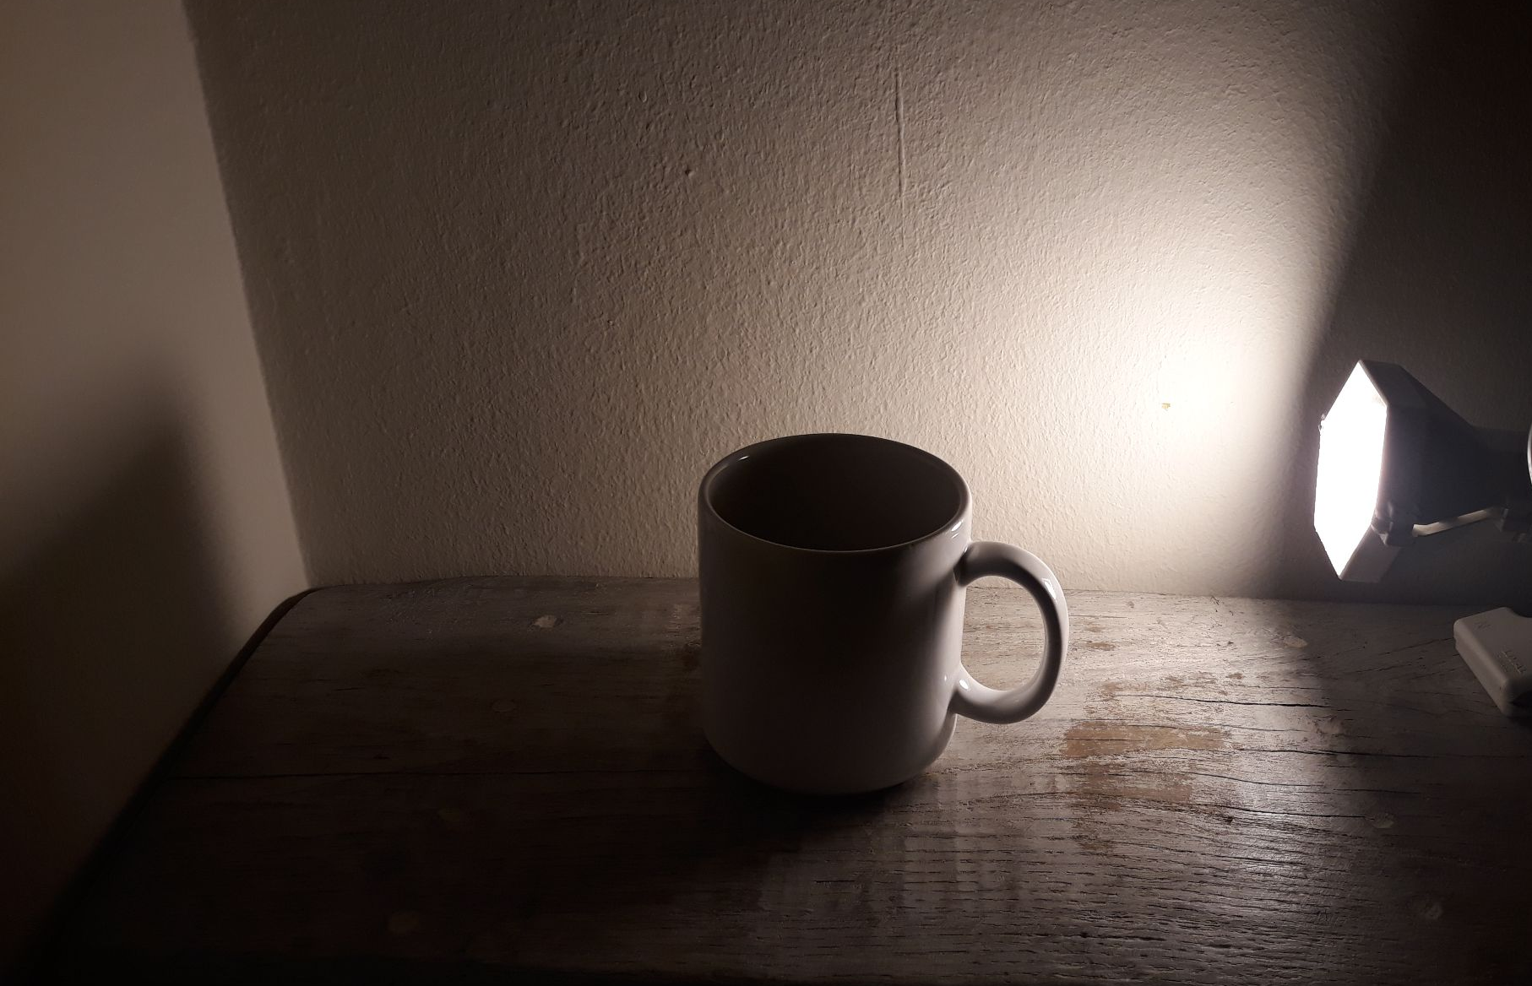
The shadow is always cast directly opposite the light source and depends on the light source properties and quality.
primary shadow
light source
cast shadow
image III

Slide 19
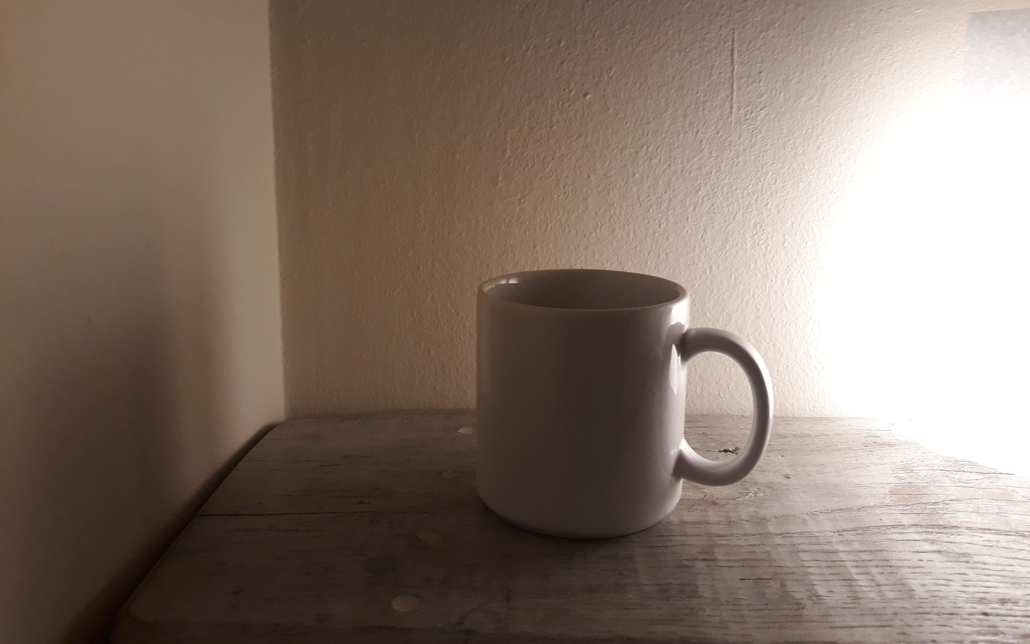
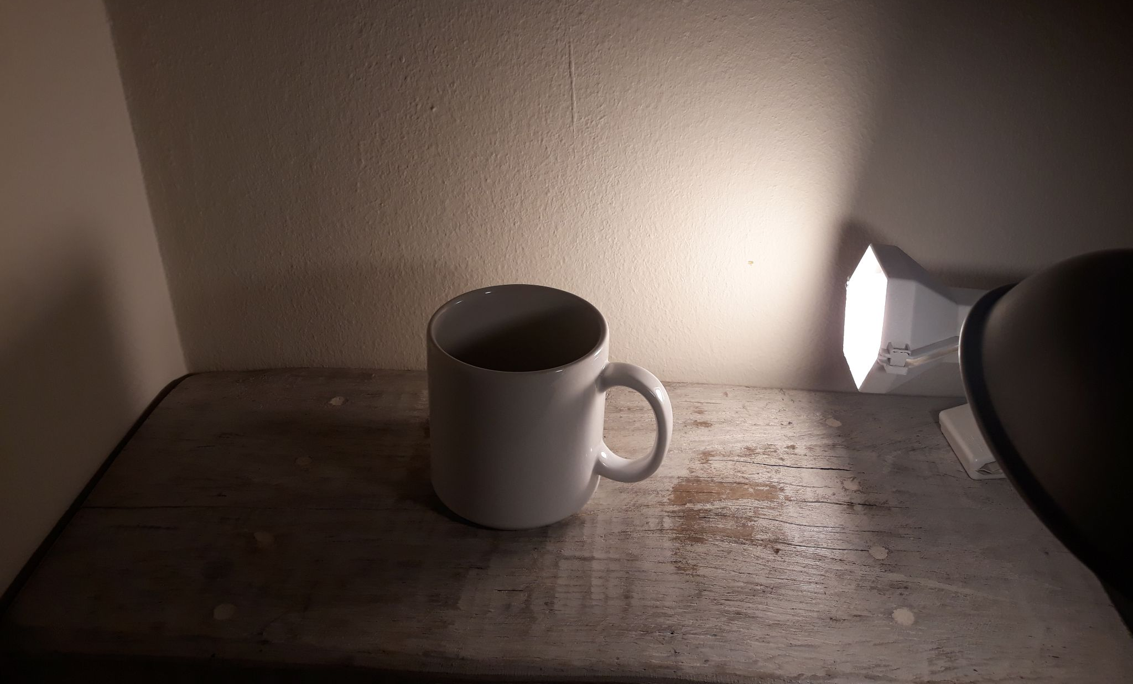
When the light is strong, or very close to the object, then the shadow is dark and intense (image I)
When the light is soft and diffussed, the shadow is lighter (Image II)
We have one cast shadow for each light source (Image III)
image IV
light source 1
image III
light source 2
cast shadow 2
cast shadow 1
image V

Slide 20
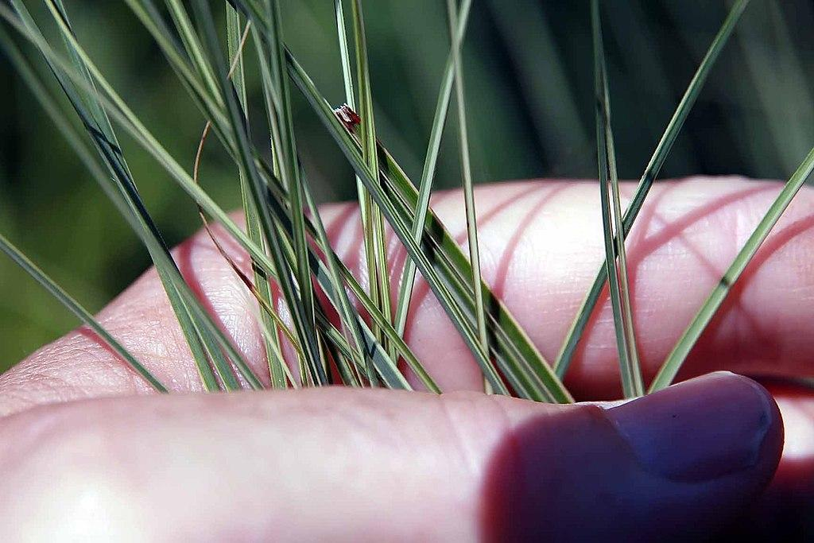
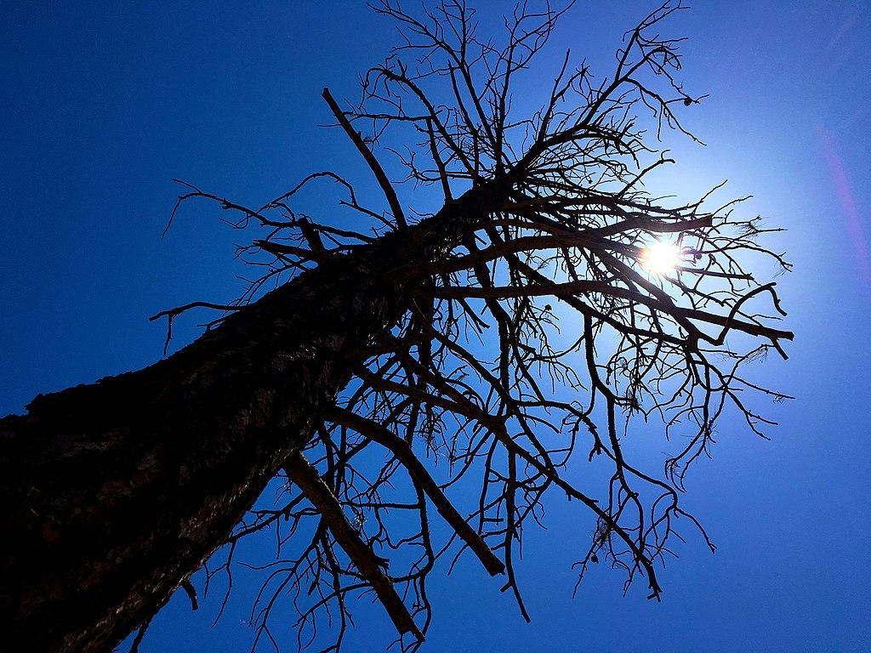
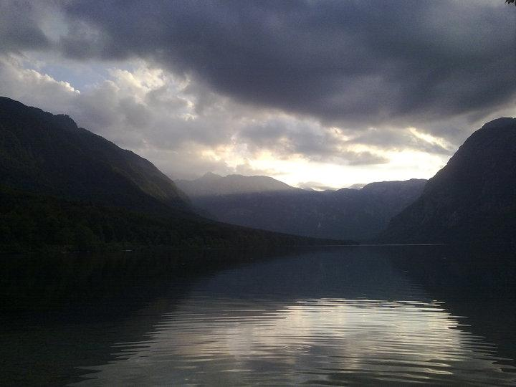
The quality of light
Light has the power to alter the image of the world!
image 13
image 14
image 15
Under the morning light objects usually seem clear and defined.
At noon, when the sun is high and the light is strong, objects gain high contrast and can be dazzling.
In the evening light, shapes become softer, with no hard edges and they become ambiguous.
The type of light source we have at a given moment, i.e. the sun, a candle, a lamp (white, colored, soft or intense) may create a harsh or a soft ambience.

Slide 21
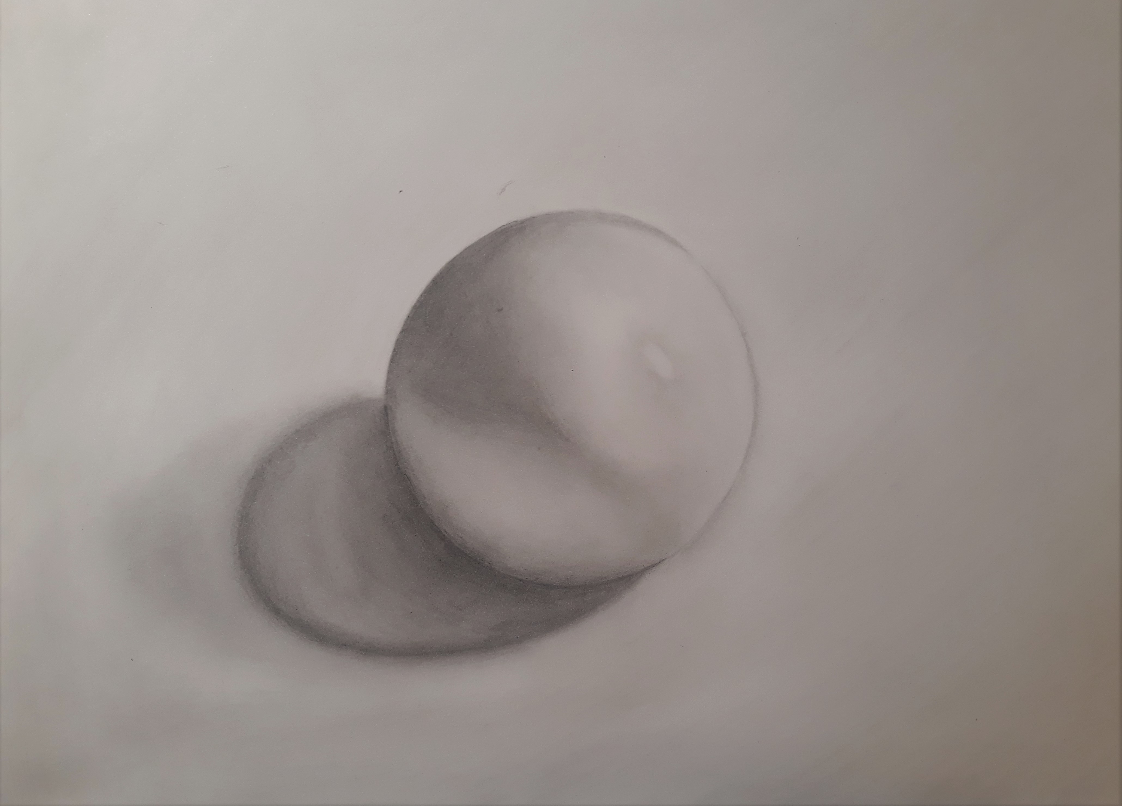
Light, shape, texture and volume
When we are watching light and shadows on an object we can understand the shape, the texture , and the volume of this object and get a lot of information.
We can use the knowledge we gained from these observations, in drawing and painting, when trying to represent nature in a realistic manner.
image A: pencil drawing-study on light and shadow.

Slide 22
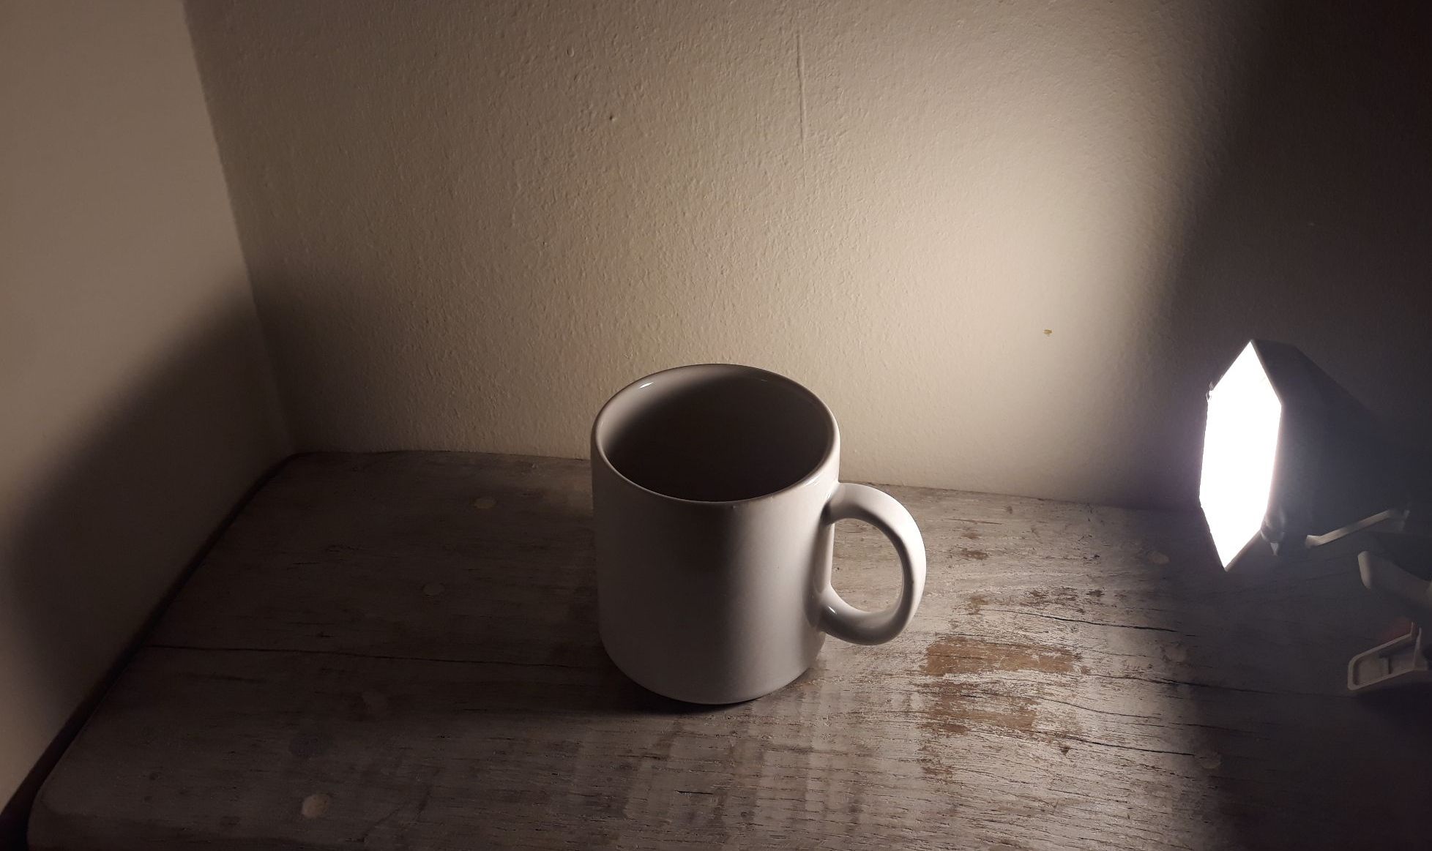
Light tones
Light’s distance and direction from objects create surfaces of different tonal intensity:light and dark surfaces on the object and around it. Thus, human mind is able to perceive elements in space such as volume, distance between objects and orientation.
image III

Slide 23
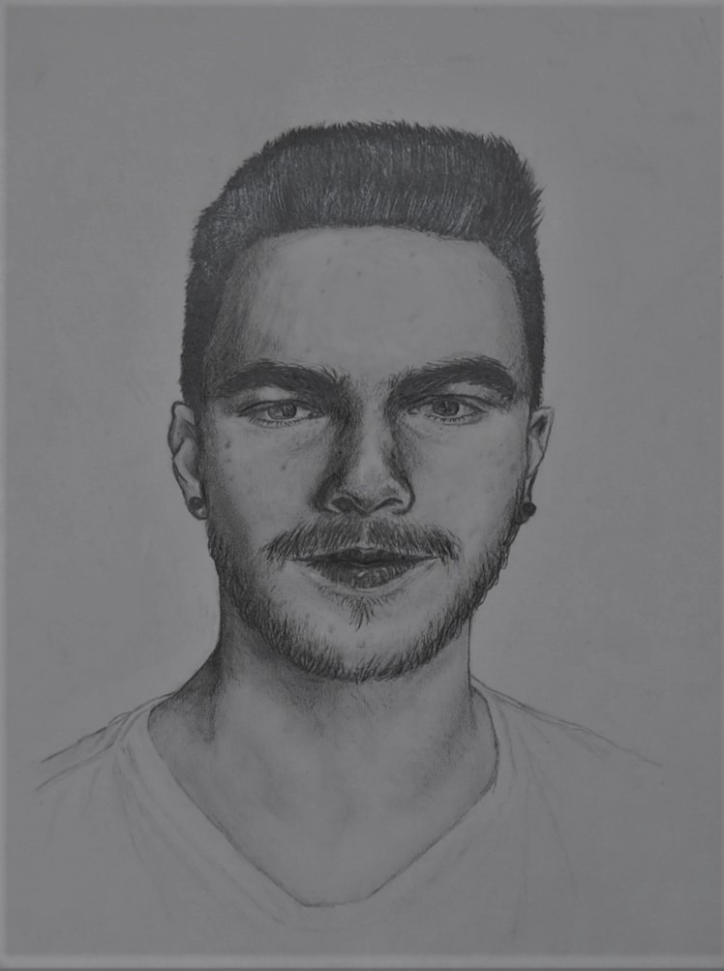
Light and shadow interaction on objects and figures is actually the main concern and theme of any artist trying to represent reality and volume.
Tonal scale
Tonal contrast or tonal harmony
Contrast and volume (depth)
Here are some elements referring to light, which are crucial for representing life in painting:
image C

Slide 24
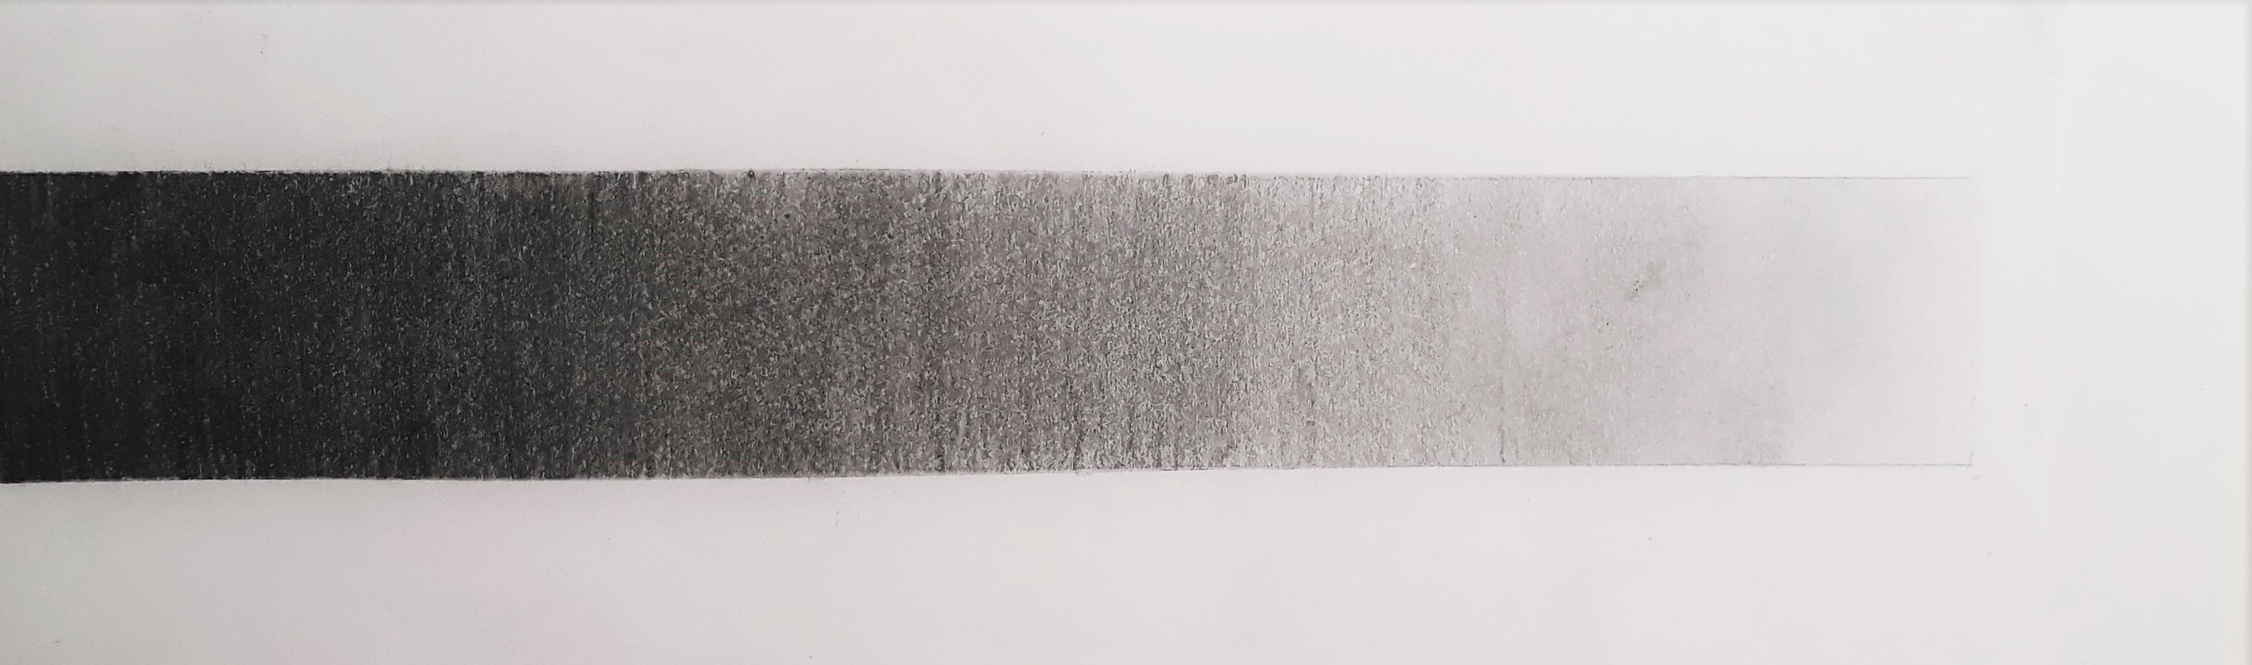
Tonal scale/grayscale: Light varies from complete darkness to dazzling brightness and between these two we have infinite shades of light tones. This gradation is called the tonal scale of light (colors have a tonal scale too).
Image B: Tonal scale-grayscale with pencil.
Light is very important for a work of art, because it can be used in many different manners to create tonal harmony, or contrast in order to express different ambience, content and meaning.

Slide 25
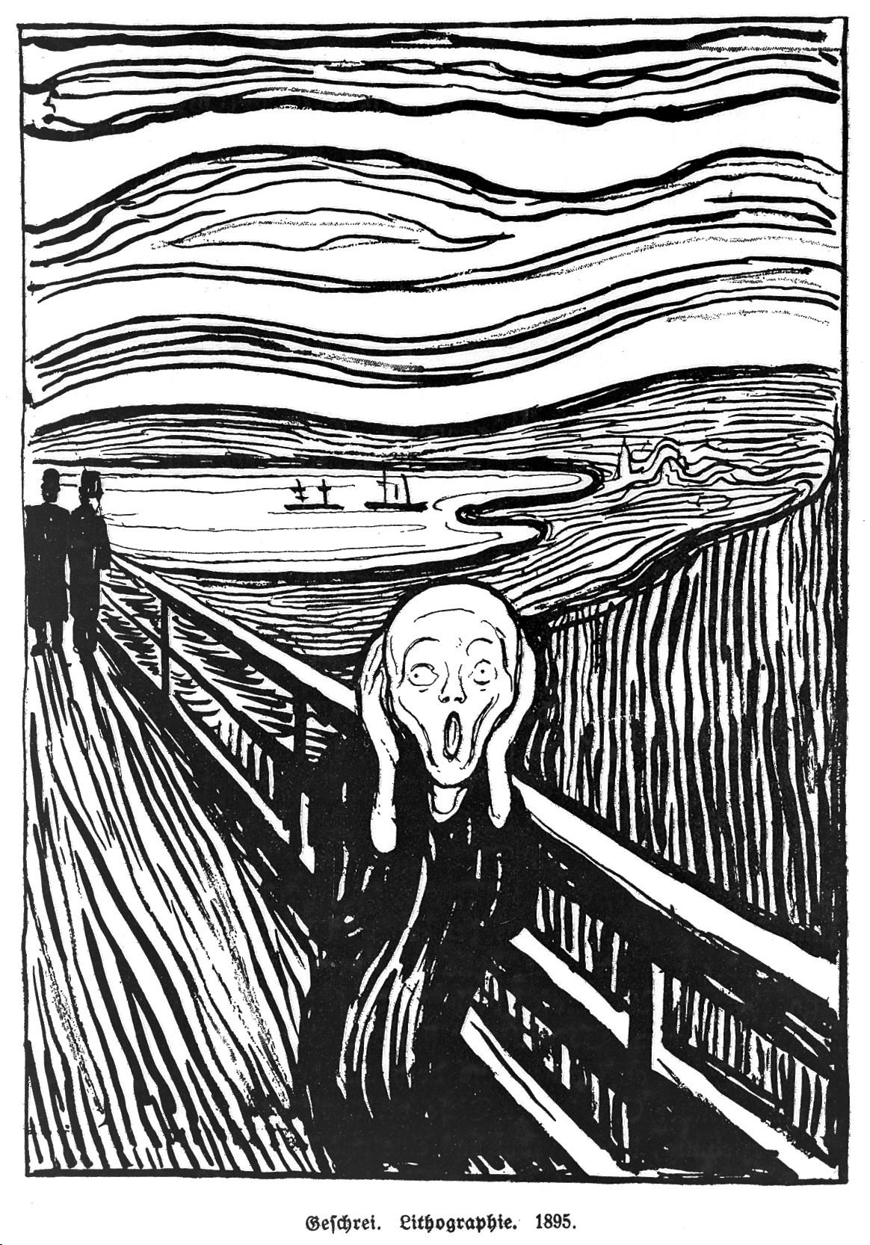
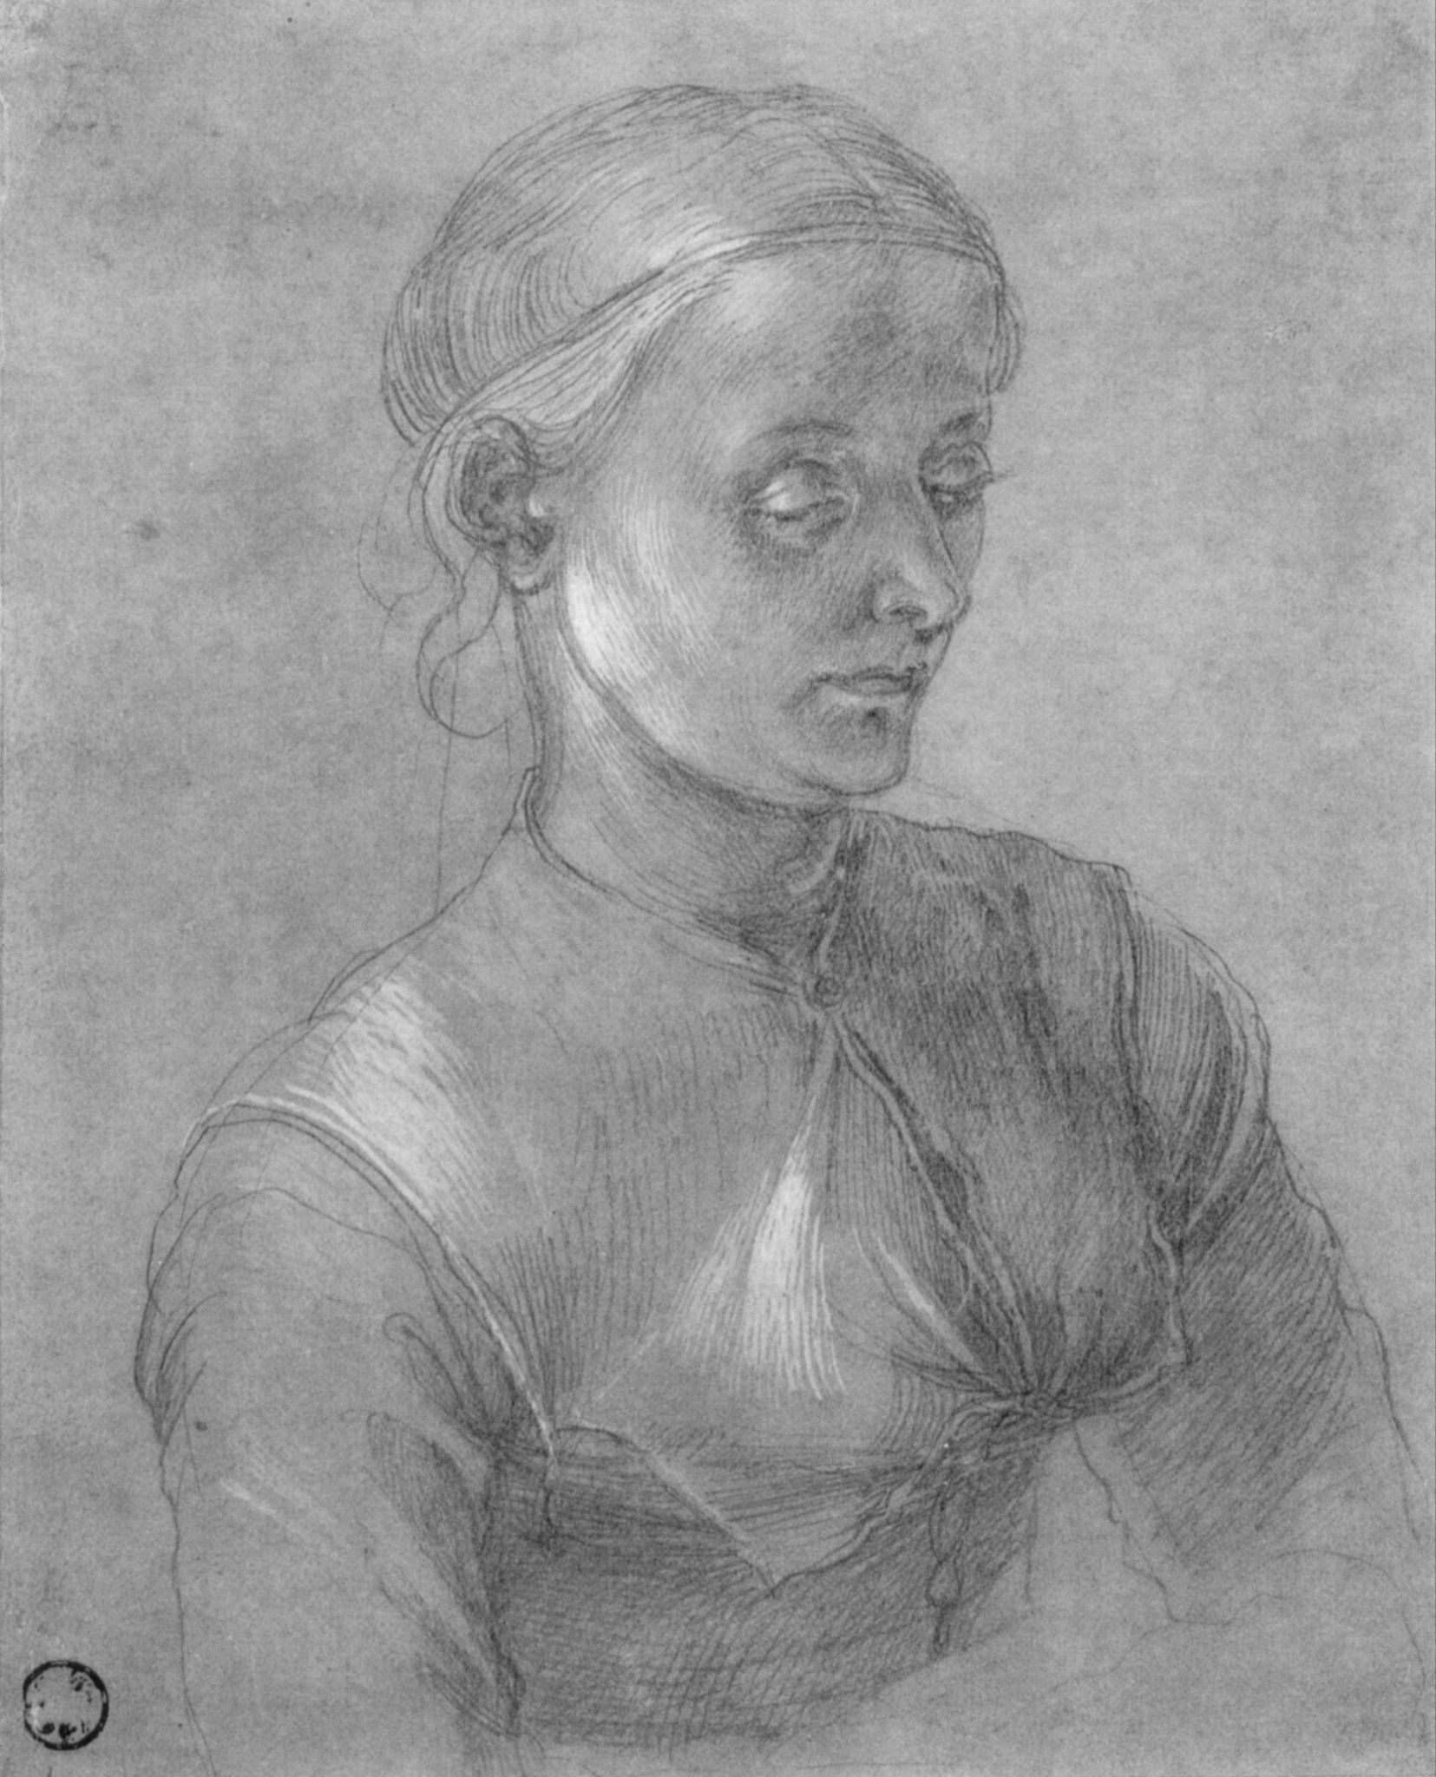
2. Tonal Contrast and Tonal Harmony
Tonal Contrast is used when an artist wants to create a vivid, strong painting or drawing. Black and white create the strongest contrast.
Tonal harmony is when a painter uses tones that are close and similar, for example light and medium grey. Such combinations usually create a quiet and serene atmosphere for the viewer.
Image 17. Portrait of a woman (Agnes Dürer), Albrecht Durer,c.1497
Image 16.The Scream, Edvard Munch, 1895

Slide 26
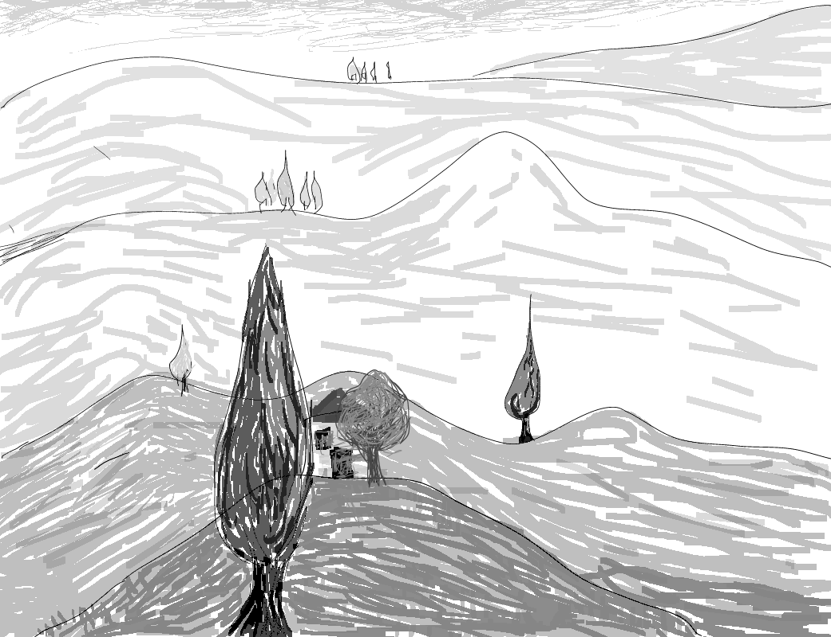
2. Contrast and the feeling of depth-Aerial perspective
When objects are brightly lit and their primary or cast shadows are intense, they give the impression that they are placed closer to the observer. When something is vaguely lit, or is placed in the shadows, it gives the impression it is away and not very important. Thus, when we want to draw a space with “depth” and some dominant objects or figures we can remember this rule!
low contrast+lighter tones
=
far away
high contrast+dark tones
=
closer to the observer
Image VI,Study for aerial perspective, digital image, 2020

Slide 27
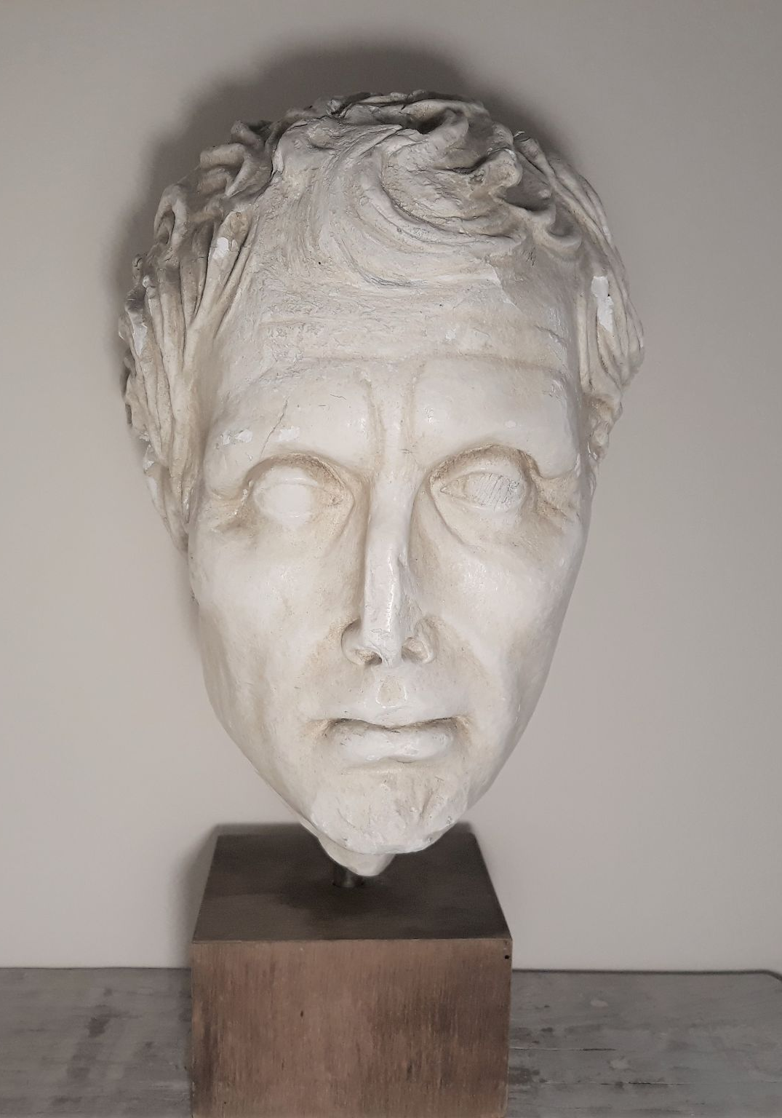
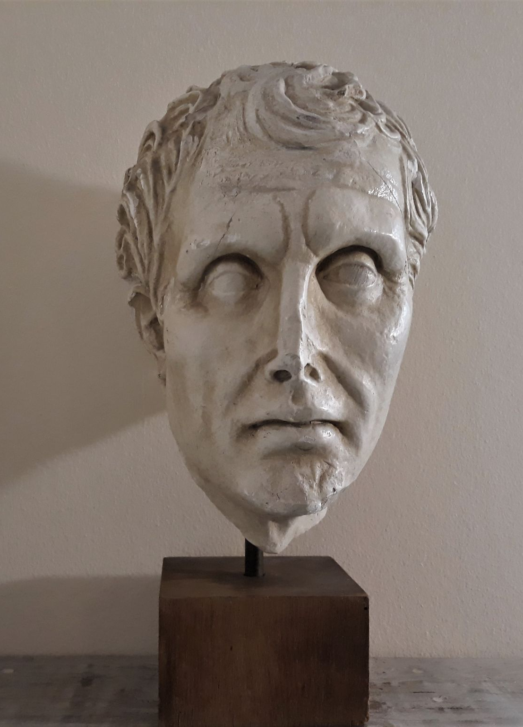
Light direction may also give the impression of volume/depth (3D-3 dimensional effect), or flatness (2D-two dimensional effect) to a drawing.
⇒For example, when a face is lit from the front with a strong light, it seems flat (Im. V). On the contrary, when it is lit from one side with a softer light, it has a three dimensional effect (Im.VI).
image VII
image VIII

Slide 28
References
Part of the information provided in this presentation is drawn by the greek e-books for
Visual Arts and Physics, Level/Grade C Hihgschool,
1. Ιωάννης Αντωνόπουλος, Μαρία Δουκάκη, Εικαστικά Γ΄ Γυμνασίου, Ινστιτούτο Τεχνολογίας, Υπολογιστών και εκδόσεων, Διόφαντος
http://ebooks.edu.gr/ebooks/v/html/8547/2306/Eikastika_G-Gymnasiou_html-empl/index1_1.html
2. Νικόλαος Αντωνίου, Παναγιώτης Δημητριάδης, Κωνσταντίνος Καμπούρης, Κωνσταντίνος Παπαμιχάλης, Λαμπρινή Παπατσίμπα,
Φυσική, Γ Γυμνασίου, Ινστιτούτο Τεχνολογίας, Υπολογιστών και Εκδόσεων Διόφαντος.
http://ebooks.edu.gr/ebooks/v/html/8547/2226/Fysiki_G-Gymnasiou_html-empl/index.html
Images
1.Pythagoras, Greek Wikipedia:
The original uploader was Galilea at German Wikipedia - Transferred from de.wikipedia to Commons.(Original text: Fotografiert am 30.03.2005), CC BY-SA 3.0, https://commons.wikimedia.org/w/index.php?curid=171958
2. Empedocles, via wikipedia, Photo By Unknown- http://www.phil-fak.uni-duesseldorf.de/philo/galerie/antike/empedok.html, Κοινό Κτήμα, https://commons.wikimedia.org/w/index.php?curid=74149
3. Plato, via wikipedia, by Silanion - User:Bibi Saint-Pol, own work, 2007-02-08, Κοινό Κτήμα, https://commons.wikimedia.org/w/index.php?curid=1775137
4. Euclid, via Φωτόδεντρο Μαθησιακό αντικείμενο: Ευκλείδης- Η ζωή και το έργο του, http://photodentro.edu.gr/ugc/r/8525/1057
5. Bust of Aristotle, Greek Wikipedia From:After Λύσιππος - Jastrow (2006),commons, https://commons.wikimedia.org/w/index.php?curid=1359807
6. Portrait of Sir Isaac Newton, 1689, Godfrey Kneller, Public domain, via Wikimedia Commons, https://upload.wikimedia.org/wikipedia/commons/3/3b/Portrait_of_Sir_Isaac_Newton%2C_1689.jpg

Slide 29
7. Prism and the Color Spectrum: by D-Kuru, CC BY-SA 3.0 AT https://creativecommons.org/licenses/by-sa/3.0/at/deed.en, via Wikimedia Commons
8. Albert Einstein, Photograph by Orren Jack Turner, Princeton. This image is available from the United States Library of Congress&#039;s Prints and Photographs division, under the digital ID cph.3b46036, Public Domain, https://commons.wikimedia.org/w/index.php?curid=925243, Greek wikipedia.
9. Light: wave and particle,nature-Lucas Vieira, Public domain, via Wikimedia Commons, https://upload.wikimedia.org/wikipedia/commons/8/8b/Light_dispersion_conceptual.gif
10. The complete electromagnetic spectrum with the spectral subdivisions of the visible waveband, from Researchgate, Verhoeven, Geert,2017/10/25,13,18, The reflection of two fields – Electromagnetic radiation and its role in (aerial) imaging, VL - 55, DO-10.5281/zenodo.3534245
11. Generous Shadow, by EleonorRigby, CC BY-SA 4.0 <https://creativecommons.org/licenses/by-sa/4.0>, via Wikimedia Commons, https://upload.wikimedia.org/wikipedia/commons/2/21/Generous_shadow.jpg
12. Sunny green paddy fields with trees and long shadows at golden hour
Basile Morin, CC BY-SA 4.0 <https://creativecommons.org/licenses/by-sa/4.0>,via Wikimedia Commons
13. Miscanthus sinensis Morning Light 6zz, Photo by David J. Stang, CC BY-SA 4.0 <https://creativecommons.org/licenses/by-sa/4.0>, via Wikimedia Commons, https://upload.wikimedia.org/wikipedia/commons/1/13/Miscanthus_sinensis_Morning_Light_6zz.jpg
14. Ponderosa Pine Under a Noon Sun, cogdogblog, CC0, via Wikimedia Commons, https://upload.wikimedia.org/wikipedia/commons/0/04/2016-366-145_Ponderosa_Pine_Under_a_Noon_Sun_%2827234573375%29.jpg,

Slide 30
15. Bohinj lake in the evening light, Eiwen Thorunsdóttir, CC BY 3.0 <https://creativecommons.org/licenses/by/3.0>, via Wikimedia Commons, https://upload.wikimedia.org/wikipedia/commons/e/e9/Bohinj_lake_in_the_evening_light.jpg
16. The Scream, Edvard Munch, 1895, lithograph on paper, Public domain,from wikiart:
https://www.wikiart.org/en/edvard-munch/the-scream-1896/
17. Portrait of a woman (Agnes Dürer), Albrecht Durer,c.1497, Public domain, from Wikiart, https://www.wikiart.org/en/albrecht-durer/portrait-of-a-woman-agnes-d%C3%BCrer
Images I, II, III, IV, V, VI, VII, VIII by Eugenia Palla, palla.eugenia@gmail.com, CC BY-SA 4.0, 2022
Images A&B by student M. P.,CC BY-SA 4.0, 2021
Image C by student I. A., CC BY-SA 4.0, 2020
Eugenia E. Palla
2022
palla.eugenia@gmail.com

