Slide 1
in Science and Art
Color

Slide 2
Color
in Science
1st Teaching Period

Slide 3
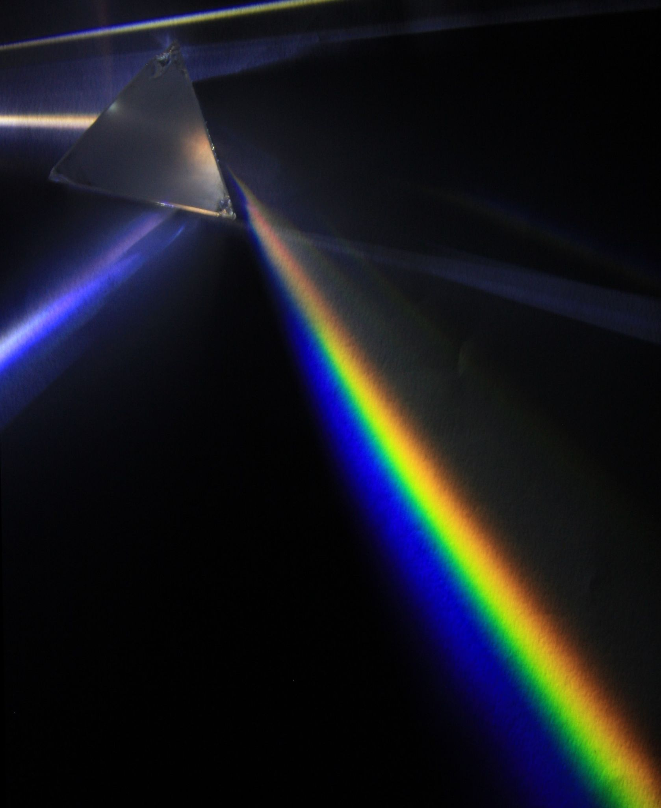
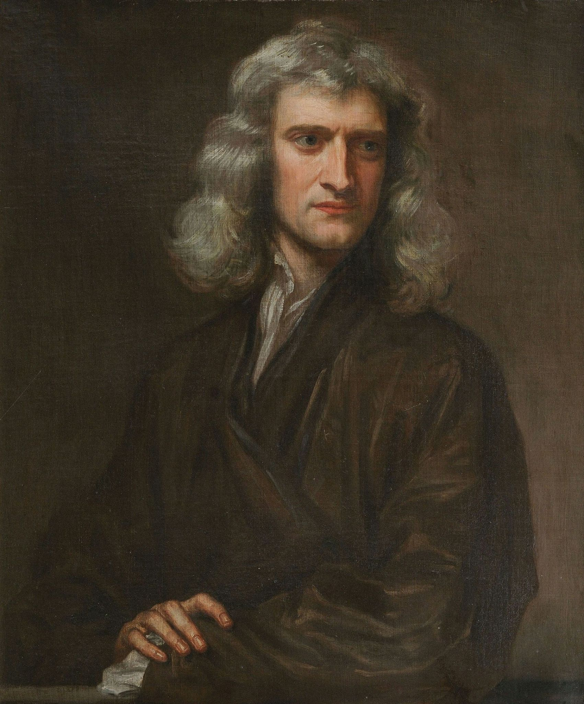
In 1666, Sir Isaac Newton, in England, discovered the color spectrum.
image 1
Isaac Newton’s Experiment:
In a dark room, he made a thin beam
of white sunlight pass through a prism.
image 2

Slide 4
image I
Casting the rays of light that came out of the prism on a white screen,
Newton saw the color spectrum:
red orange yellow green cyan blue violet
the 7 colors of the rainbow!
The combination of these colors creates white light.

Slide 5
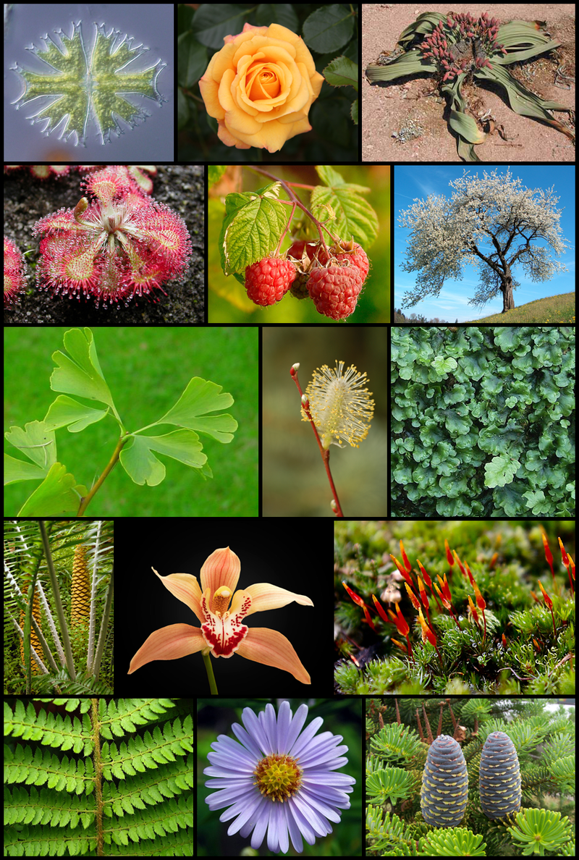
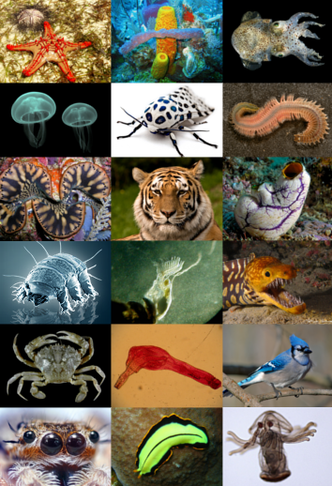
Light
This “visible energy” conveys the beauty of the universe to the human perception.
If there was no light, we could not see anything! This is the reason why we see colors!
image 4
image 5

Slide 6
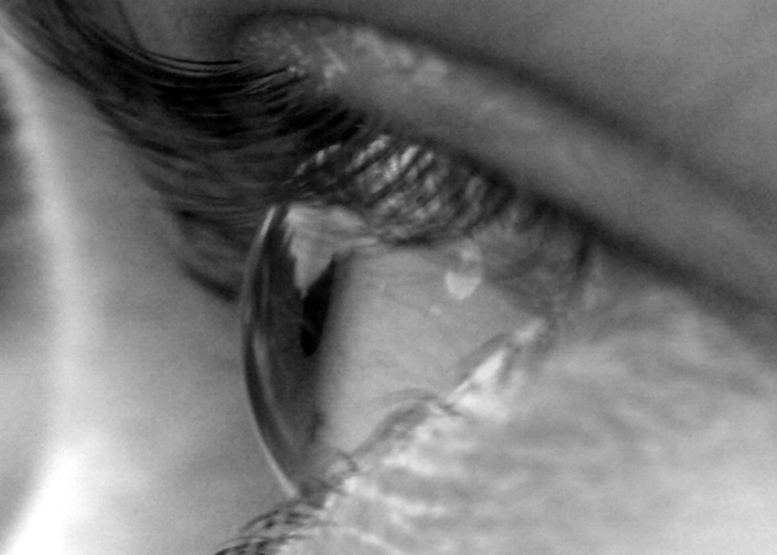
But, why and how do we experience color in our environment???
Objects are visible because
they reflect part of the radiation coming from a light source, while they absorb the rest of it.
radiation
The reason we perceive this cube as red, is that it absorbs all other colors of the color spectrum and reflects only red
image II
image 3

Slide 7
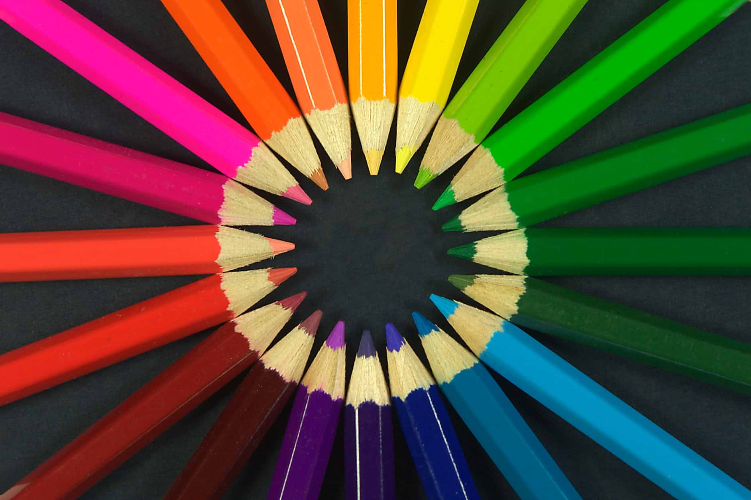
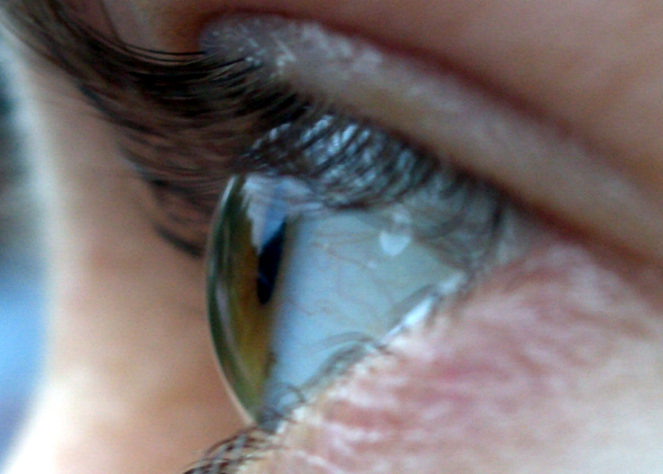
Surfaces are not actually blue or red! The materials they are made out from have different physical and chemical qualities, thus they absorb different parts of the light spectrum!
image 3
Example:a blue pencil seems blue, because its surface has a specific chemical synthesis, which absorbs all other colors of the visible spectrum, making our eyes only perceive blue. This is the reason we see this colored pencil as blue!
image 6

Slide 8
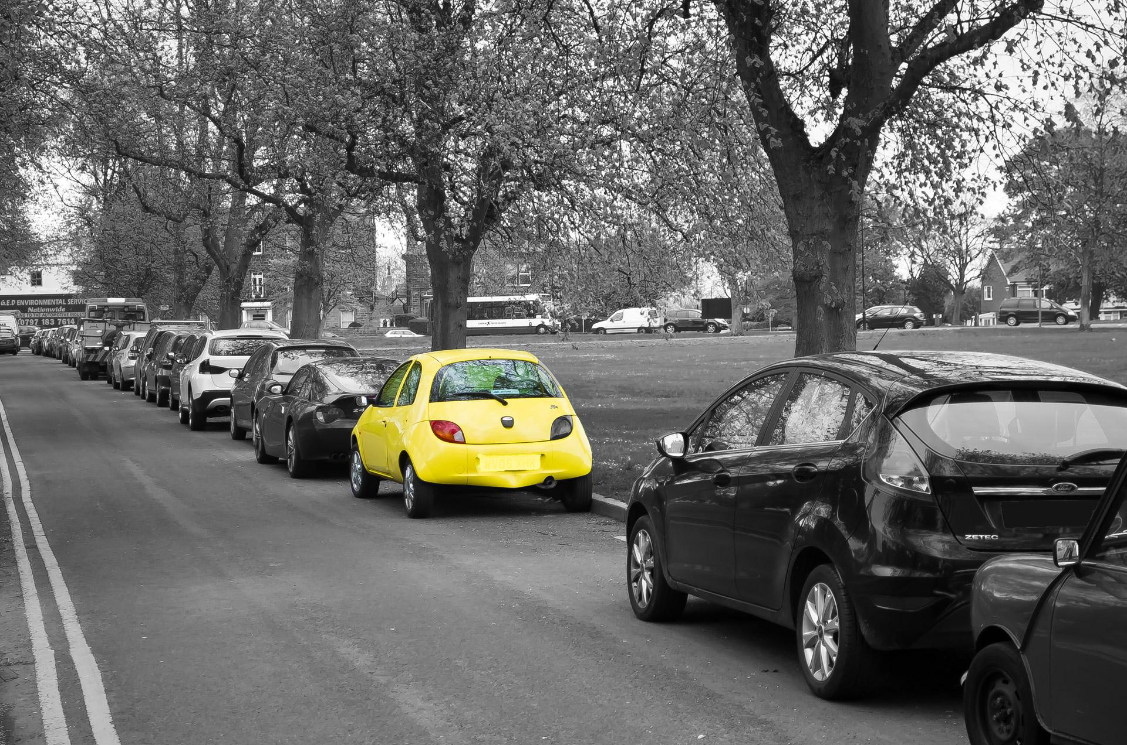
When we see a yellow car, this means that the car’s paint absorbs all the other colors of the visible light spectrum and reflects only yellow.
image 7

Slide 9
Color
in ART

Slide 10
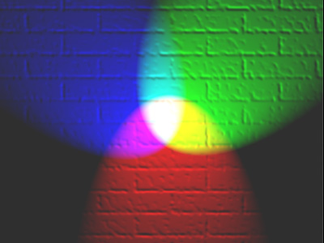
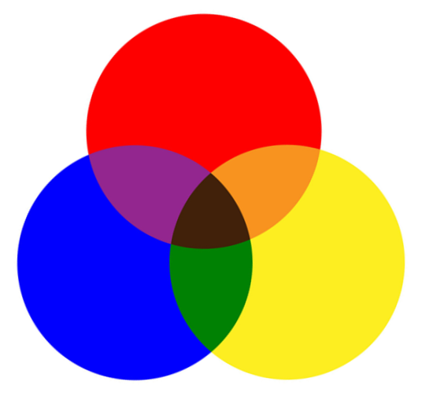
RGB and RYB
In lighting and screens (TV, cell phones etc) the primary colors are
Red, Green and Blue-RGB
By mixing these three colors we get three secondary colors! This is an additive color mixing procedure. When we add a color to another one, we get a brighter color light.
Red + Green = Yellow
Red + Blue = Magenta
Green + Blue = Cyan
Red + Green + Blue = White light
In painting the primary colors are
Red, Yellow and Blue-RYB
By mixing these three colors we get three secondary colors! This is a subtractive color mixing procedure, because by adding we get a color of less brightness. By adding a secondary to another one, we get neutral colors/browns.
Red + Yellow= Orange
Red + Blue = Purple
Yellow + Blue = Green
Red + Yellow+ Blue = Black (or brown)
image 8
Additive color mixing (light): projecting primary color lights on a white screen shows secondary colors where two overlap; the combination of all three primaries in equal intensities makes white.
image 9
Subtractive color mixing (paint): primary colors produce secondary colors where two overlap; the combination of all three primaries in different quantities makes brown or black.
Black

Slide 11
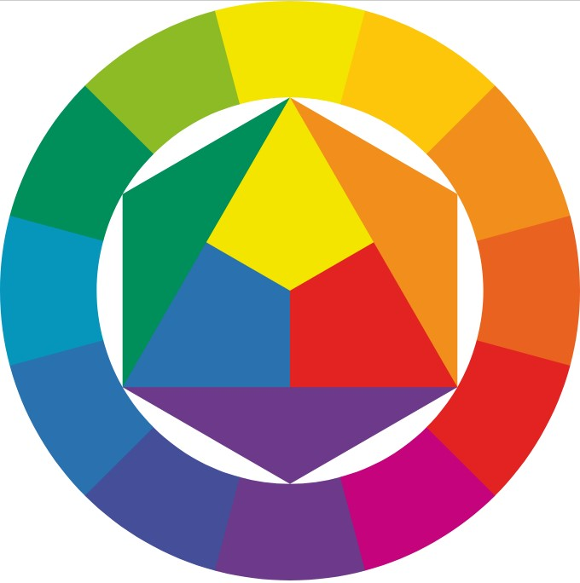
Color Wheel
by Johannes Itten (1888 – 1967)
Artist and Bauhaus professor J. Itten organized colors in a circle, presenting the basic facts about color in painting and containing fundamental color mixing.
1
3
3
3
3
1. Primary colors
Are the three colors that cannot be created by other color combinations (RYB)
2.Secondary colors
Are the colors that are created by mixing two primary colors in equal quantity (Y+B=Green, Y+R=orange, R+B=purple)
3. Hues
Potentially, infinite number of different secondary colors hues are possible, according to the amount of each primary color they contain.
2
1
2
3
3
1
1
1
1
2
3
3
3
image 10

Slide 12
cool colors
4.Complementary colors (CC)
Are the colors that are directly opposite in the wheel:
1.Red-Green
2.Blue-Orange
3.Yellow-Purple
They create the brightest color contrasts when they are seen side-by-side.
Complementary color couples are made up of one primary and one secondary color(the one that is produced by mixing the other two primary colors). Complementary color couples consist by one warm and one cool color!
4
CC
purple
4
CC
red
4
CC
blue
2
1
2
1
1
4
CC
orange
2
4
CC
green
4
CC
yellow
warm colors
image 10

Slide 13
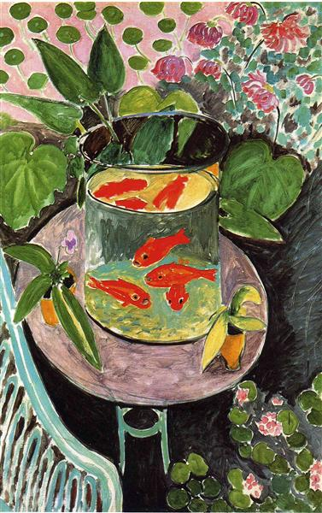
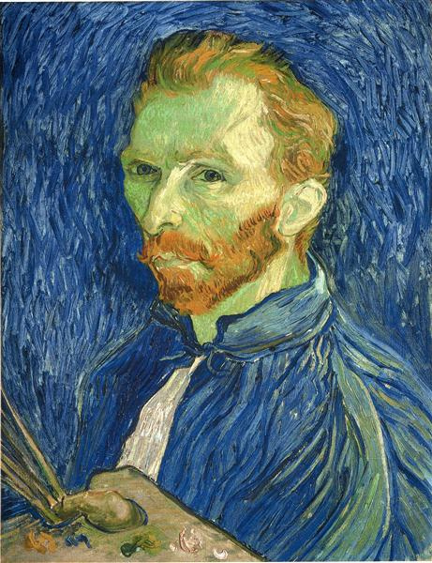
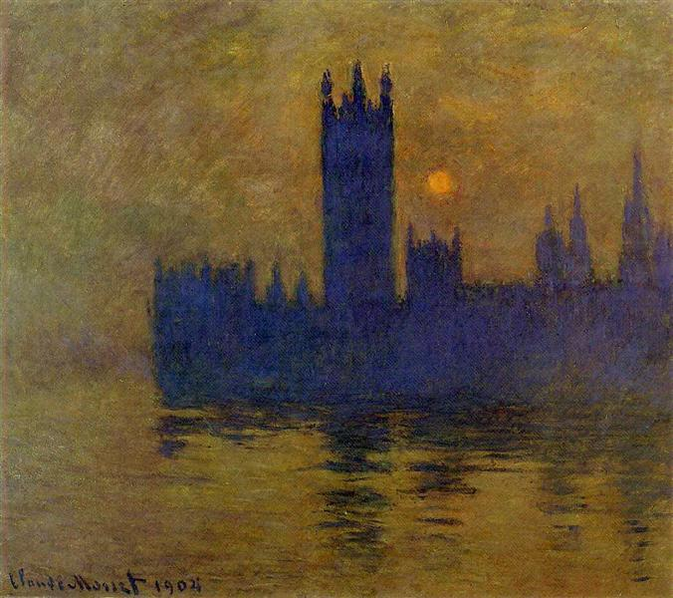
Complementary colors are used by artists to make important elements of a painting stand out and create vivid works of art.
Image 13.
Houses of Parliament, Sunset 02, Claude Monet,1904
(Yellow hues on the sea and sky
and purple buildings)
Image 12.
Self portrait with Pallet, Vincent Van Gogh, 1889,(Orange hues on the face and a blue background)
Image 11.
Goldfish, Henri Matisse 1911
(Red fish on green background)

Slide 14
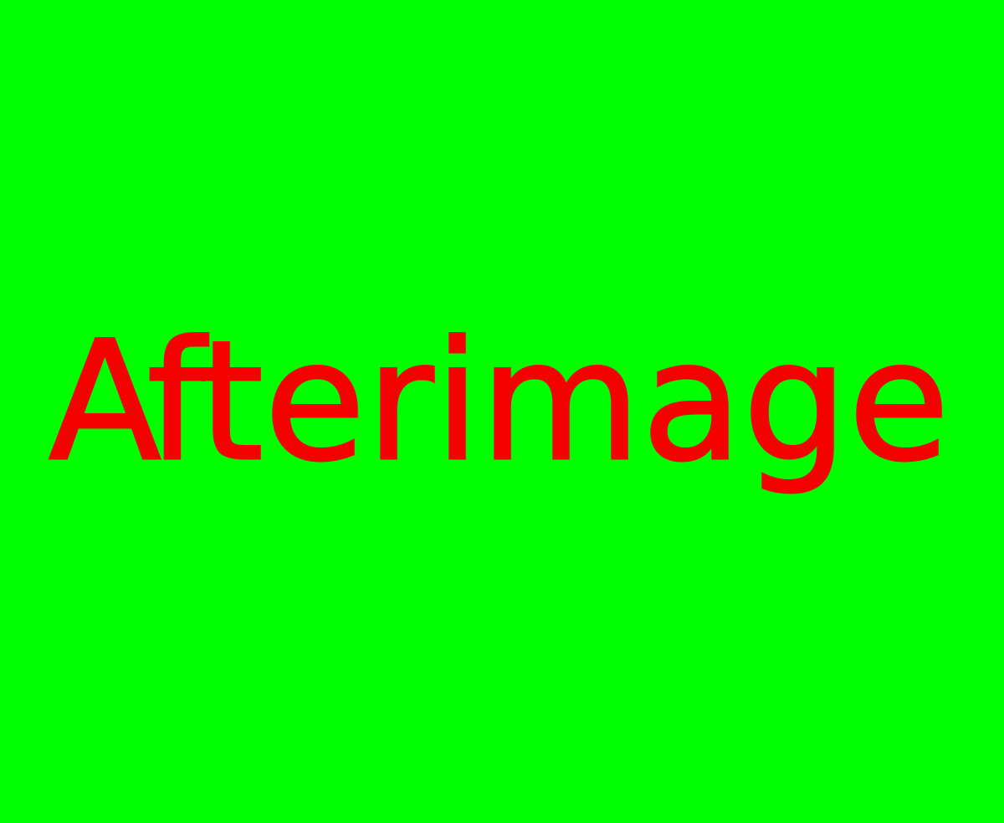
Complementary colors-Afterimage Experiment
Experiments have shown that human eyes and brain tend to complete the color spectrum when we look at one of the colors, by creating the impression of its complementary color.
* Stare at the image for 10”
* Then turn to the white surface for another 5”
* What do you see? What color is it?
image 14
Afterimage is the optical phenomenon we observe, after we have looked at an image and this image has been removed.
It’s a characteristic of the human eye and brain: The shape of the image “remains” to our perception as an illusion for fractions of a second, after the original image has been removed, and it has the opposite/complementary color.
The arts of cinema and animation are based on afterimage, this property of the eye,
which allows humans experience the ilussion of moving image.

Slide 15
Complementary colors-Afterimage Experiment
Observe the afterimage phenomenon by the following experiment
*Stare at the red circle for 10”
*Then turn to the white surface for another 5”
*What do you see? What color is it?

Slide 16
Complementary colors-Afterimage Experiment
*Stare at the yellow circle for 10”
*Then turn to the white surface for another 5”
*What do you see? What color is the afterimage?

Slide 17
Complementary colors-Afterimage Experiment
*Stare at the blue circle for 10”
*Then turn to the white surface for another 5”
*What do you see? What color is the afterimage?

Slide 18
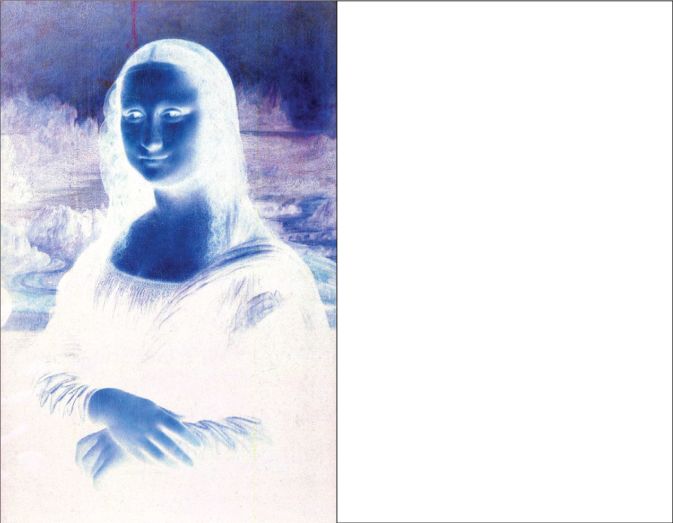
* Stare at the nose of Mona Lisa image for 20”
* Then turn to the white surface for another 5”
* What do you see? What color is it?
image 15

Slide 19
Color
in ART
3d Teaching Period

Slide 20
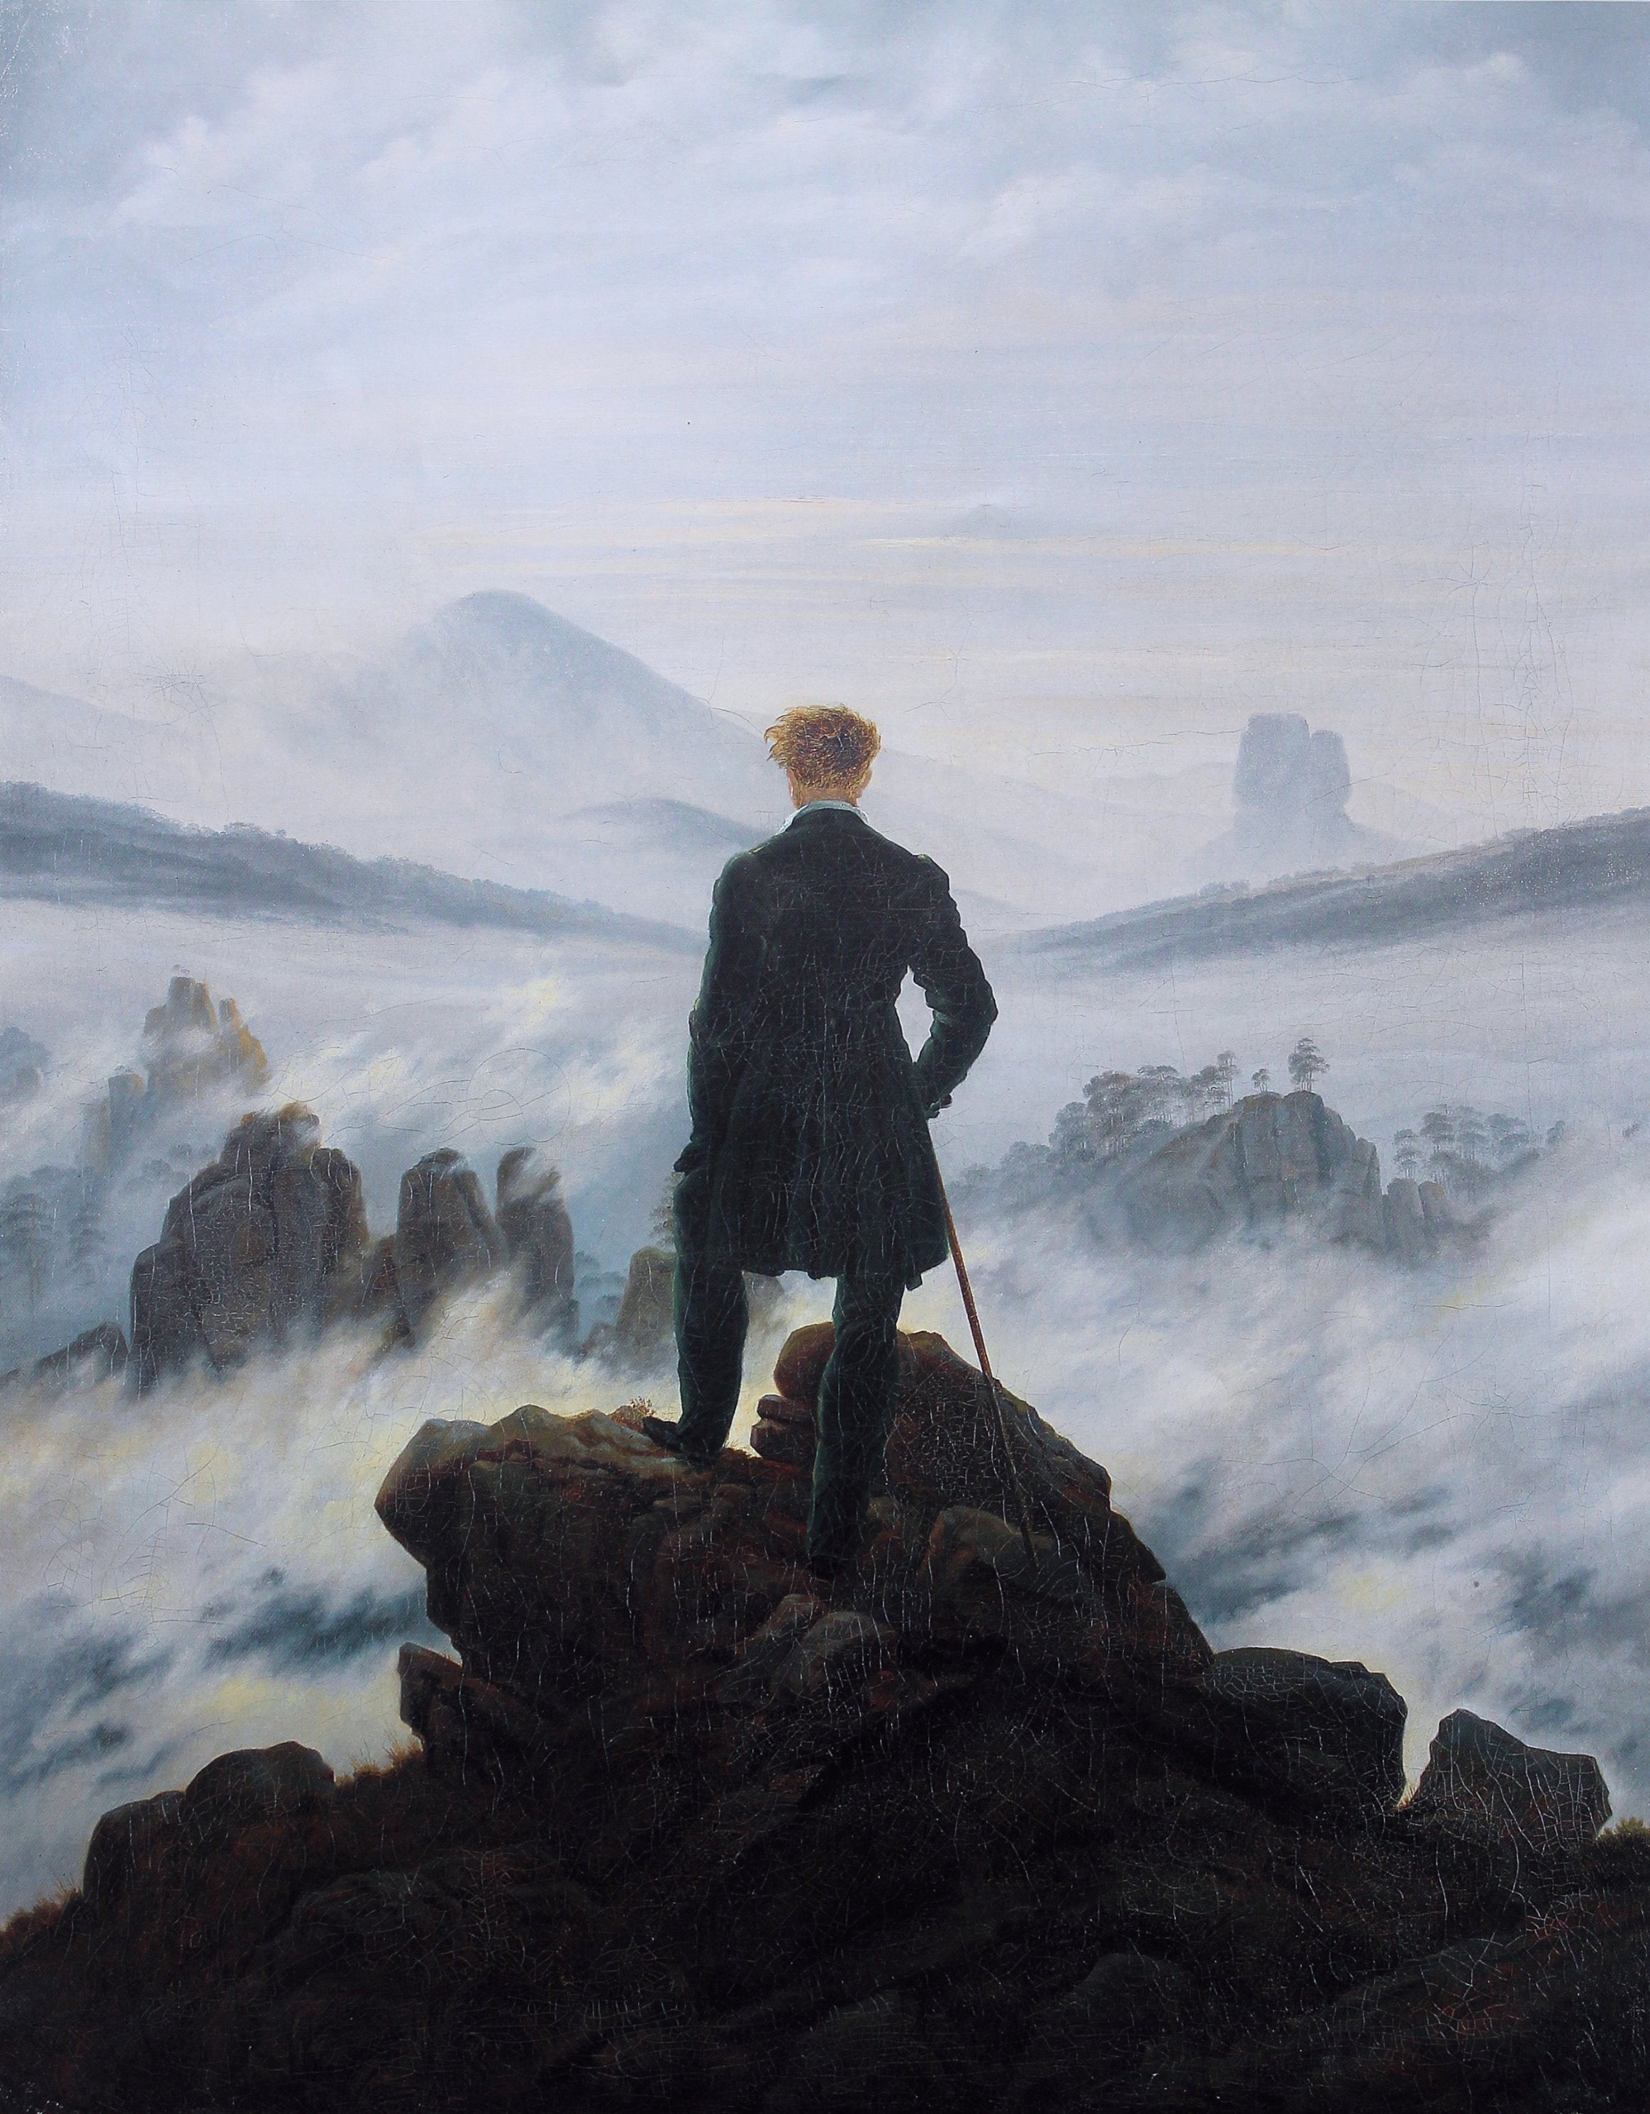
Aerial Perspective
Aerial perspective painting hints
Color is used by artists to create the feeling of depth. The effect of aerial perspective mimics real life visual perception: Objects that are far away seem colorless and without contrast. In Friedrich’s painting we see a man looking at the mountains far away. The impression of depth is created by the variation of color tones and hues:
1. In the foreground the man and the rocks are painted with dark tones, high contrast and warm colors (blond hair, warm brown rocks).
2. In the background, as we move further away, the contrast diminishes, the tones become lighter and the colors cooler.
Symbolic meaning of the painting:
The man is looking back at his life remembering
some important moments which stand out,
just like the mountain peaks stand out from the fog!
image 16, Wanderer over a sea of fog, Caspar David Friedrich,
c 1888, Romanticism, Symbolism.

Slide 21
Color
in ART
4th Teaching Period

Slide 22
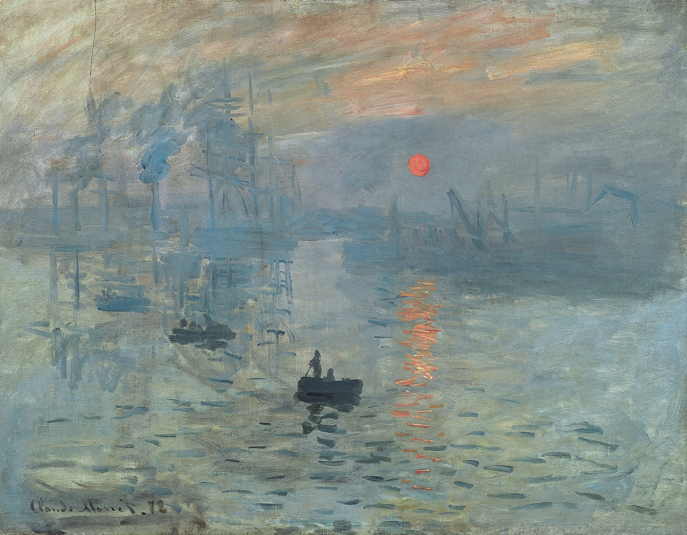
Impressionism and color
The impressionistic coloring technique
captures the constantly changing light on the surfaces, and gives an impression of the objects or figures, which are represented without detail.
Painting is quick, with vibrant colors and large brushstrokes. The theme is actually the light and color as observed on objects and figures in outdoor scenes, landscapes, etc.
Some impressionists used to paint the same theme on different hours of the day, or different seasons of the year, trying to study and capture the difference of light and color to create different atmosphere.
image 17, Impression, Sunrise, Claude Monet, 1872, the first impressionistic artwork

Slide 23
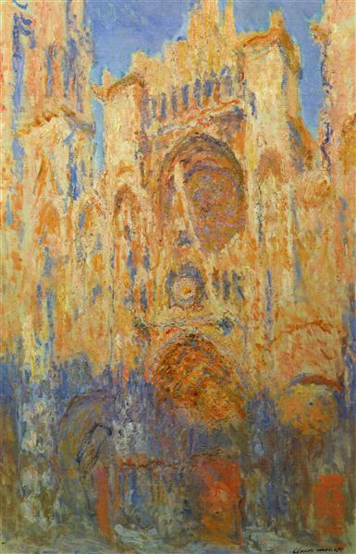
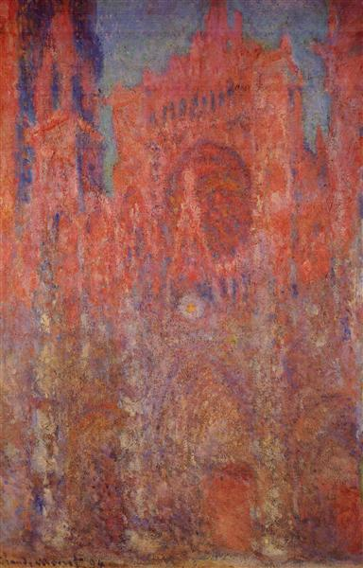
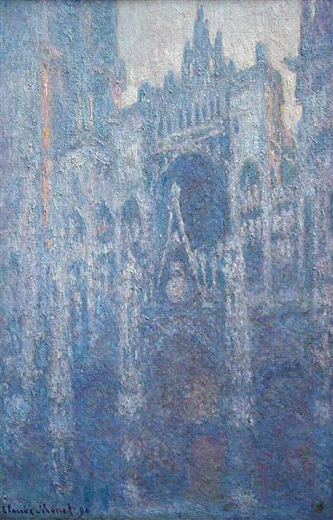
Can you guess by the color Monet used in each painting of Rouen Cathedral which time of the day,
or season of the year is represented? (Monet painted the same theme 30 times!)
image 18
image 19
image 20
Rouen Cathedral, Claude Monet, 1892-3
Rouen Cathedral, Claude Monet,1894
Rouen Cathedral, Clear Day, Claude Monet,1894

Slide 24
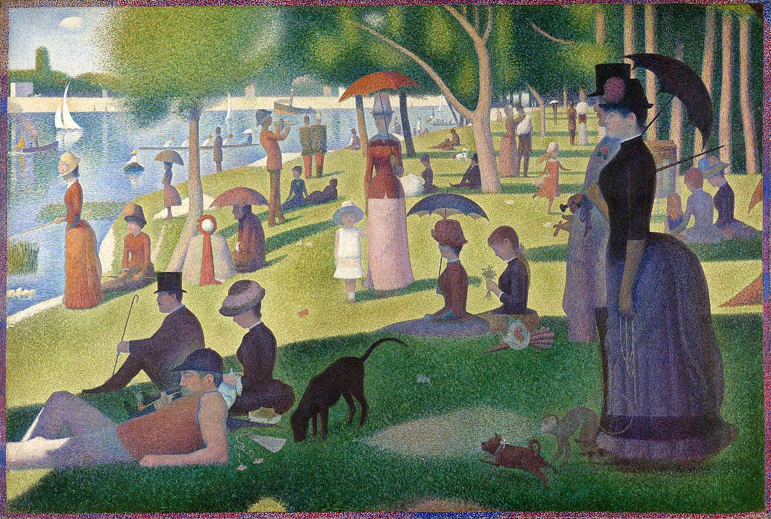
Color in
Neo-Impressionism/
Pointillism
In pointillism
color/paint is not
mixed at all!
The painter places
clear color dots
(points)on the
canvas and the color
mixing happens in our
eyes/brain. In Seurat’s work you can observe the trees are
made out of dots
of pure color:
Yellow, blue, red.
Our vision creates the color mixture, thus we can see various light and dark green hues on the trees!
image 21.
A Sunday Afternoon on the Island of La Grande Jatte, Georges Seurat, 1884-1886,

Slide 25
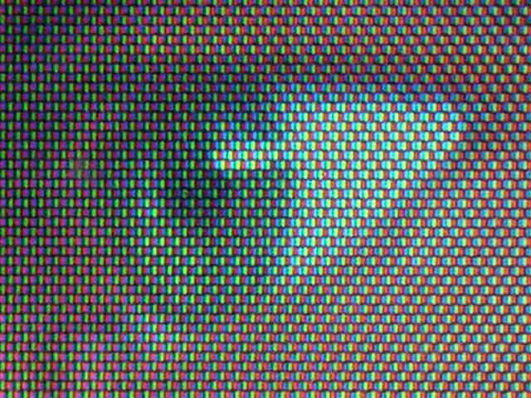
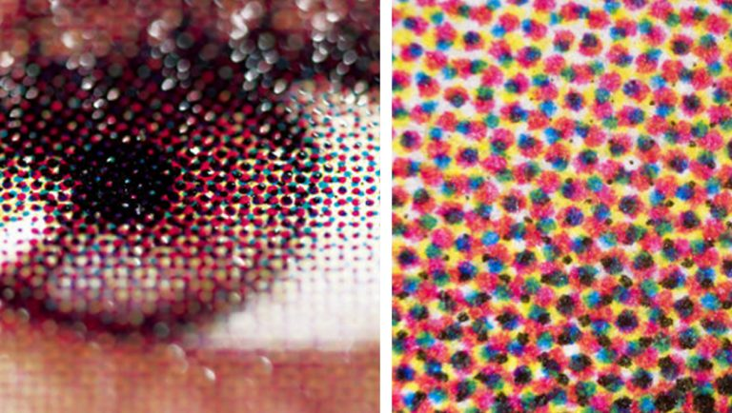
Color in digital and printed images
Pixels are the colored elements all digital images are made out of.
If we enlarge a digital image we can distinguish the pixels it consists of in 3 colors, RGB. Pixels are small colored digital spots in combinations, which create a mosaic we perceive as the picture. This resembles the pointillists’ color technique!
image 22. Digital image (eye)on the LCD screen of a camera
image 23. Printed image (eye) and detail with printed CMYK dots
In printing too, images are created by a “puzzle” of printed colored dots in 4 colors:
Cyan, Magenta, Yellow and Black (key color)-CMYK color system.

Slide 26
References.Images
1. Portrait of Sir Isaac Newton, 1689, Godfrey Kneller, Public domain, via Wikimedia Commons, https://upload.wikimedia.org/wikipedia/commons/3/3b/Portrait_of_Sir_Isaac_Newton%2C_1689.jpg
2. Prism and the Color Spectrum: by D-Kuru, CC BY-SA 3.0 AT https://creativecommons.org/licenses/by-sa/3.0/at/deed.en, via Wikimedia Commons
3. Human eye, By Paul Savage - https://www.flickr.com/photos/45202571@N00/60833726/, CC BY 2.0, https://commons.wikimedia.org/w/index.php?curid=36530322
4.A selection of diverse Plant Species, by Rkitko - cobbled together by User:Rkitko from images available on Wikimedia Commons., CC BY-SA 4.0, https://commons.wikimedia.org/w/index.php?curid=6412607
5. A selection of diverse animal species, by creator of composite, User:Medeis; original authors, as credited individually, wikipedia.
6. Colouring Pencils, MichaelMaggs, via Wikimedia Commons, CC BY-SA 3.0, https://creativecommons.org/licenses/by-sa/3.0
7. Yellow car, by George Hodan, public domain.
8. Additive color mixing: By en:User:Bb3cxv - http://en.wikipedia.org/wiki/Image:RGB_illumination.jpg, CC BY-SA 3.0, https://commons.wikimedia.org/w/index.php?curid=3157464
9. RYB color model, via Wikimedia Commons,Zenao1, CC BY-SA 4.0 https://creativecommons.org/licenses/by-sa/4.0
10. Itten’s color wheel, via wikipedia, Originally by MalteAhrens at de.wikipedia. Vectorization by User:SidShakal - Raster version from Wikimedia Commons, Public Domain, https://commons.wikimedia.org/w/index.php?curid=3574696

Slide 27
11. Gold fish, Henri Matisse, via wikiart, public domain, https://www.wikiart.org/en/henri-matisse/goldfish-1911
12. Self portrait with Pallet, Vincent Van Gogh, via wikiart, public domain, https://www.wikiart.org/en/vincent-van-gogh/self-portrait-with-pallette-1889
13. Houses of Parliament, Sunset 02, Claude Monet, via wikiart-public domain,
https://www.wikiart.org/en/claude-monet/houses-of-parliament-sunset-02
14. Afterimage, via wikipedia, Originally uploaded by Freakmighty at en.wikipedia converted to SVG by Moxfyre - Transferred from en.wikipedia to Commons by Sreejithk2000 using CommonsHelper., Public Domain, https://commons.wikimedia.org/w/index.php?curid=10482999
15. Mona Lisa negative image, via sciphile.org, https://sciphile.org/lessons/yang-and-yin-negative-afterimages
16. Wanderer over a sea of fog, Caspar David Friedrich-The photographic reproduction was done by Cybershot800i. (Diff), Public Domain, https://commons.wikimedia.org/w/index.php?curid=1020146
17. Monet - Impression, Sunrise, Claude Monet, Public domain, via Wikimedia Commons, https://commons.wikimedia.org/wiki/File:Monet_-_Impression,_Sunrise.jpg
18. Rouen Cathedral, Claude Monet, 1892-1893, public domain, via wikiart, https://www.wikiart.org/en/claude-monet/rouen-cathedral-1893
19. Rouen Cathedral, Claude Monet, 1894, public domain, via wikiart, https://www.wikiart.org/en/claude-monet/rouen-cathedral
20. Rouen Cathedral, Clear Day, Claude Monet, 1894, public domain, via wikiart, https://www.wikiart.org/en/claude-monet/rouen-cathedral-clear-day

Slide 28
21. A Sunday Afternoon on the Island of La Grande Jatte, Georges Seurat, via wikipedia, https://www.bostonglobe.com/arts/theater-dance/2016/09/01/huntington-two-georges-one-sondheim/OR1D4DPM8GsME67aXEjWiP/story.html, Public Domain, https://commons.wikimedia.org/w/index.php?curid=11500785
22. Pixels on the LCD monitor of Raz Kupferman's Sony DSC-S70 camera,
23. Printed image (eye) and detail with printed CMYK dots.
https://www.printplace.com/blog/reasons-for-cmyk-printing/
images I & II, by Eugenia Palla,palla.eugenia@gmail.com, CC BY-SA 4.0, 2022
Eugenia E. Palla
2022
palla.eugenia@gmail.com

