Slide 1

Tax havens: International tax avoidance and evasion
1.1. What are tax havens?
● The term tax havens refers to countries that provide low to zero taxation burdens on foreign companies that choose the country as their headquarters.
Tax havens
● In particular, tax havens are defined as countries that provide at least one of the following facilities: a) zero or near zero taxation for non-residents, b) strong privacy and data protection provisions, and c) easy / fast / flexible legislation for the establishment of companies.

Slide 2
Tax havens: International tax avoidance and evasion
1.1. What are tax havens?
Tax havens
The countries that choose to become tax havens are usually small countries but also large financial centres, which deliberately choose a regime with zero or very low taxation, in order to gain a comparative advantage over other countries for conducting global trade in them.
Although they do not earn income through taxation, the benefits they ultimately reap are increased employment through new jobs created or unrelated economic activities.

Slide 3
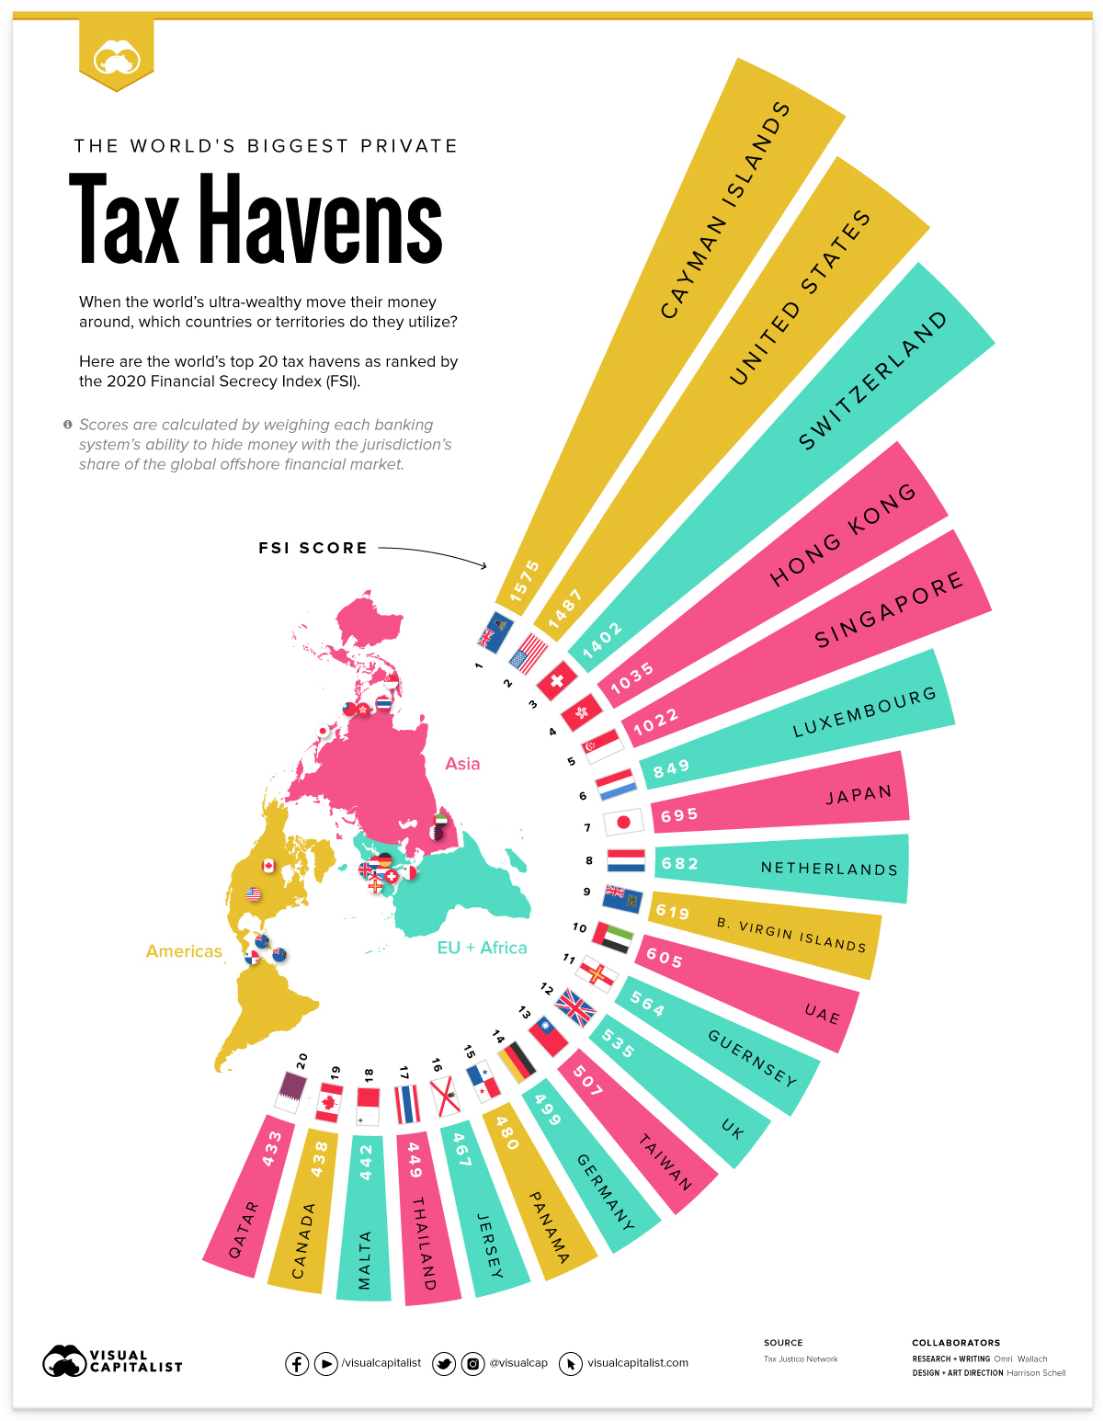
Tax havens: International tax avoidance and evasion
1.2. The tax havens preferred by most companies worldwide

Slide 4
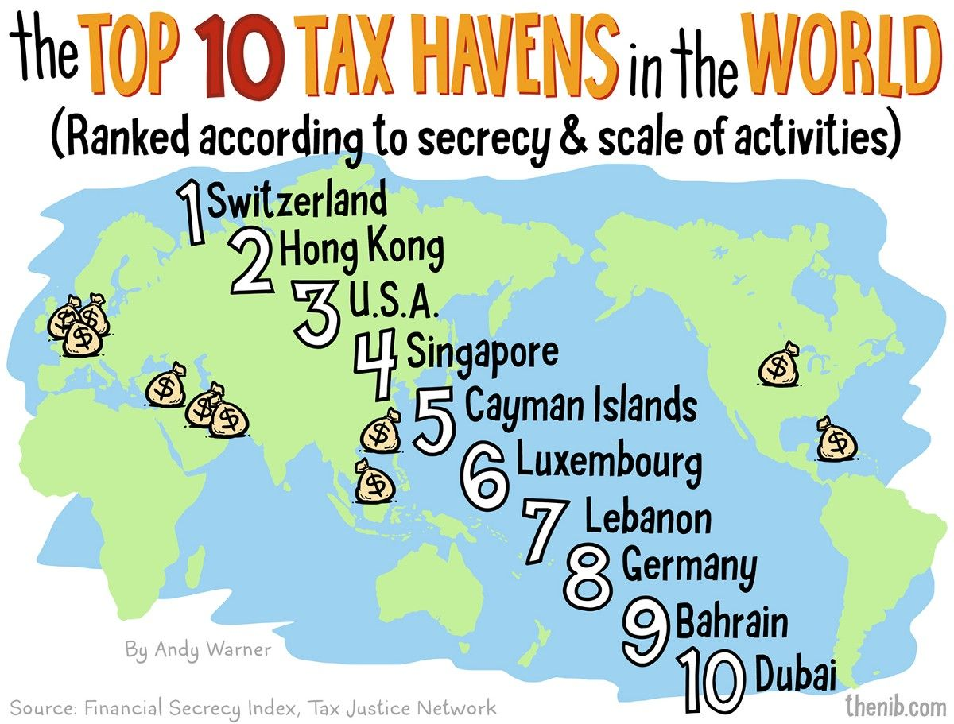
Tax havens: International tax avoidance and evasion
1.2. The tax havens preferred by most companies worldwide

Slide 5
Tax havens: International tax avoidance and evasion
1.3. What are offshore companies
Offshore companies
→ The term "tax haven" refers to countries that have introduced tax reliefs specifically for foreign investorsς.
→ Offshore companies are not only founded by individuals or small organizations that want to hide revenue, but also by large multinationals that choose tax havens to be taxed at a low rate.
→ The natural or legal persons and the international companies that resort to these states, in order to establish their headquarters there, with the ultimate goal of exploiting the tax reliefs provided to them, are called offshore companies, from the English term ‘offshore’, meaning away from the coast, outside the territory.

Slide 6
Tax havens: International tax avoidance and evasion
2.1. Conceptual definition of taxation
Taxation is the mandatory imposition of taxes in favour of the state. It is an important activity of the public body in all countries worldwide and especially in the most developed ones, as it usually secures more than 90% of their income.
The payment of taxes is a form of fulfilment of the terms of the social contract, which is concluded between the state and the citizen and from which mutual obligations also derive.
Government revenue from taxes is a source of revenue for government expenditures, such as public health, administration, national defence and education.
Tax is levied on income, property and consumption. The amount of taxation is provided by law and aims to distribute the cost of production of public goods among citizens, in a fair way.

Slide 7
Tax havens: International tax avoidance and evasion
2.2. Objectives of fiscal policy
Objectives of fiscal policy
Financing government expenditures in conjunction with fiscal policy.
The redistribution of wealth which relates to the social form of the economy, aiming at reducing inequalities, since through taxes the socially vulnerable groups are strengthened with social benefits.

Slide 8
Tax havens: International tax avoidance and evasion
2.3. Direct and Indirect taxes
Direct taxes
They are imposed on income & property.
Indirect taxes
They are imposed on consumer products e.g. VAT
Those who pay have a certain amount of income or are in a certain property situation e.g. income tax, real estate tax, inheritance tax, etc.
The burden is adjusted to the tax capacity of each one.
Lower incomes are mostly affected.

