Slide 1

Economic crisis: a crisis on our plate?
1.1. Economic crisis definition
● A characteristic feature of the economic crisis is that in a short period of time the citizens were suddenly confronted with a new economic and labour reality, to which they were called to "adapt" immediately.
● Economic crisis is the phenomenon in which an economy is characterized by a permanent and noticeable decrease in its economic activity.
● The planning of their lives changed rapidly and their plans for the future suddenly had to be revised.
● Some are driven to poverty and distress, while unable to meet their basic needs e.g. food, housing, etc.
● The effects of an economic crisis on a population can be complex, long-term and in some cases, not immediately obvious.

Slide 2
Economic crisis: a crisis on our plate?
1.2. Social impact of the economic crisis
Social impact of the economic crisis
Youth migration
Imposition of unbearable taxes
Increase in morbidity and mortality
Unemployment
Poverty & deteriorating quality of life
Overwork & labour exploitation
Increase in social inequalities

Slide 3
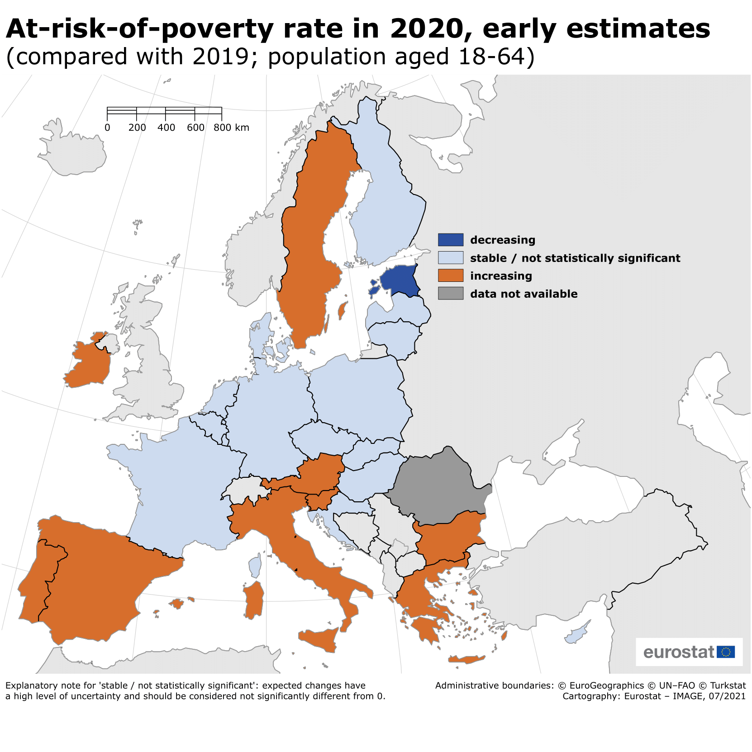
Economic crisis: a crisis on our plate?
1.2. Social impact of the economic crisis

Slide 4
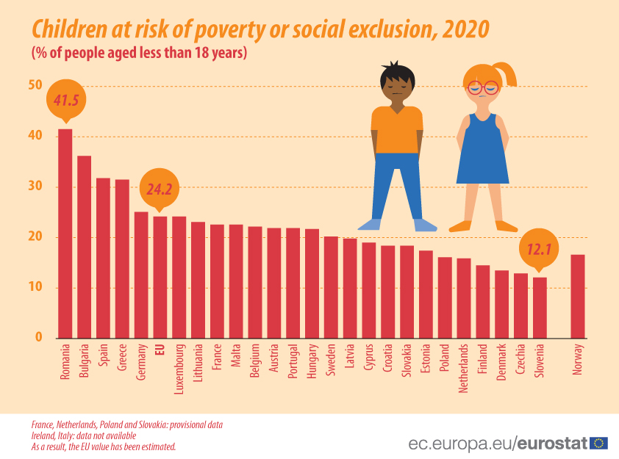
Economic crisis: a crisis on our plate?
1.2. Social impact of the economic crisis

Slide 5
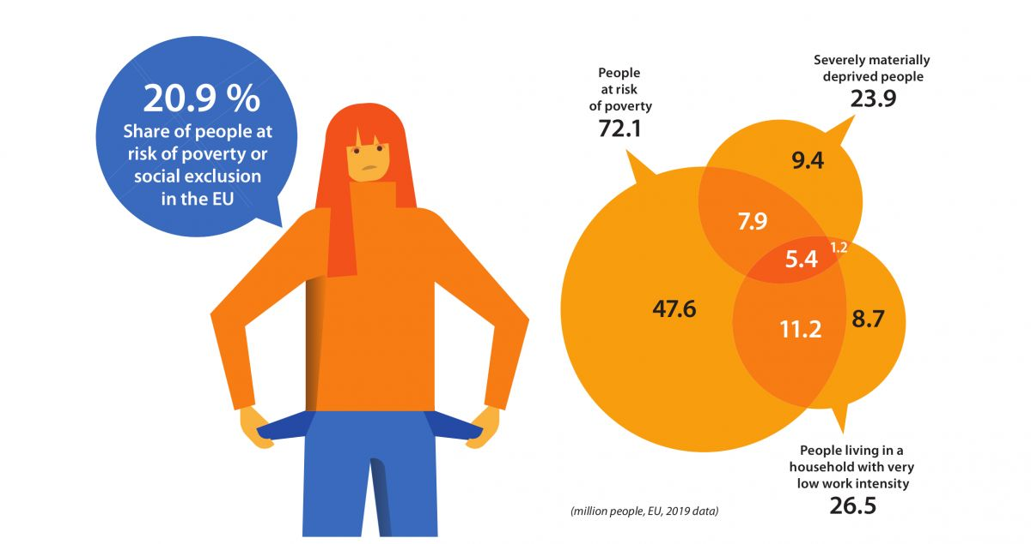
Economic crisis: a crisis on our plate?
1.2. Social impact of the economic crisis

