Slide 1

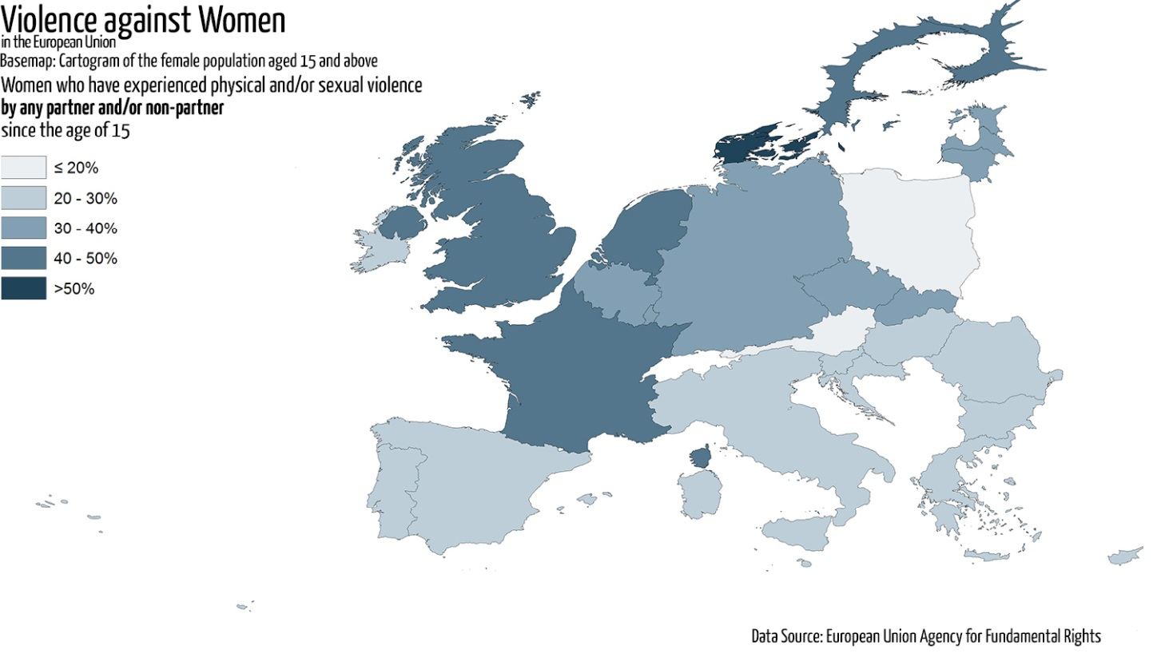
Gender-based violence: Recognise it, condemn it and stop it!
1.1. Definition of gender-based violence
Gender-based violence is a general term that encompasses any discrimination or harmful behaviour directed at a person because of her or his (real or perceived) social gender or sexual orientation.

Slide 2
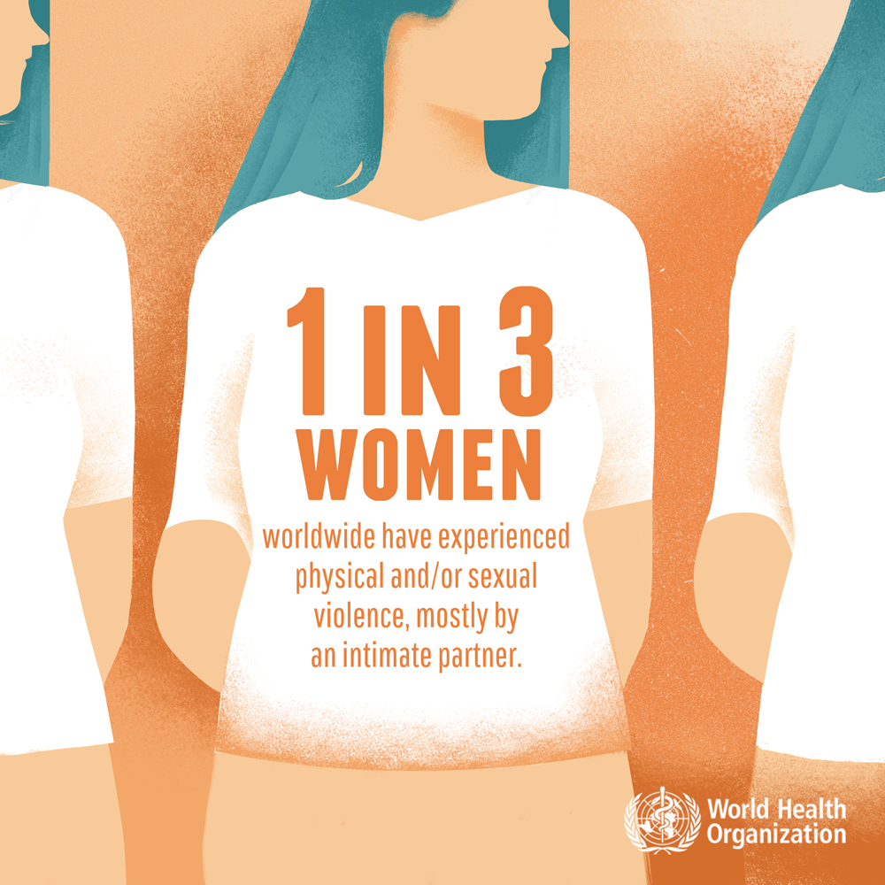
Gender-based violence: recognise it, condemn it and stop it!
1.1. Definition of gender-based violence

Slide 3
Gender-based violence: recognise it, condemn it and stop it!
1.1. Definition of gender-based violence
→ Gender-based violence affects both women and men, but disproportionately affects women reflecting their inferior position in society.
Gender-based violence
→ Different groups of men and women, such as those belonging to sexual minorities, are also likely to be disproportionately affected by gender-based violence.

Slide 4
Gender-based violence: recognise it, condemn it and stop it!
1.2. What do we mean when by "biological sex", “gender” and "gender norms"?
→ The words "biological sex" and “gender" do not mean the same thing.
→ When a child is born, it is (usually) clear whether it is a boy or a girl from their genitals. “Biological sex" refers to the biological characteristics that men and women have by birth. They are universally and normally permanent, e.g. men can not breastfeed etc.
→ Gender norms are the main cause of gender-based violence. They are created by our culture, not by nature and, therefore, they can change over time. For example, a few decades ago it would have been extremely unusual for a man to do the housework e.g. cleaning etc.
→ Gender is the way society believes that people should behave (how they should dress, what their role is, etc.) according to their biological sex.

Slide 5
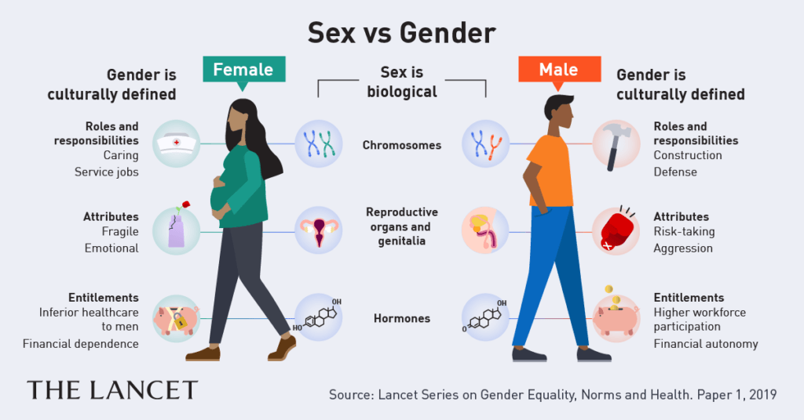
Gender-based violence: recognise it, condemn it and stop it!
1.2. What do we mean when by "biological sex", “gender“ and "gender norms"?

Slide 6
Gender-based violence: recognise it, condemn it and stop it!
1.3. Gender-based violence and "gender norms": interactional relationship
→ Thus, gender-based violence is exerted by some people to control the behaviour of other people, whom they consider inferior, or as a means to "punish" those who do not conform to idealized gender norms.
→ This discrimination gives rise to unequal hierarchies of power, as society traditionally places more value on the "male gender norms" of domination, aggression and competition than on the "female" norms of submissiveness and vulnerability.
→ Rigid gender norms not only limit people's identity and capabilities, but also distinguish men from women based on social expectations for their appearance, behaviour, and actions.
→ Men and women socialize in such a way as to try to "fit" into ideals of masculinity or femininity. People who do not conform to these male or female ideals are often isolated, discriminated, or abused.

Slide 7
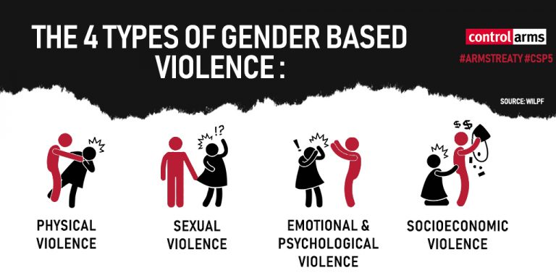
Gender-based violence: recognise it, condemn it and stop it!
1.4. Types of gender-based violence

Slide 8
Gender-based violence: recognise it, condemn it and stop it!
1.4. Types of gender-based violence
Psychological
(verbal and non-verbal)
→ Verbal abuse (insults, shouts, abusive speech, devaluation, humiliation, spreading negative rumours, accusations without reason, criticism).
→ Emotional bullying (terrorism, threats, breaking objects, destroying personal objects).
→ Lack of freedom (isolation from family or friendly environment, prohibition of any activity, jealousy, control of personal belongings, dictating eg what to wear, etc.). It appears together with other forms of violence or prepares the ground for their emergence.
Physical
→ Conduct that causes physical pain or injury: beating, kicking, punching, abandonment in a dangerous or remote place, deprivation of basic needs such as food, water, etc.
Sexual
→ It includes all forms of sexual imposition, such as coercion into sexual activity without consent, as well as any unwanted, and often repetitive and unresponsive, sexual advances or unwanted verbal or physical sexual conduct. It includes rape, child sexual abuse, sexual harassment and trafficking in human beings for the purpose of sexual exploitation.
Economic
→ It includes seizure of property, deprivation of goods to meet basic needs, control of the victim’s financial returns, prohibition of work and exclusion of victims from decision-making processes that concern them.

Slide 9
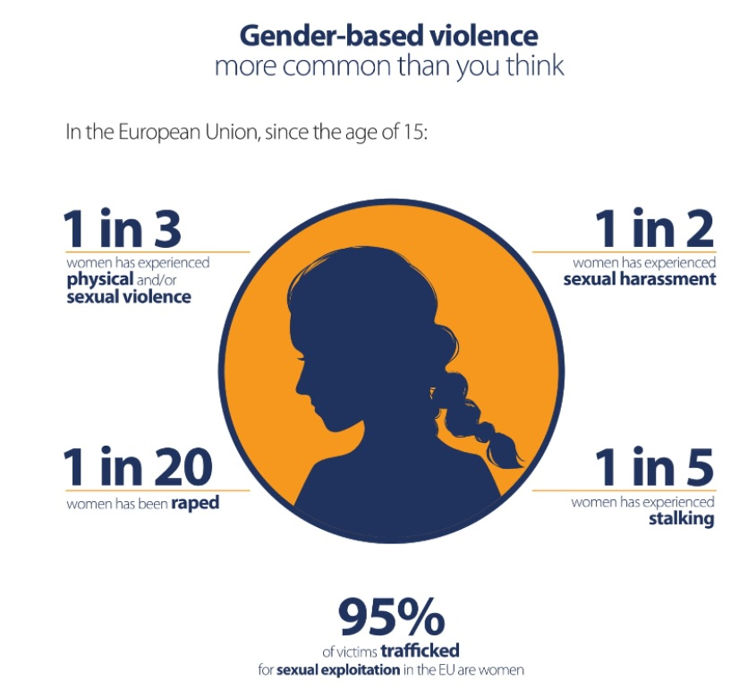
Gender-based violence: recognise it, condemn it and stop it!
1.4. Types of gender-based violence

Slide 10
Gender-based violence: recognise it, condemn it and stop it!
1.5. Characteristics of an abusive relationship
Characteristics of an abusive relationship
Perpetrator
→ speaks disparagingly.
→ is extremely jealous.
→ exercises control over every movement of the victim.
→ loses control, threatens, becomes violent e.g. breaks objects, beats the victim, etc.
Victim
→ makes excuses for the perpetrator to others.
→ fears to provoke anger.
→ gives up activities
→ has unexplained injuries and wounds.
→ appearance & body weight change dramatically
→ depression

Slide 11
Gender-based violence: recognise it, condemn it and stop it!
1.6. Characteristics of a healthy relationship
Characteristics of a healthy relationship
We make decisions together.
There is no fear in the relationship.
We have free personal time to spend as we wish.
There may be conflicting opinions, but we make compromises.
We listen to and respect each other's views.
We disagree, but we discuss calmly.

Slide 12
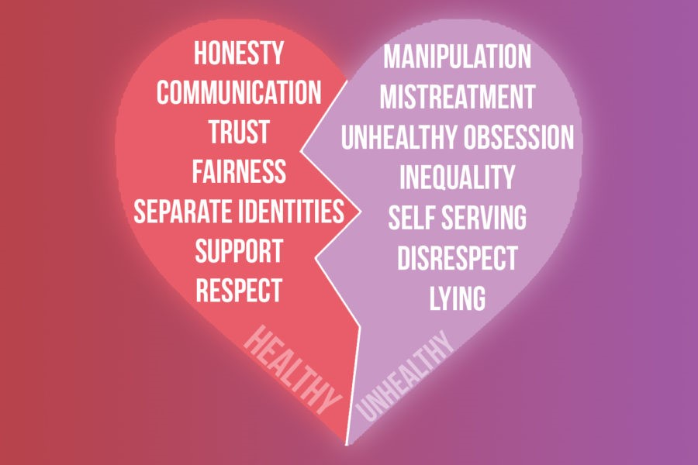
Gender-based violence: recognise it, condemn it and stop it!
1.6.1. Comparison of the characteristics of healthy and abusive relationships

Slide 13
Gender-based violence: recognise it, condemn it and stop it!
1.7. Consequences of gender-based violence
Lowered self-esteem, safety & self-control of the victim.
Fear, shame, guilt, anger and despair.
Indulging in alcohol or drugs.
Anxiety, depression and sleep disorders (insomnia, nightmares).
Feeling trapped
&
isolated from family and friends or peers.
Bodily harm.

Slide 14
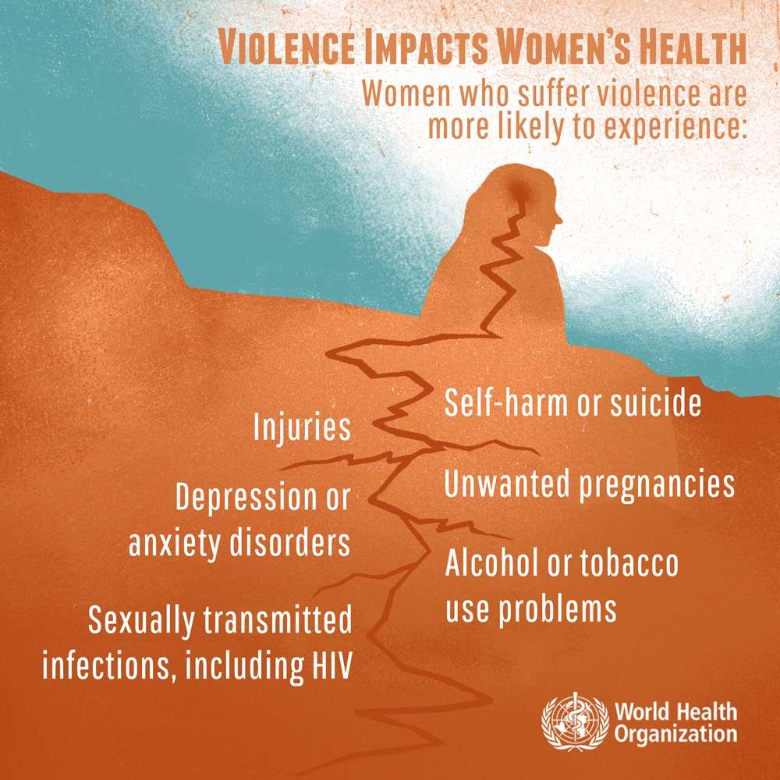
Gender-based violence: recognise it, condemn it and stop it!
1.7. Consequences of gender-based violence

Slide 15
Gender-based violence: recognise it, condemn it and stop it!
1.8. What you should do……
When you are in an abusive relationship:
When you know that your friend is being abused:
Contact institutions and services that support victims of gender-based violence in order to receive the necessary information and support.
She does not cause the abuse herself.
She is not to blame for her partner's behaviour.
She can not change her partner’s behaviour.
Apologies and promises won’t put an end to the violence.
She is not alone.
Abuse is not a loss of control, it is a means of control.
→ Try to be close to her as often as possible, so that she feels safe and trusts you.
Violence is never acceptable or justified.
→ Her physical safety is first priority. If you think she is in danger, you must act immediately.
→ Give her clear messages, including the following:
If there is someone you trust, explain the situation and ask this person to call the police if he / she realizes that you are in danger.

Slide 16
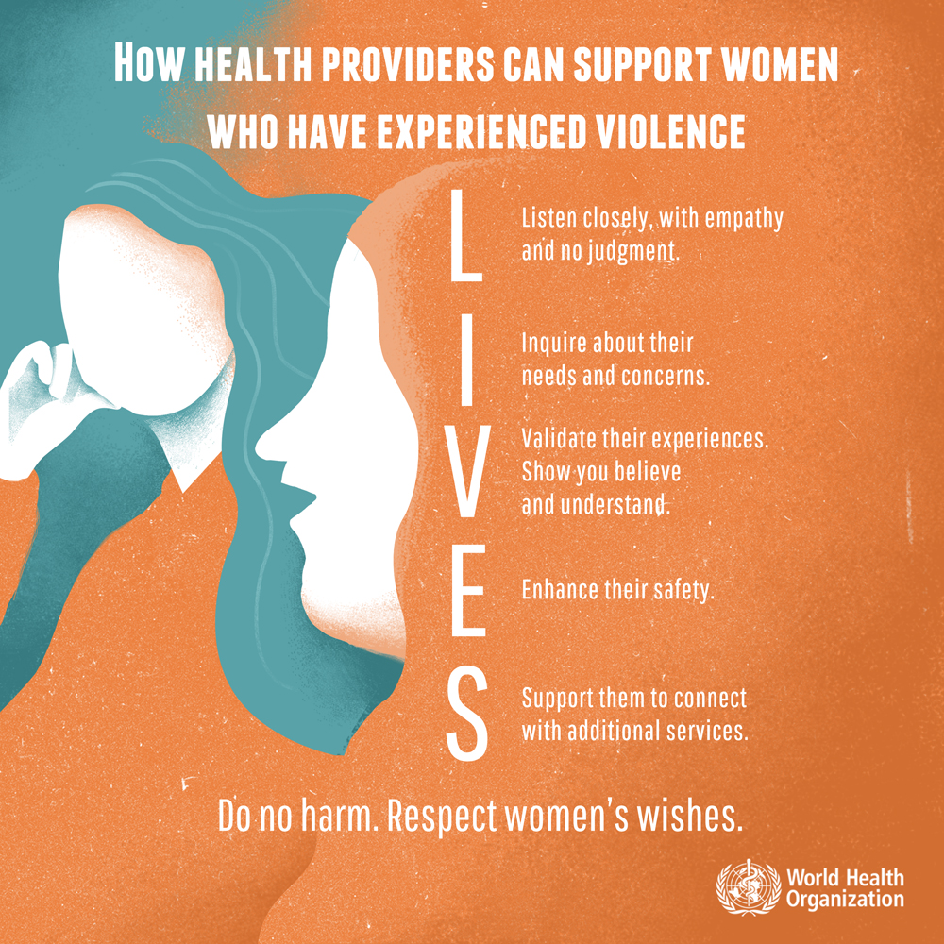
Gender-based violence: recognise it, condemn it and stop it!
1.8. What you should do……

Slide 17
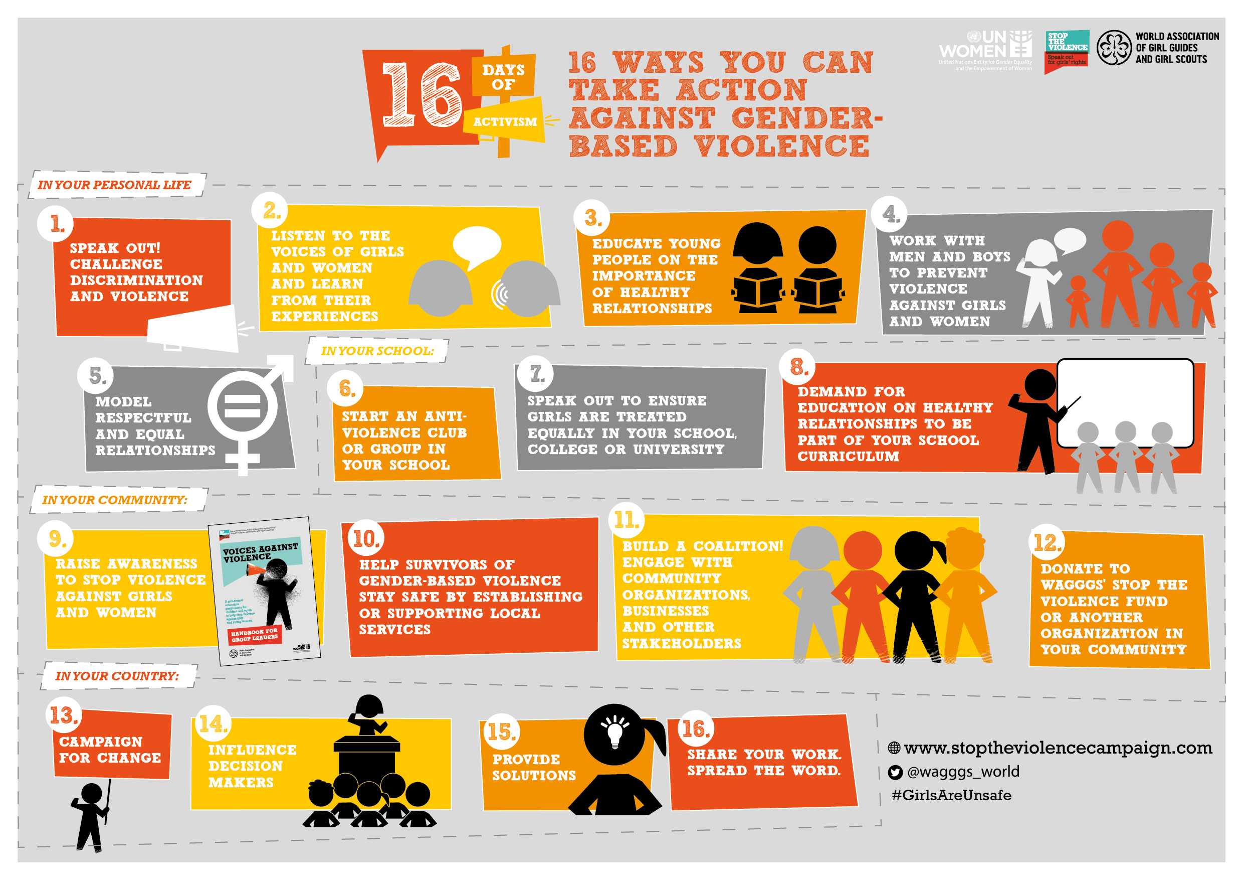
Gender-based violence: recognise it, condemn it and stop it!
1.8. What you should do……

Slide 18

Gender-based violence: recognise it, condemn it and stop it!
1.8. What you should do……
Zero tolerance for gender-based violence is the only appropriate solution.
It is vital that we all contribute to its elimination. Because it concerns all of us!
Do not overlook gender-based violence, when you encounter a case.

