Slide 1

Vegetation: Ecological autonomy and self-defence!
1.1. Vegetation –Factors affecting vegetation establishment and development
Flora is the name given to all the plant species of an area.
Vegetation refers to the way plants grow in an area.
The species of flora and the vegetation of an area also establish its fauna, i.e. the animals that live in it, at a specific time period.

Slide 2
Vegetation: Ecological autonomy and self-defence!
1.1. Vegetation –Factors affecting vegetation establishment and development
Factors that determine the type of vegetation of a place
Altitude
Climate
Temperature
Local conditions prevailing in an area (eg wind, humidity, rain, etc.)

Slide 3
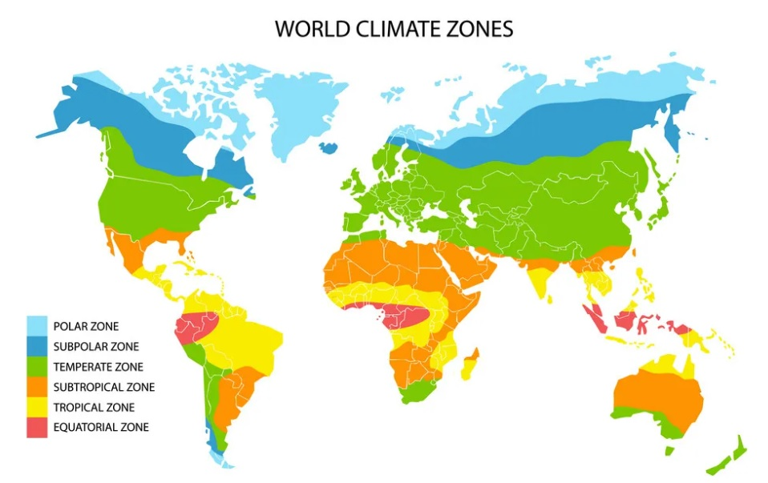
Vegetation: Ecological autonomy and self-defence!
1.1. Vegetation –Factors affecting vegetation establishment and development

Slide 4
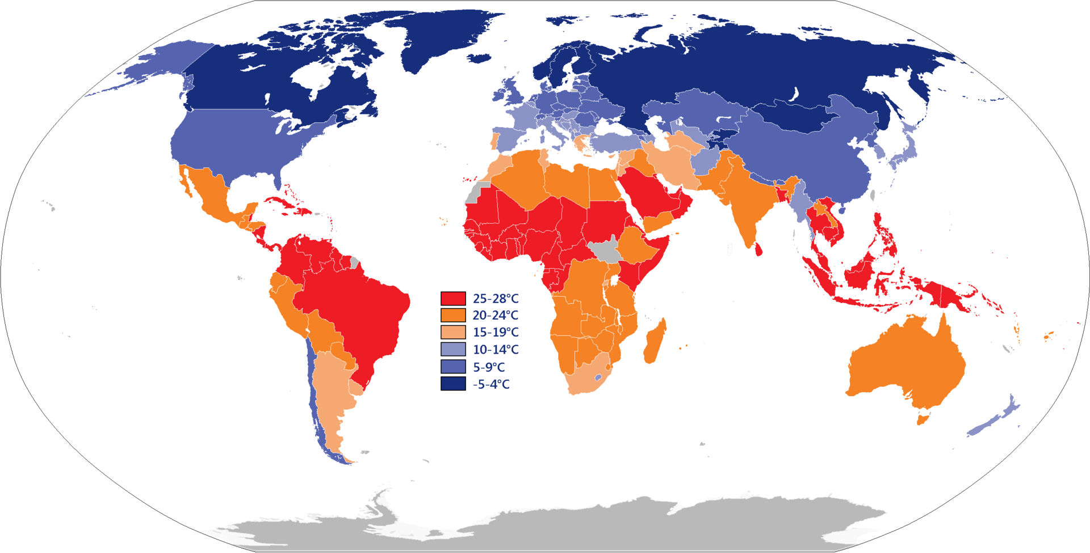
Vegetation: Ecological autonomy and self-defence!
1.1. Vegetation –Factors affecting vegetation establishment and development
World temperature map

Slide 5
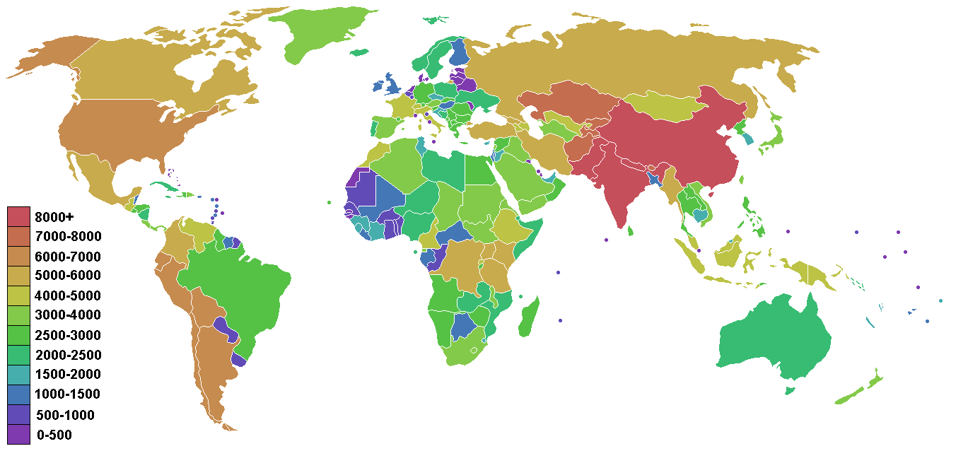
Vegetation: Ecological autonomy and self-defence!
1.1. Vegetation –Factors affecting vegetation establishment and development
Map of countries coloured according to their highest point

Slide 6
Vegetation: Ecological autonomy and self-defence!
1.2. Vegetation zones
The distribution of plant species and their vegetation on the Earth's surface is established in vegetation zones, just as climate zones are established.
Polar zone
Temperate zone
Tropical zone

Slide 7
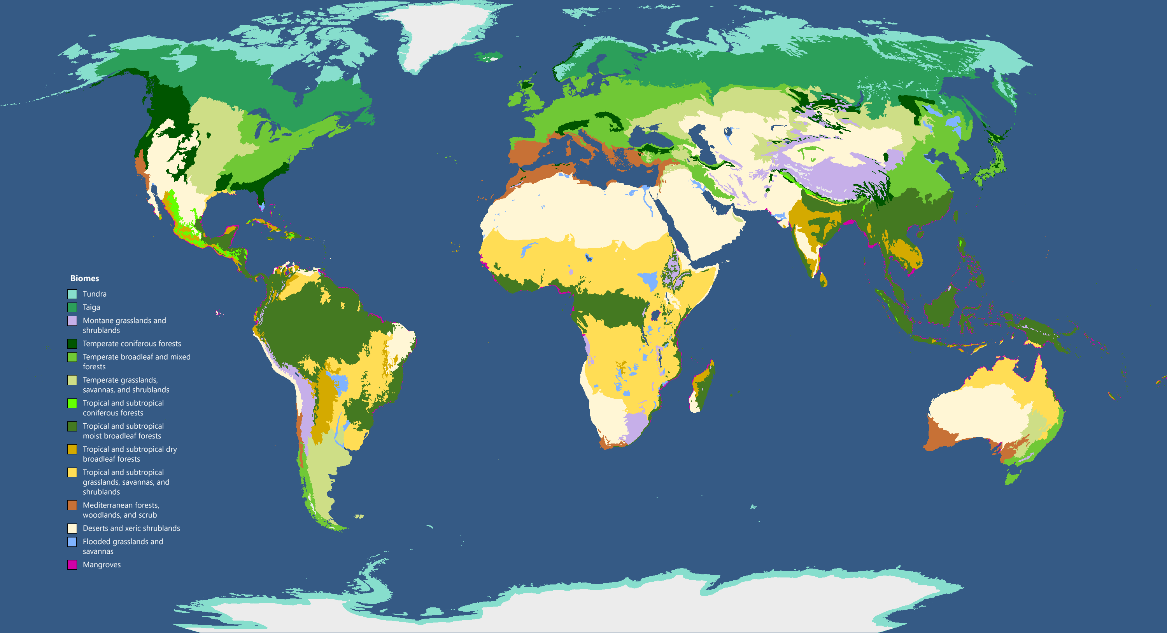
Vegetation: Ecological autonomy and self-defence!
1.2. Vegetation zones

Slide 8
Vegetation: Ecological autonomy and self-defence!
1.2. Vegetation zones
1.2.1. Polar zone
Tundra
• The tundra refers to the bioclimatic landscape that prevails in glacial regions.
• Tree growth is hindered by low temperatures.
• The vegetation of the tundra consists mainly of moss, lichens, small shrubs, dwarf trees and perennial grasses. Reindeer, wolves, bears, migratory birds, etc. can live in this type of vegetation.

Slide 9
Vegetation: Ecological autonomy and self-defence!
1.2. Vegetation zones
1.2.2. Temperate zone
Taiga
• The taiga is found between tundra and the temperate forest, in regions of high altitude. The taiga forests are mainly coniferous forests, such as firs and pines.
Animal species include reindeer, bears, wolves, deer, hares, rodents, etc. There is a wide variety of birds that migrate south to spend the winter, a few amphibians and reptiles.
Mediterranean vegetation
• The temperate zone also includes the Mediterranean vegetation with dominant plant species such as vine, olive tree, phrygana, etc.
• Animal species include snakes, chameleons, turtles, foxes, etc.
Steppe
In the temperate zone there are also meadows with a dry climate called steppes.
Deciduous forests
• In temperate climates, summers are long and winters are cold but not too cold, with plenty of rain. The predominant plant species are oak and beech.
• Animal species include a wide variety of mammals such as squirrels, deer, rats, foxes, wild boars, insects and birds such as woodpeckers etc.
The main species of fauna are bison, antelopes, coyotes, wolves, wild horses, rodents, etc.
The steppe is covered with clusters of short grasses, due to the little water available and has few plants with woody trunks.

Slide 10
Vegetation: Ecological autonomy and self-defence!
1.2. Vegetation zones
1.2.3. Tropical zone
ηηξ
Tropical forests or jungle
• Tropical forests are home to more species than any other biosystem.
• In rainforests we find broadleaf trees, epiphytic plants (they cling to the branches and trunks of trees), as well as shrubs and bushes.
• The fauna in the rainforests is extensive and varied. It includes a few large animals such as tigers, puma, etc. and at the same time many species of insects, reptiles and birds.
Savanna
• Very high herbaceous and shrubby vegetation with the presence of only scattered trees. It consists of palm trees, cacti and deciduous trees with small leaves and thorns.
• Elephants, zebras, tigers, lions, etc. live in the savannah.
Steppe
• The steppe is found in the tropical zone (as in the temperate zone), and consists of small shrubs and small trees.
• Steppes are dominated by herbivores (horse, camel), rodents (hamsters, rabbits), lizards and snakes..
Desert
• The ecosystem consists of various species of plants and animals adapted to live in regions with severe drought. Some examples of desert plants are succulents, such as cacti.
• Snakes, lizards, arachnids, vultures, mice, camels, etc. live in the desert.

