Slide 1

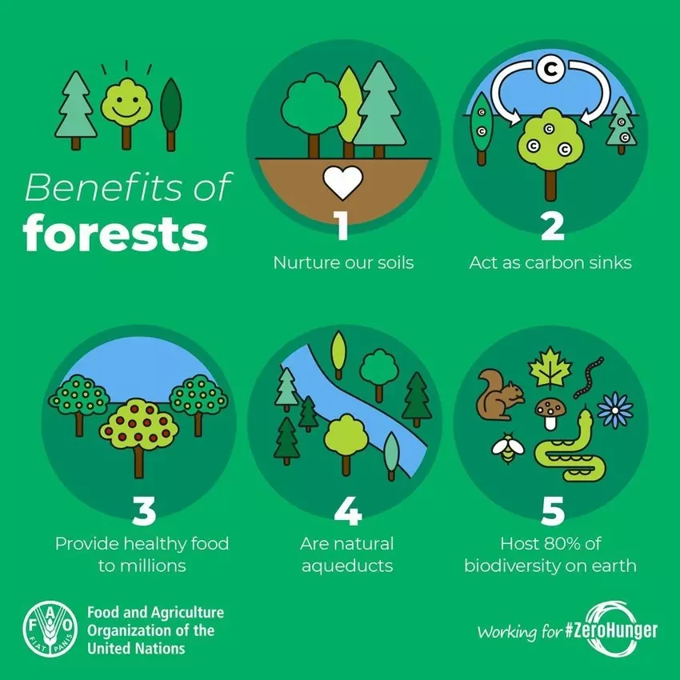
Vegetation: Ecological autonomy and self-defence!
1.3. What are the benefits of forests?

Slide 2
Vegetation: Ecological autonomy and self-defence!
1.4. Degradation of forests
1.4.1. The main causes of deforestation
Fires
Uncontrolled urbanization
Overuse of timber
Overcultivation
&
overgrazing
Uncontrolled industrial development

Slide 3
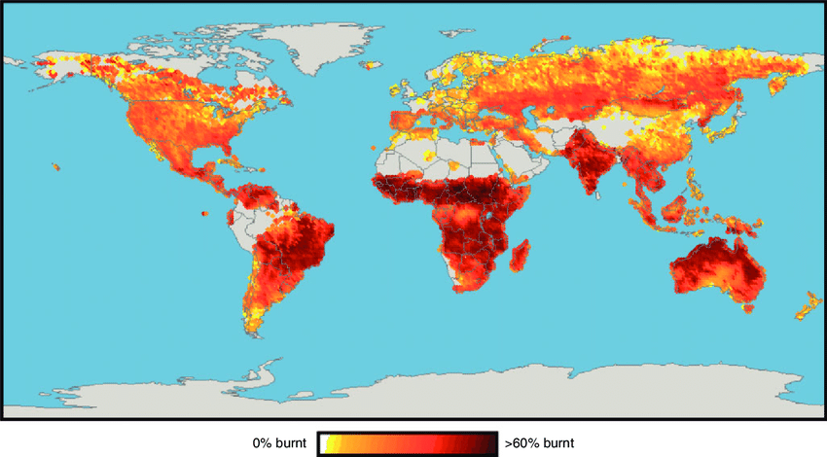
Vegetation: Ecological autonomy and self-defence!
1.4. Degradation of forests
1.4.1. The main causes of deforestation
Global map of average annual area burned (percentage of cell burned)

Slide 4
Vegetation: Ecological autonomy and self-defence!
1.4. Degradation of forests
1.4.2. The main consequences of deforestation
Climate change
Shrinking economy
Biodiversity loss
Rural abandonment
Floods

Slide 5
Vegetation: Ecological autonomy and self-defence!
1.4. Degradation of forests
1.4.3. What should we do to protect forests?
State care - Fire protection measures e.g. fire zones, patrols etc.
Reforestation
Strict legislation & fines
Environmental information / individual sensitivity
Forest protection

