Slide 1

Sustainable diet for a healthy planet!
2.2. Model of sustainable-healthy diet: Mediterranean diet
Model of sustainable diet
The sustainable diet model is based on the consumption of domestic products, using the available resources of each region or country, with an emphasis on plant-based, less processed foods. One such example is the Mediterranean diet.
Compared to the typical Western diet that seems to be consumed by the majority of the population today, the Mediterranean diet is an exemplary model of sustainable nutrition, leading to significantly less greenhouse gas emissions (72%), less land use (58%), energy consumption (52%). ) and water resources (33%).
It combines the positive impact on consumer health, increased access to food and economy (due to domestic production), but also the protection of the sustainability and biodiversity of the environment (win-win). At the same time, the use of local products contributes to the local economy.
At the core of the Mediterranean diet are mainly plant sources of domestic food, with small or moderate amounts of animal products and wine. It is characterized by a large amount of fruits, vegetables, nuts, legumes, cereals, fish & olive oil, moderate amounts of dairy products and wine, and small amounts of meat, mainly red.

Slide 2
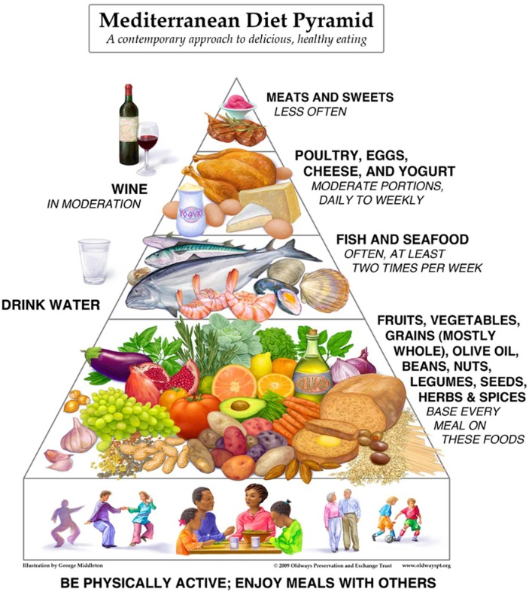
Sustainable diet for a healthy planet!
2.2. Model of sustainable-healthy diet: Mediterranean diet

Slide 3
Sustainable diet for a healthy planet!
2.3. Principles of a sustainable healthy diet
Reducing food waste
Opting for sustainable food packaging , or buying products in bulk.
Increasing consumption of plant foods and limiting animal products (when possible)
Consuming seafood and fish in moderation
Selecting domestic products over imported ones
Adopting the principles of the Mediterranean diet
Principles of a sustainable healthy diet
Reducing energy intake in case of excess body weight

Slide 4
Sustainable diet for a healthy planet!
2.3. Principles of a sustainable healthy diet
In order to improve our diet, taking the protection of the environment into account, we must first keep in mind that there are no good or bad foods.
Eco-friendly foods do not pollute water and soil resources, as they are not produced with extensive use of fertilizers, antibiotics or pesticides.
It all depends on how the food was grown, produced or caught.
Animal species are not hunted intensively in order to ensure the preservation of their population, while at the same time forests and plains are not destroyed for the extensive cultivation of plant products.
Therefore, environmentally friendly foods have minimal environmental impact as they are produced responsibly, in a way that respects wildlife and its habitats.

Slide 5
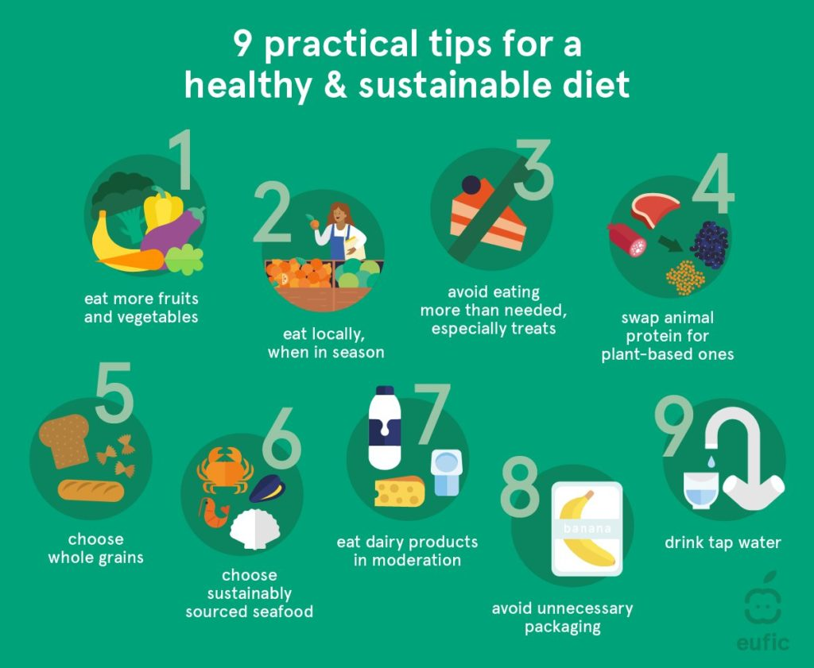
Sustainable diet for a healthy planet!
2.3. Principles of a sustainable healthy diet

Slide 6
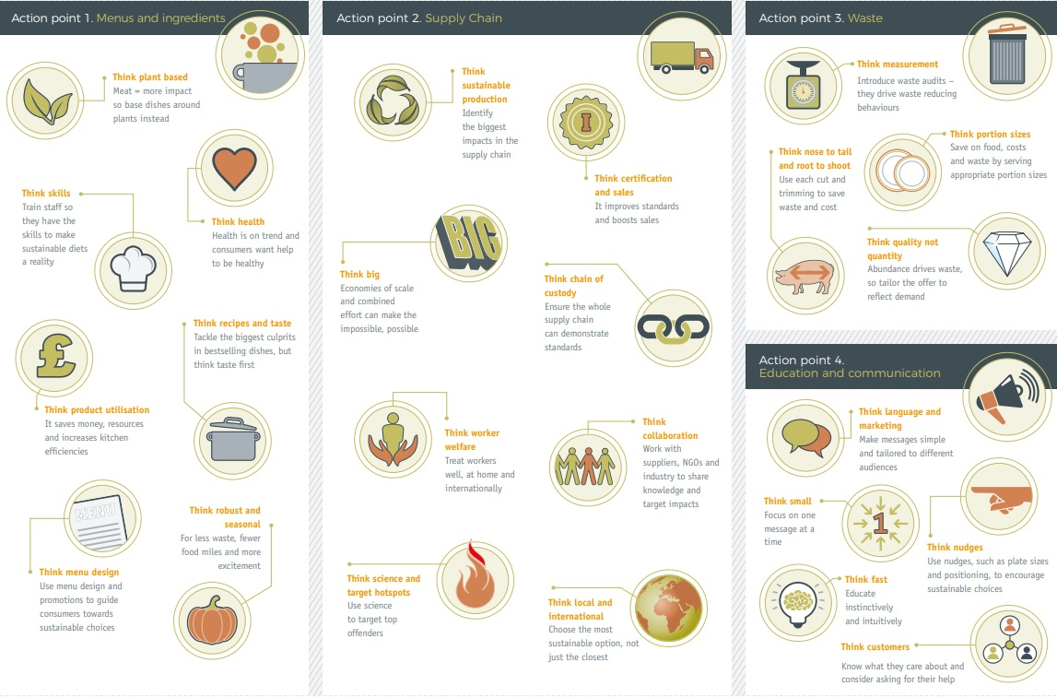
Sustainable diet for a healthy planet!
2.4. A guide to sustainable diet

