Slide 1
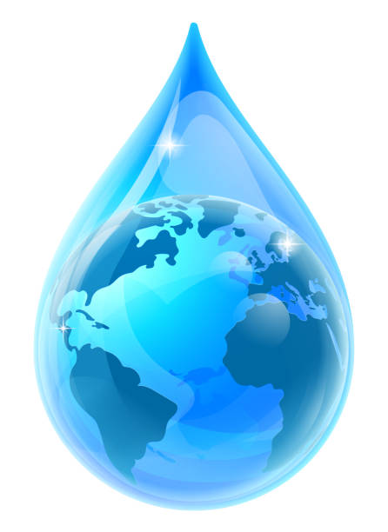
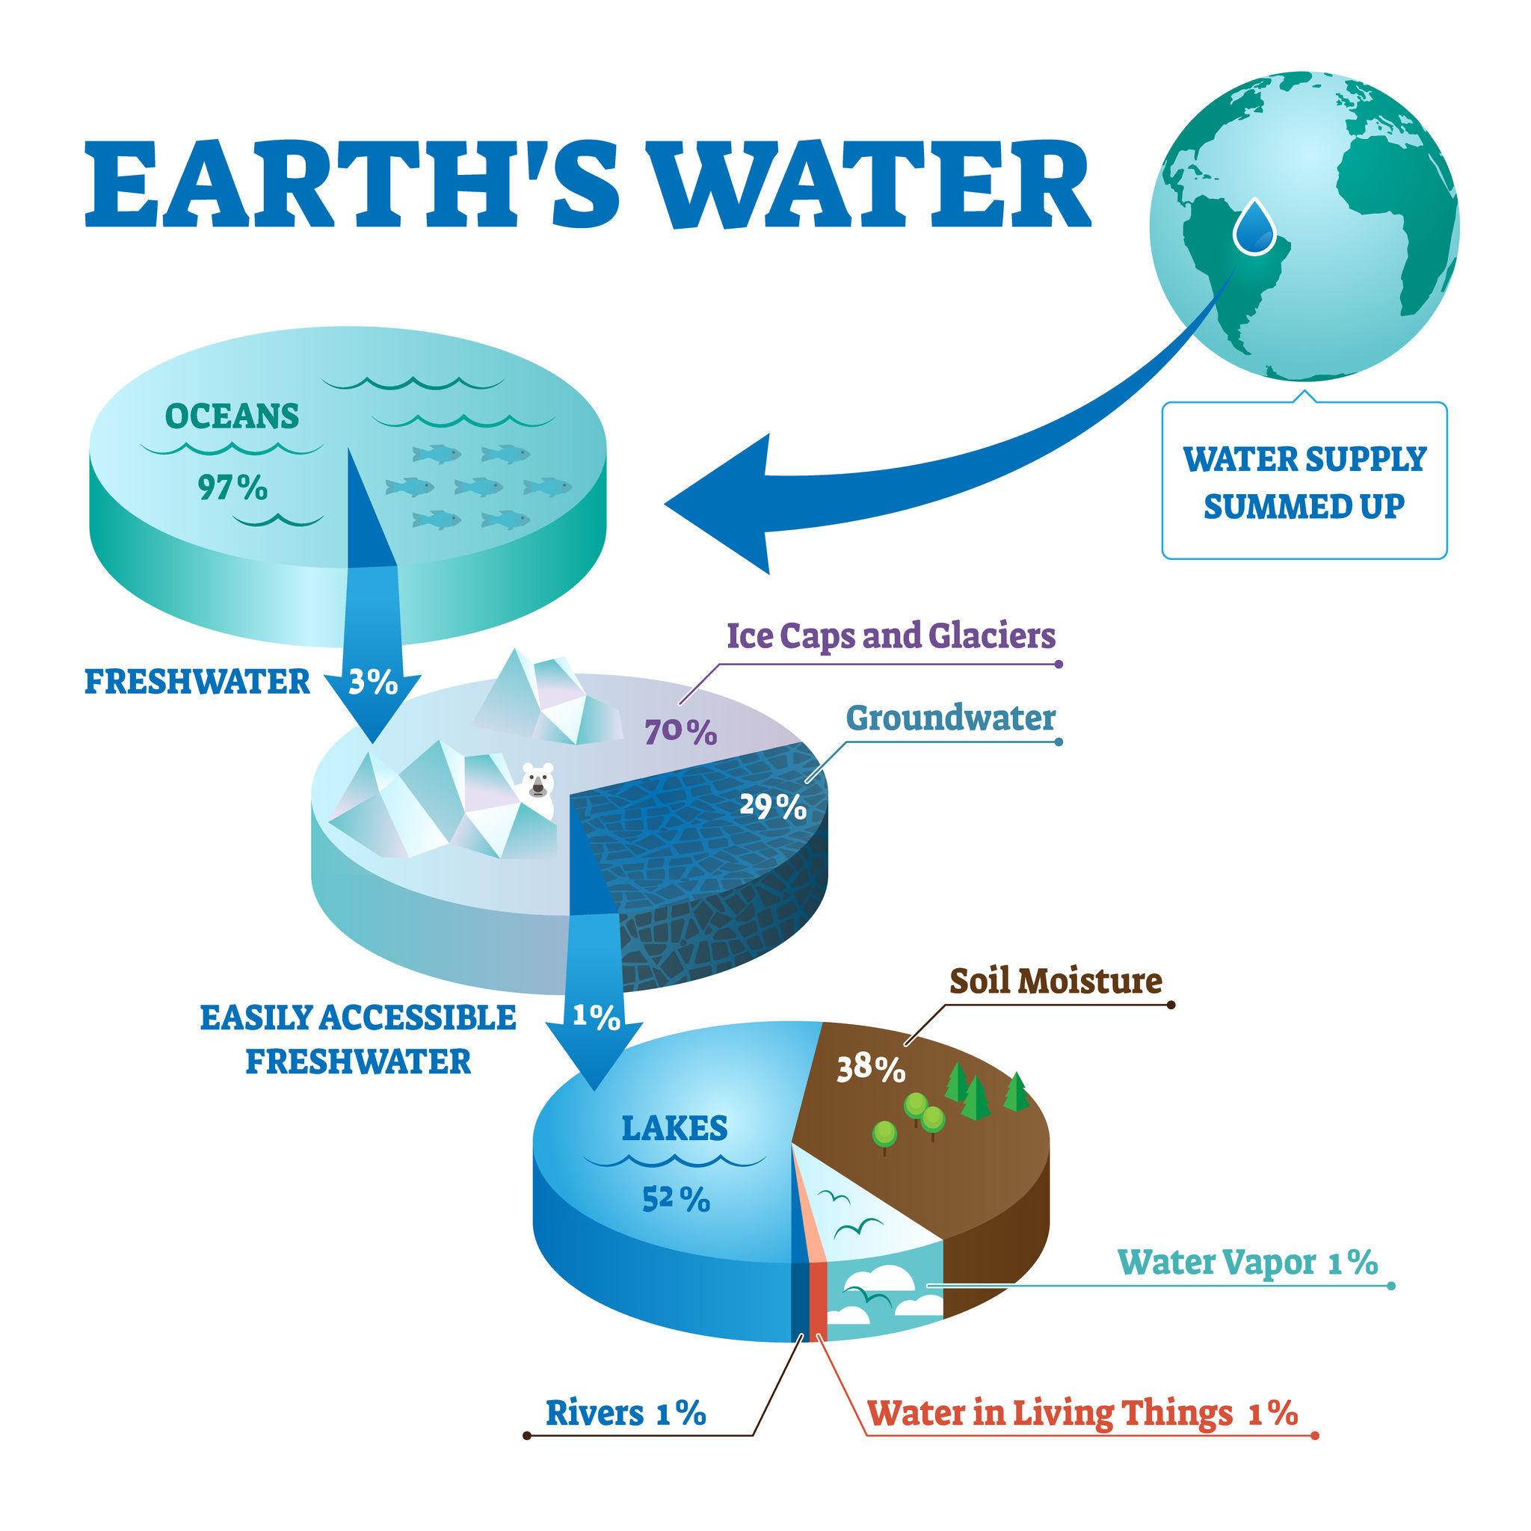
Exploring the great waterways of the world
Rivers and lakes of the world
1.1. Distribution of water on the Earth’s Surface
Water is essential for all life and is the most abundant substance on Earth. Water covers 75% of the earth’s surface, however only a very small amount is fresh water that can be used directly by people, animals and plants because:
→ 2% is frozen at the north and south poles, in glaciers and on snowy mountain ranges.
→ 97% of this water is in oceans and is too salty for people, animals or plants to use.

Slide 2
Exploring the great waterways of the world
Rivers and lakes of the world
1.2. The importance of rivers and lakes in people's lives
Rivers and lakes are a valuable natural resource for humans. The water in them are used for:
Industrial production
Fishery
Tourism activities
Irrigation of agricultural lands
Power generation
Entertainment
Urban water supply
Industrial production
Transportation

Slide 3
Exploring the great waterways of the world
Rivers and lakes of the world
1.3. What are the criteria for evaluating and comparing rivers?
Length
Delta
Water supply
Location
Βasin
Impact on people’s lives
Estuary
Ecological significance

Slide 4
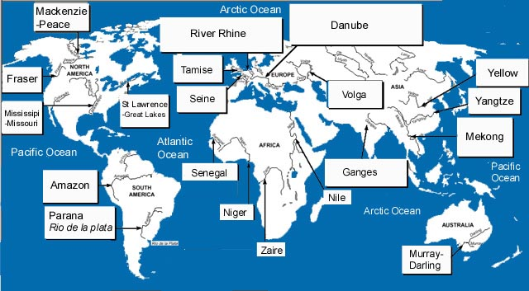
Exploring the great waterways of the world
Rivers and lakes of the world
1.4. Earth’s great rivers

Slide 5
Exploring the great waterways of the world
Rivers and lakes of the world
1.4. Earth’s great rivers
Amazon
Danube
Mississippi
Nile
Murray & Darling

Slide 6
Exploring the great waterways of the world
Rivers and lakes of the world
1.5. Earth’s great rivers
The Earth's lakes cover less than 2% of its surface.
Some are saline, such as the Caspian and the Dead Sea, whose water is 7.7 times saltier than the sea

Slide 7
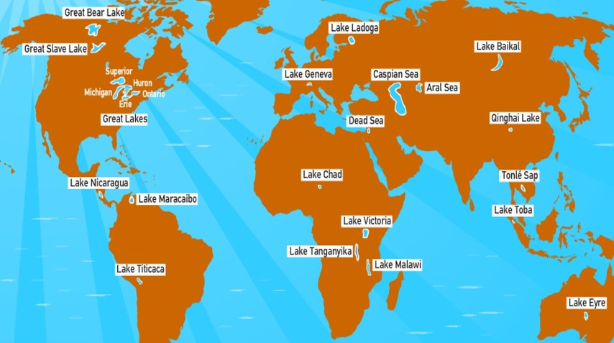
Exploring the great waterways of the world
Rivers and lakes of the world
1.5. Earth’s great rivers

Slide 8
Exploring the great waterways of the world
Rivers and lakes of the world
1.5. Earth’s great rivers
Victoria
Superior
Huron
Baikal
Michigan

