Slide 1

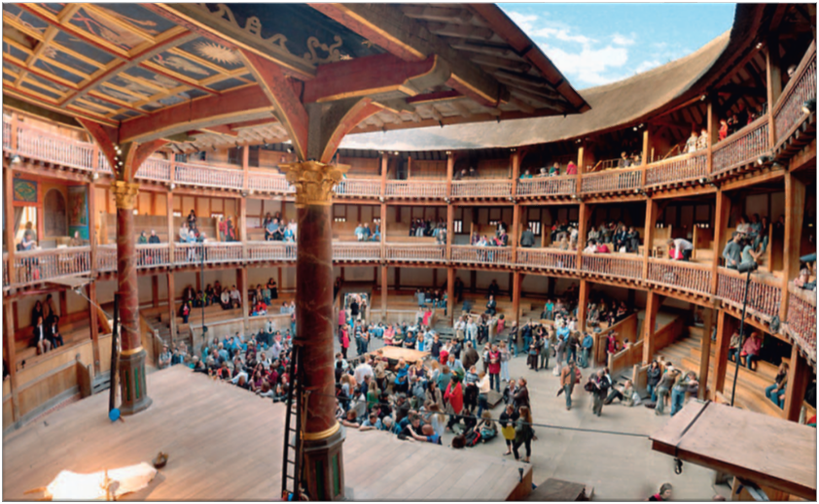

Slide 2
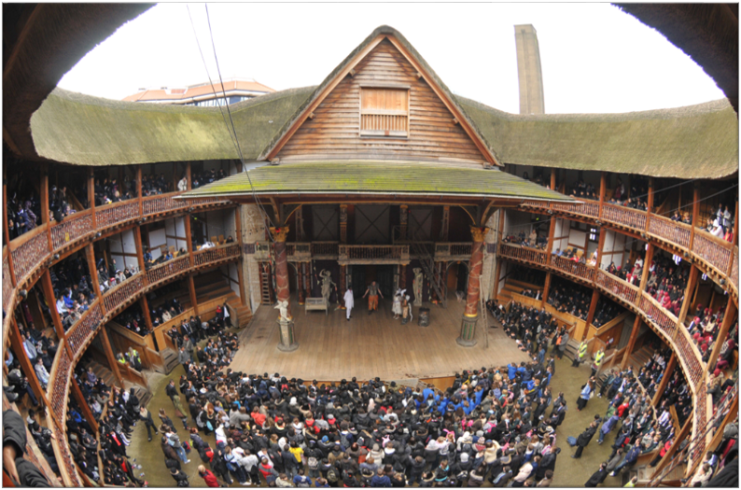
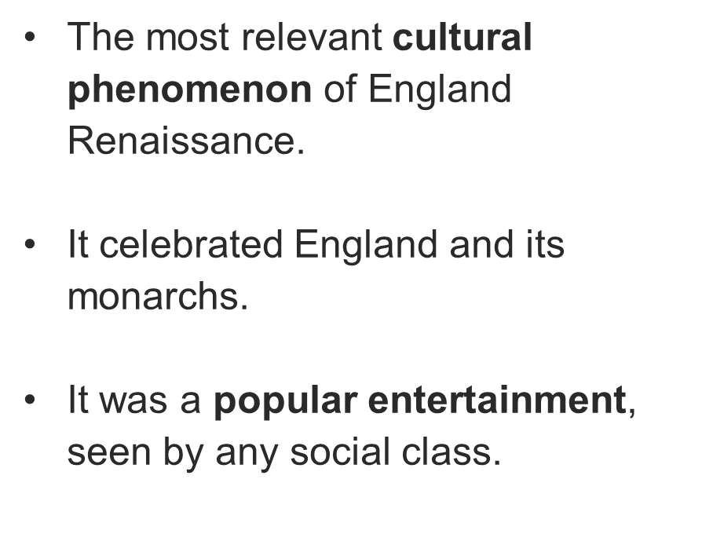

Slide 3
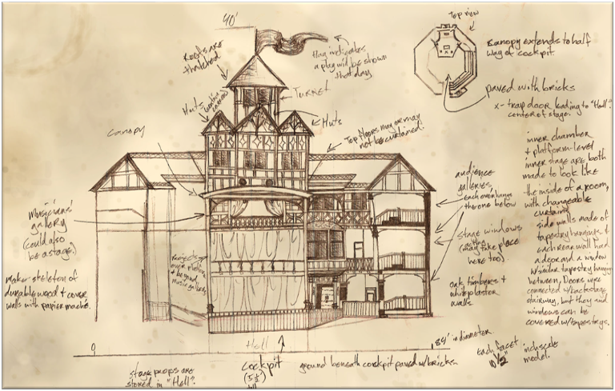
It was the result of changes in social and performing conditions.
Courtyards of the London inns.
In 1574 public performances were banned by the government.
Public outdoor playhouses were built in areas around the City.

Slide 4
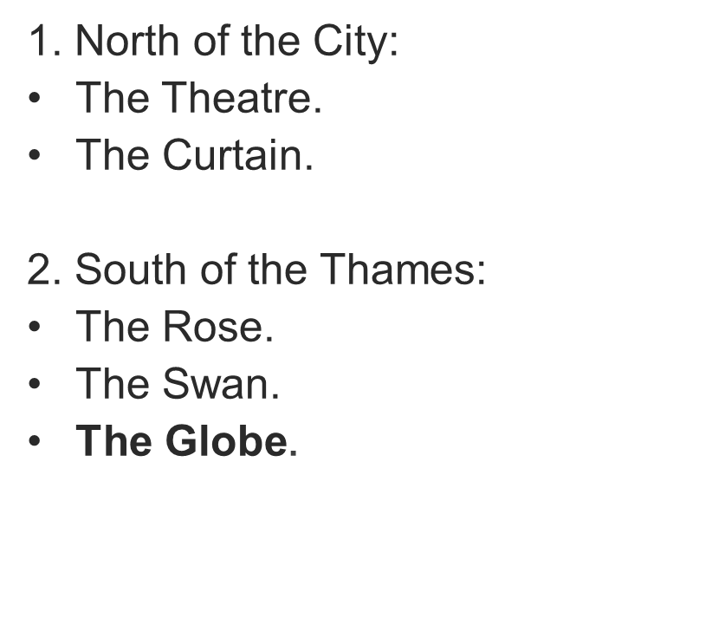
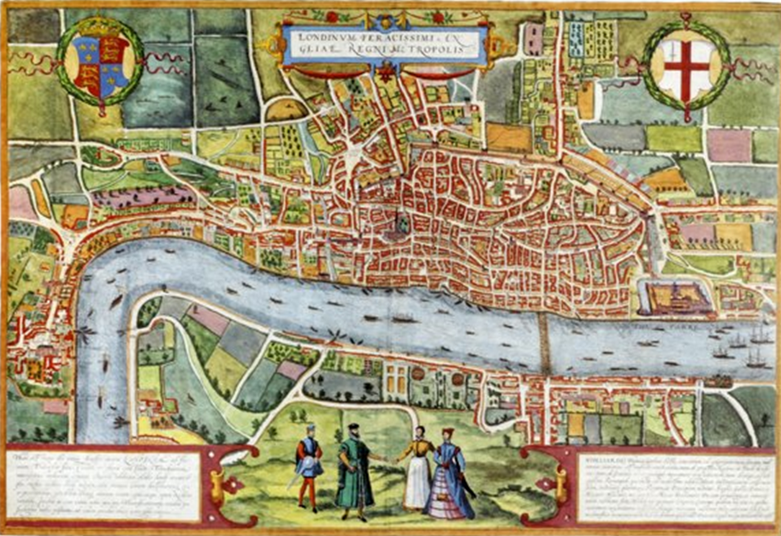

Slide 5
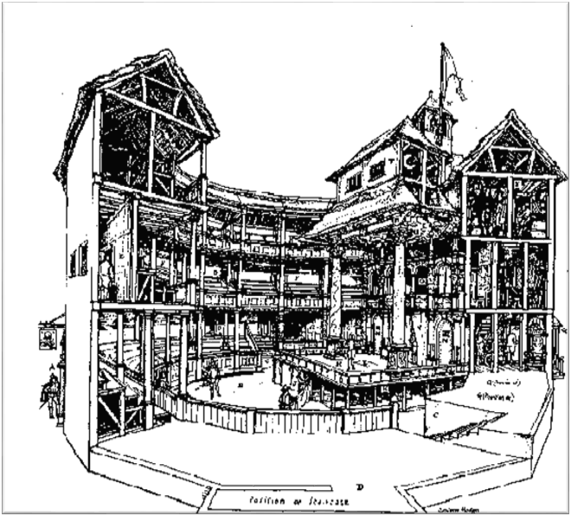
THE STRUCTURE OF A PLAYHOUSE
There were two main areas:
The stage.
The place for the audience:
The arena surrounding the stage.
Groundlings could stand there.
The galleries around the playhouse.
Spectators could seat there.
Different prices varied according to the position occupied by the audience

Slide 6
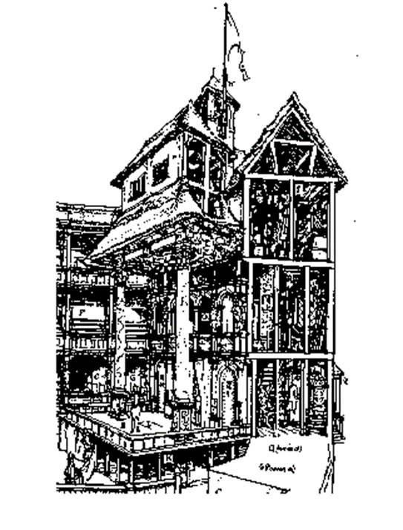
THE STAGE
It was an apron stage, jutting out into the arena.
It had a high symbolical meaning.
The upper stage was used for scenes played on different levels.
The inner stage was used for indoor scenes.

Slide 7
THE ACTORS
Vagabonds.
They were organised in companies under the protection of a patron.
The most famous company was The Lord Chamberlain’s Men.
They were in close contact with the audience.
All female roles were played by young boys.
Performances took place in the afternoon.

Slide 8
PLAYS
They were written by playwrights.
They were performed on the stage.
They were usually divided into acts and scenes.
Normally there were five acts (introduction, development, turning point, complications, denouement).
They were expected to respect the Aristotelian unities
of time, place and action.

Slide 9
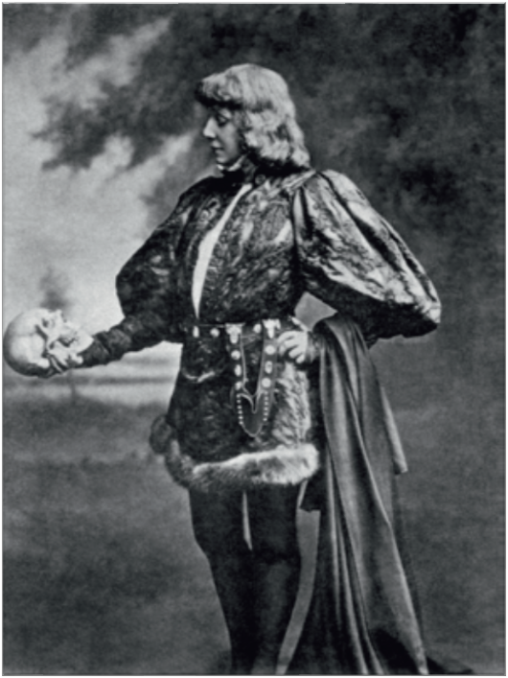
TRAGEDY
The most popular form of drama.
Prologues and epilogues.
It is usually about the conflict between. the individual and the society.
Revenge tragedies.
Poetic language.

Slide 10
COMEDIES
Their characters are usually ordinary people set in everyday situations and using everyday prosaic language.
They are about the successful integration of the individual in the society.
The plots revolve around love and mistaken identities.
Subplots are used to keep the various plots in suspense.
They can be romantic, satiric and of manners.

Slide 11
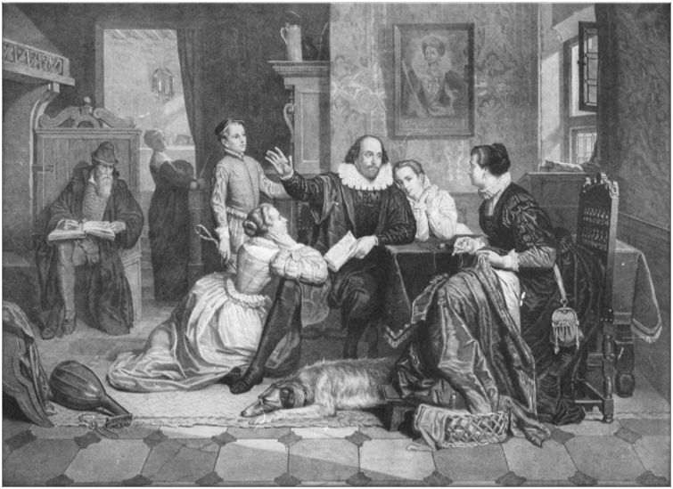
CHARACTERS
The main character is the hero or the heroine.
They are described through dialogues or monologues, stage directions, types of speech and language.
Minor characters are sometime called villains.
They can be round or flat.

