Slide 1
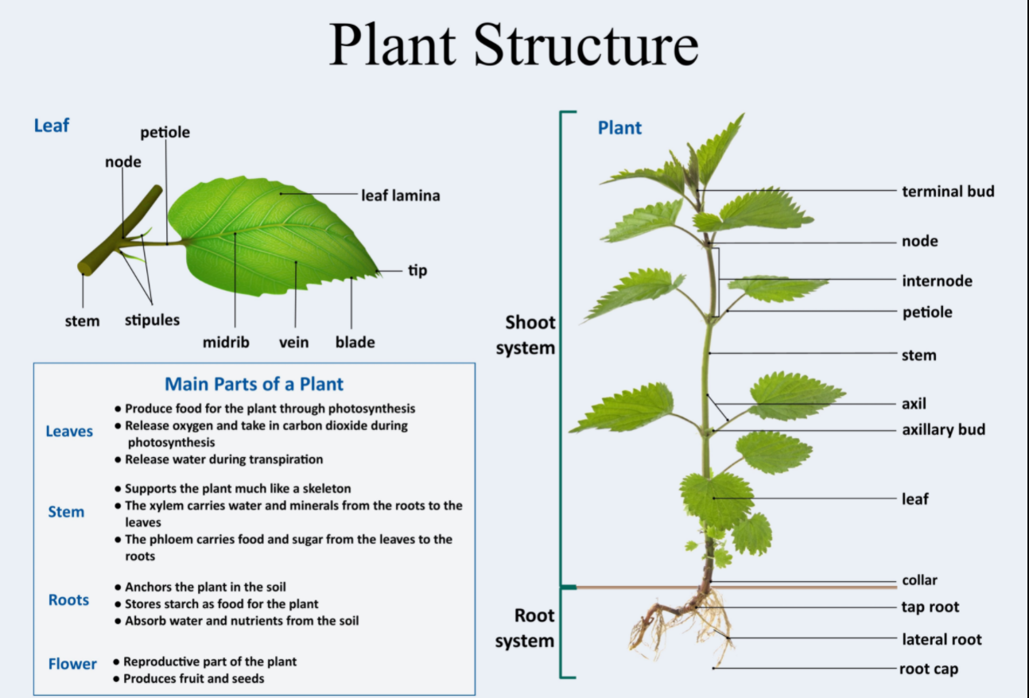
The plants

Slide 2
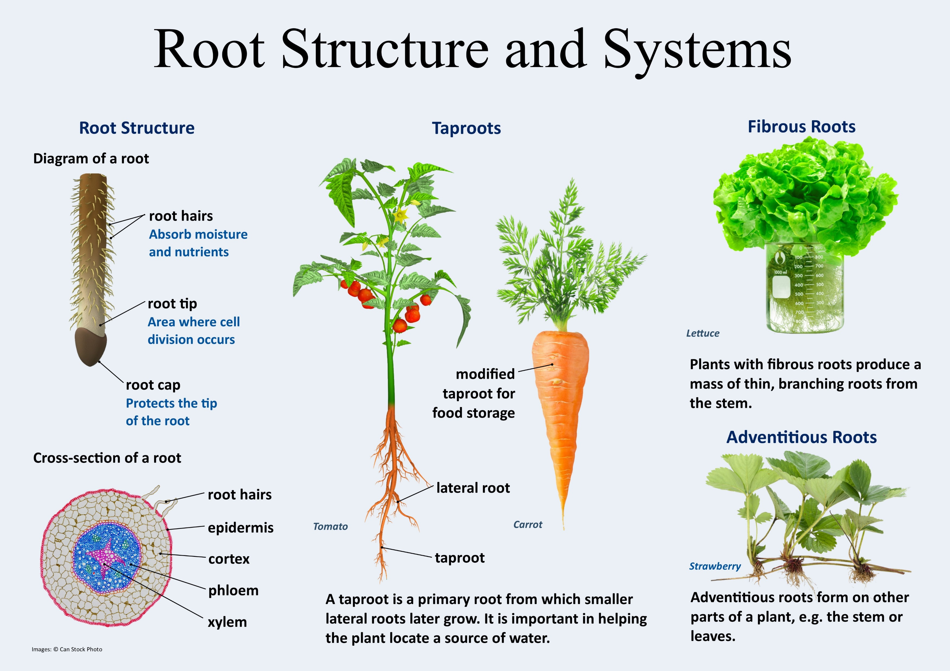

Slide 3
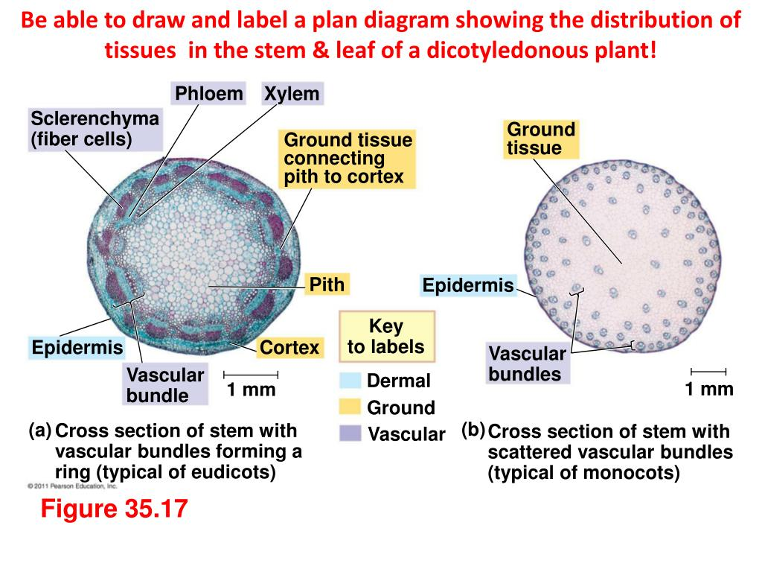

Slide 4
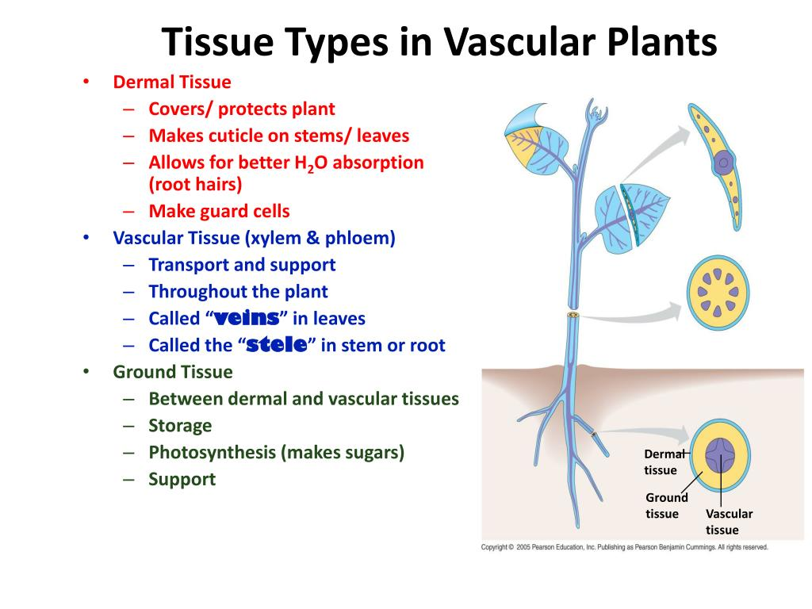

Slide 5
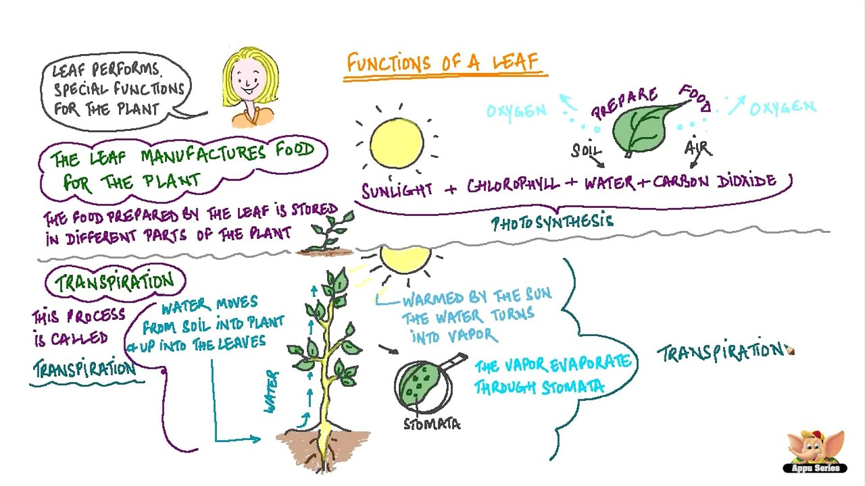
LEAVES
https://youtu.be/rUgEn6Pndgk

Slide 6
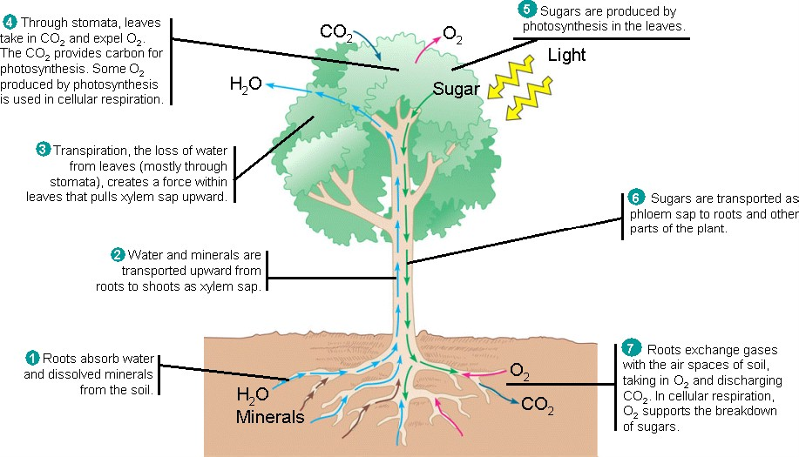

Slide 7
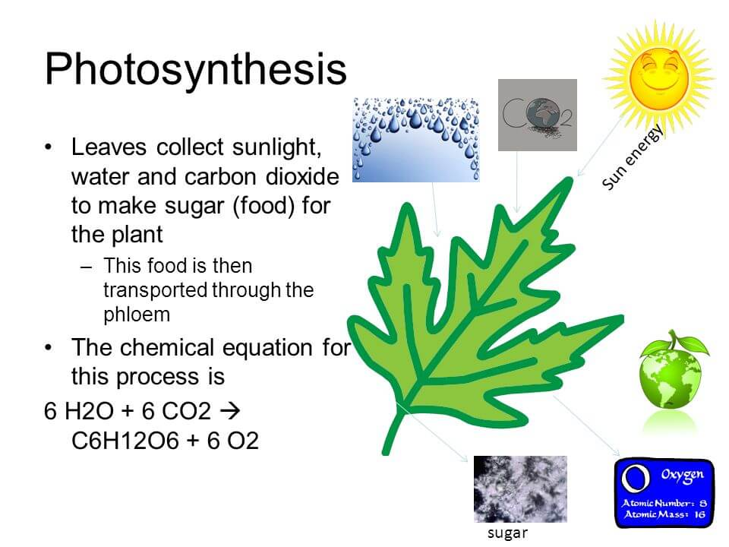
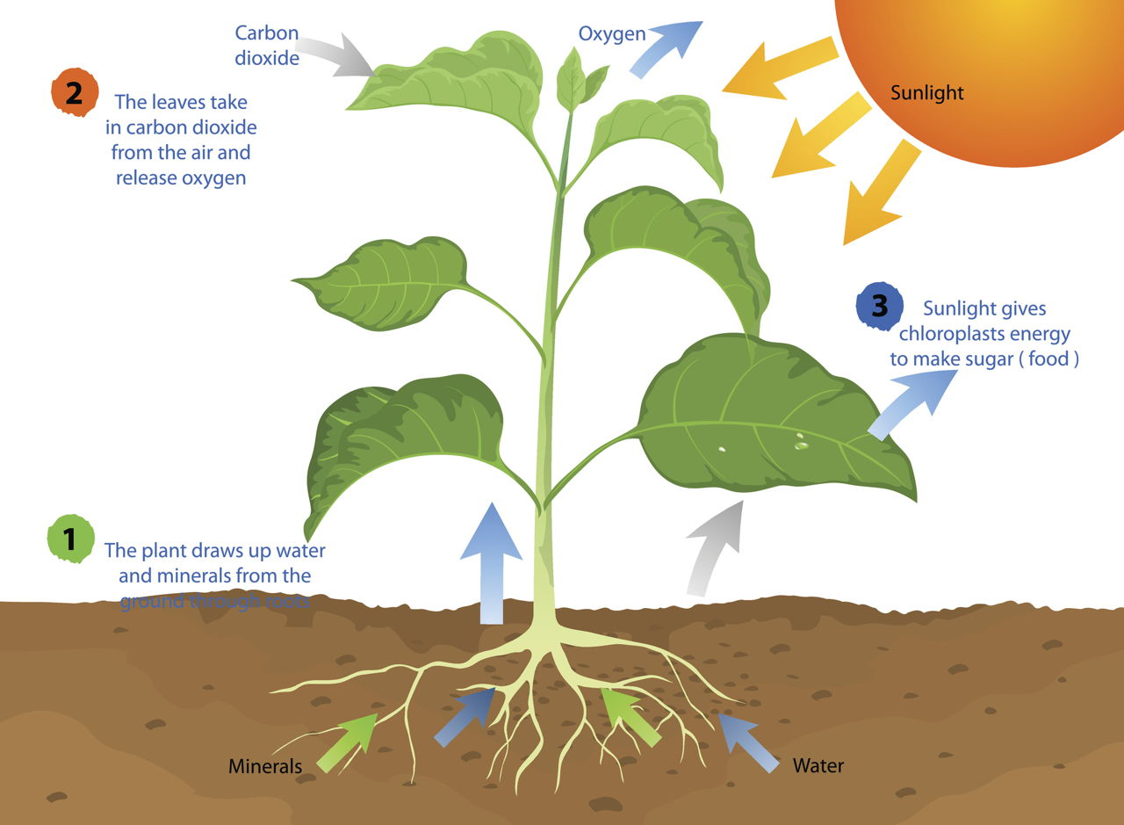

Slide 8
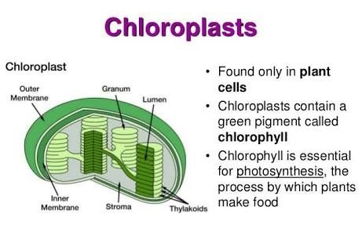
WHERE PHOTOSYNTHESIS TAKES PLACE?

Slide 9
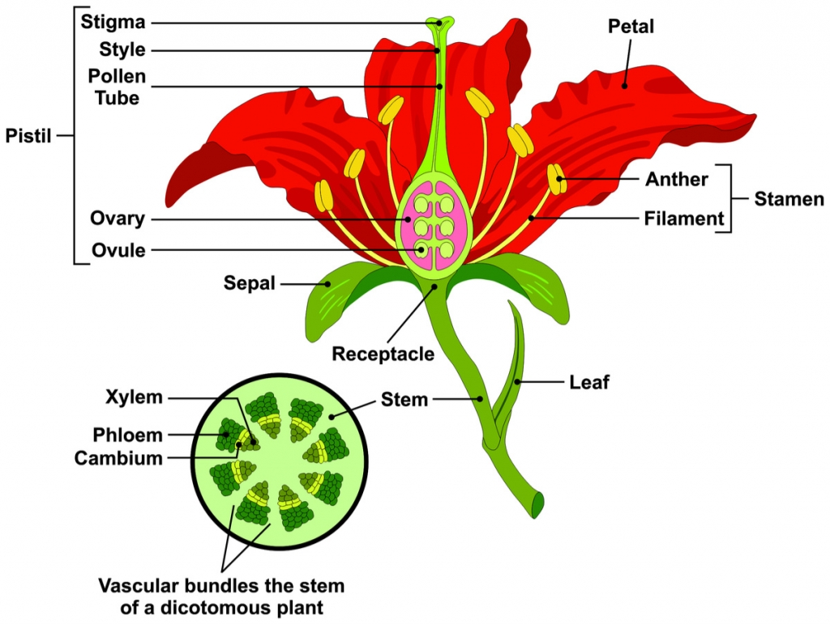
FLOWER
Flowers are the reproductive parts of the plant. Parts of a typical flower are sepals, petals, stamens and pistil.
Receptacle: The base of the flower where its different parts are attached.
Sepals: The green, leaf-like outer parts of the flower. It covers and protects the bud till it blooms into a flower.
Petal: The parts of a flower that are mostly bright in colour to attract insects and birds for pollination.
Stamen: The male reproductive organ of the flower. It has two parts:
Anther: The part of the stamen where pollens are produced.
Filament: A thin thread-like structure that carries the anther.
Pistil: The female reproductive organ of the flower.

Slide 10
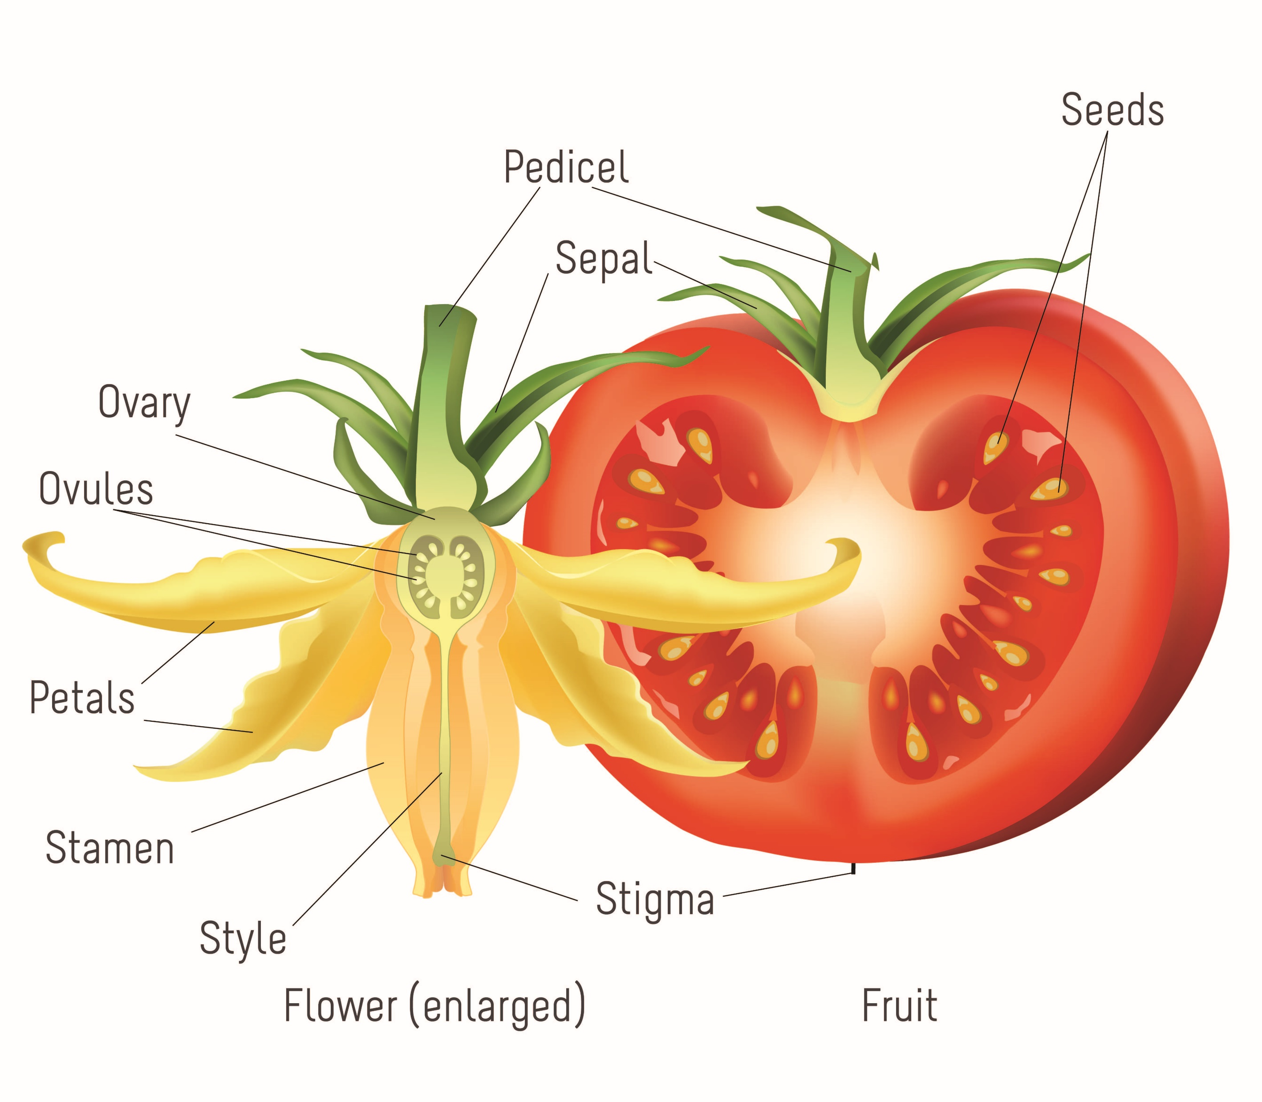
FRUIT
It is the seed-bearing structure formed from the ovary after flowering and the ovule mature to form the seed.
The seed formed in the fruits come out in different ways and get dispersed by wind, water, birds, animals and human beings. In dicot seeds (gram, beans) food for the embryo is stored in the cotyledons. In monocots, food is stored in the endosperm (wheat, maize).
The embryo in the seeds remains dormant till favourable conditions for germination (air, water, temperature and light) are met. When everything is fine, the seed germinates to form a new plant.

Slide 11
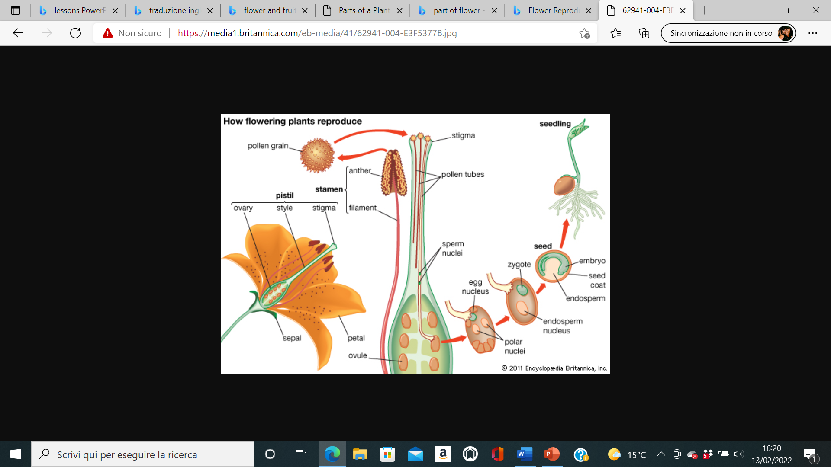

Slide 12
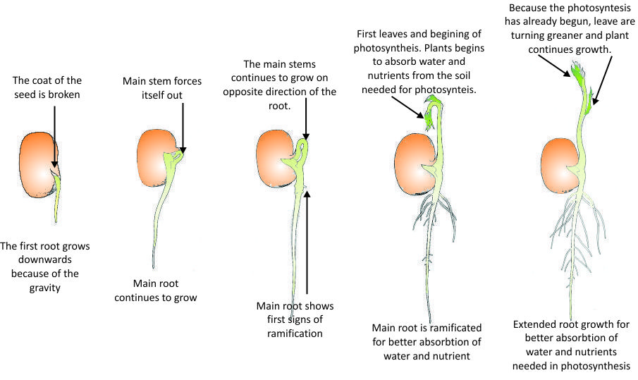
GERMINATION

Slide 13
