Slide 1





Part 1
THE EARTH
AND THE PERIODIC TABLE

Slide 2


INTRODUCTION
Coronavirus and climate change (major floods, droughts, high temperatures records, etc.) are some of the symptoms of our Planet's serious deterioration caused by the misuse of resources.

Slide 3



Our planet is screaming for help.
Some of the Earth’s natural resources are running out. Do you which?
In this scenario, you have to research the chemical elements of the periodic table and their current situation. Which ones are at risk of depletion? How long does each element have left before it is depleted?

Slide 4

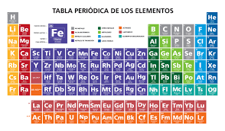

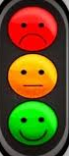

TASK
Research the current state of the chemical elements of the periodic table. How old is each element?
Classify them according to the traffic light system. Red (at risk of depletion) Green (not at risk). Create a periodic table (Appendix 1) by writing the elements in red, yellow or green and indicating their age.

Slide 5

TASK
Technology uses many elements of the periodic table at risk of depletion.
FIND:
  What elements are used for making a smartphone or a tablet.
  Where those elements may be found.

Slide 6
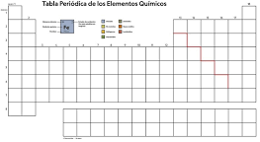
APPENDIX 1:
A BLANK PERIODIC TABLE

