Slide 1
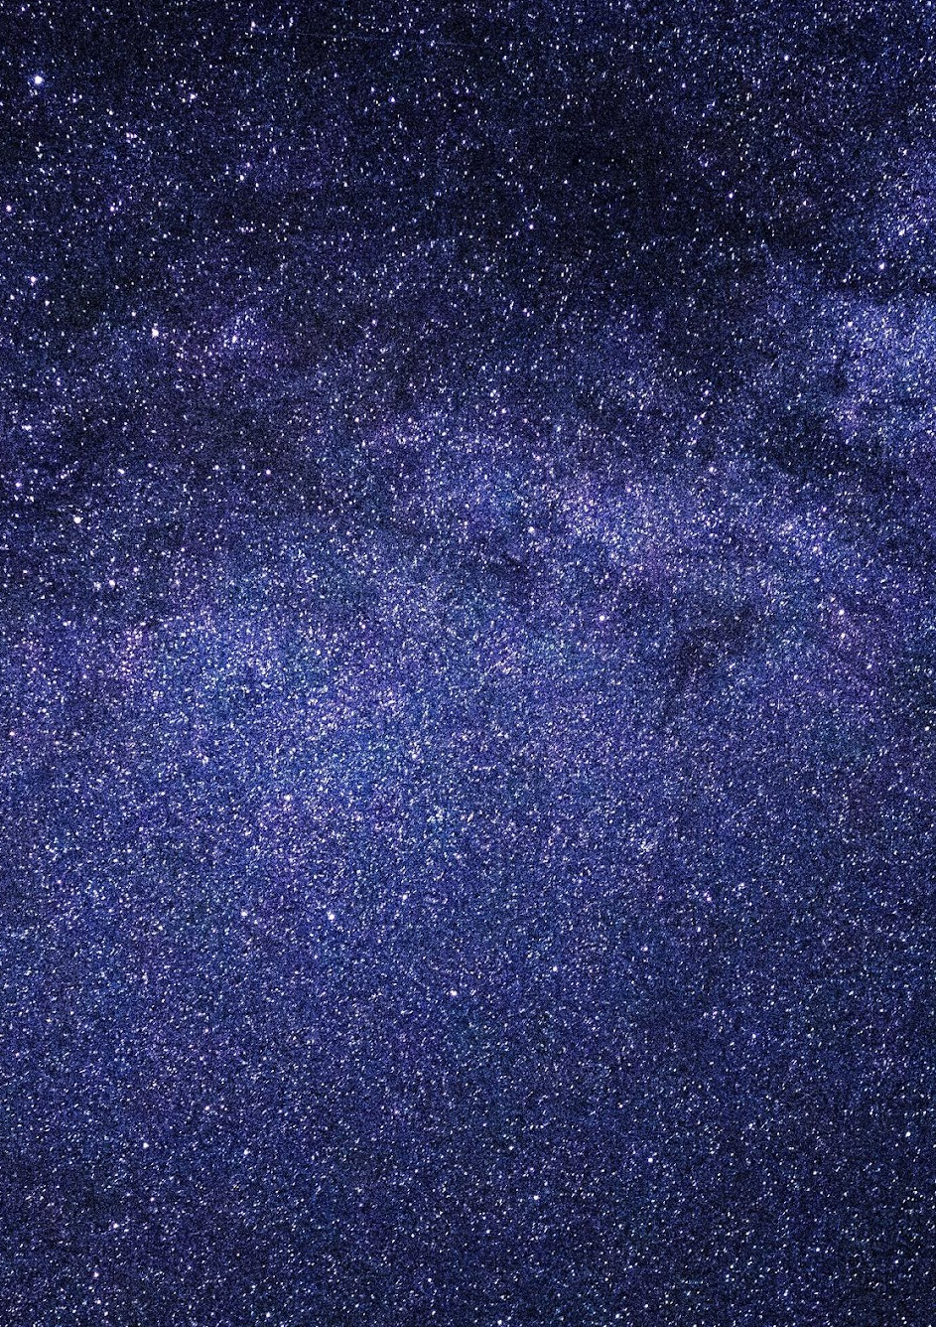
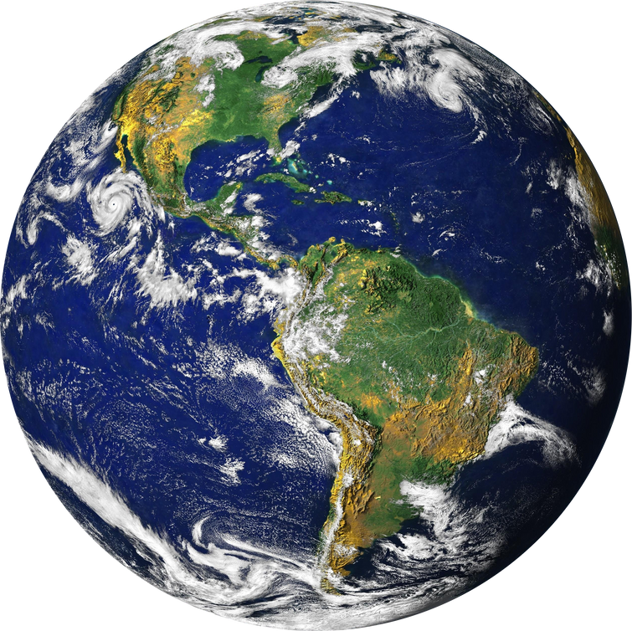
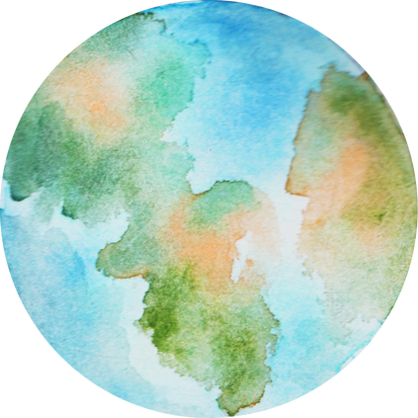

SCENARIO
4TH YEAR OF SECONDARY SCHOOL
SCIENCE
The state of Earth is becoming more and more critical. Well, actually this is no longer news, this is a fact. Earthquakes, floods, volcanic eruptions, tornadoes, thunderstorms, droughts and Coronavirus are some of the symptoms of our Planet's deterioration. One of its main causes is the misuse of resources.
WHAT DO WE KNOW ABOUT THE HISTORY OF EARTH?
WHERE IS OUR PLANET LOCATED?
WHICH OF OUR PLANET'S RESOURCES ARE IN DANGER OF DEPLETION?
To answer those questions, you will do a research project. Your project will contain three parts:
Part 1
Part 2
Part 3
THE EARTH
AND THE PERIODIC TABLE
The Earth
Dimensions of the Universe
WHAT WAS OUR PLANET LIKE IN ITS EARLY DAYS?
HOW HAS IT CHANGED?
HOW WILL IT EVOLVE IN THE FUTURE?

