Slide 1

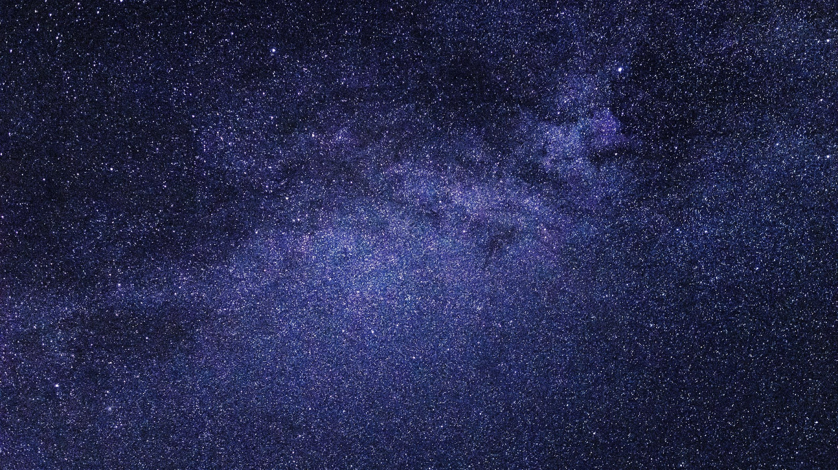


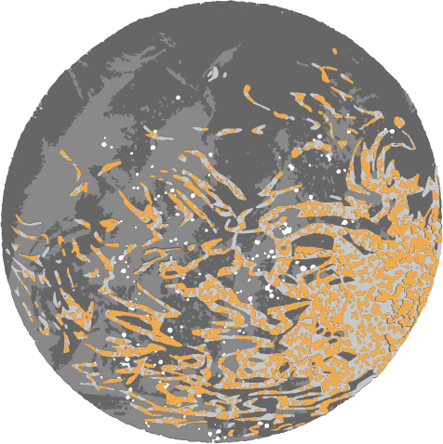
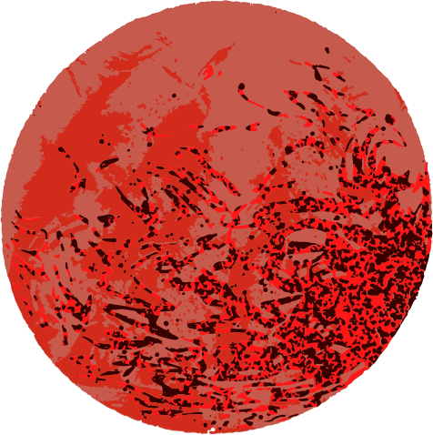

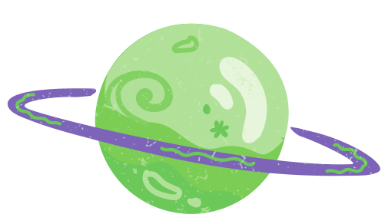

Part 2
The Earth.
Dimensions of the Universe.
Mercury
Saturn
Jupiter
Venus
Earth
Uranus
Mars
The Sun
Neptune

Slide 2

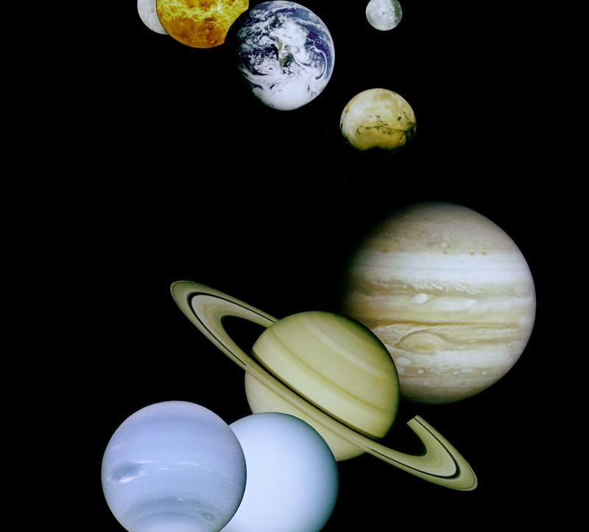
Scientific language is used for dealing with very large numbers or extremely small numerical values. Science may need to use this type of language when describing the size of the Universe or chemical bonds. The world does become extremely small through laboratory microscopes indeed. On the contrary, Astronomy deals with very large numbers. Most of the data related to the cosmos are very large numbers. Consider the distances between planets, stars, etc. or the mass of any star.
We suggest that you become an astronomer for a moment and investigate the dimensions of the Universe, providing the data in scientific notation.

Slide 3

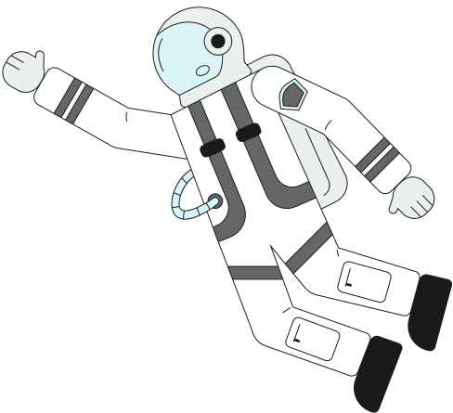
To do tasks
We will start watching these two videos:
  The Scale of the Universe: https://www.youtube.com/watch?v=uaGEjrADGPA
  Universe Size Comparison: https://www.youtube.com/watch?v=GATj2tdBJWc
Task 1: Find data on the diameters of planets and their distance from the Sun. Also, calculate their sizes and distances at the given scales. Fill in the chart in Appendix 1. The scales of the Universe: find the relationship between sizes and answer the questions in appendix 2. Use scientific language at all times.
Tarea 2: Do the calculations in Appendix 3 individually.

Slide 4
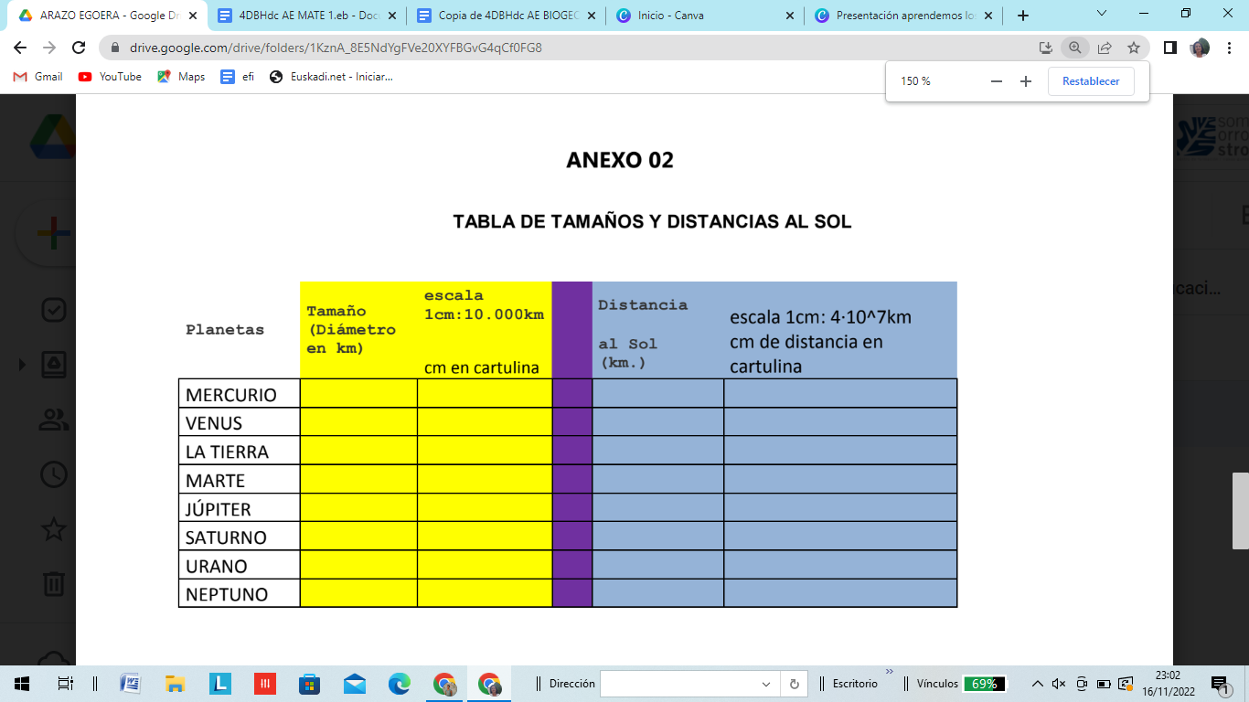
Appendix 1
Size
(Diameter in km)
Distance from The Sun (km)
Planets
MERCURY
VENUS
THE EARTH
MARS
JUPITER
SATURN
URANUS
VENUS

Slide 5

Appendix 2
1. How much bigger is Jupiter than Mercury?
2. What is the size of the sun (diameter)?
3. How much larger is the Sun than the Earth?
4. Considering the speed of light, how long does it take for a beam of light to travel from the Sun to the Earth?
5. Given that on average the speed of a space probe can be around 16km/s, how long would it take for the space probe "Somox" to travel from Errotalde to Mars?
6. And to the sun (if it reached a safe distance of 6-106km)?
7. Given that the size of a cell can range from 1 to 10 microns (or even more), how many cells would have to be lined up to reach the crossbar of a football goal?

Slide 6
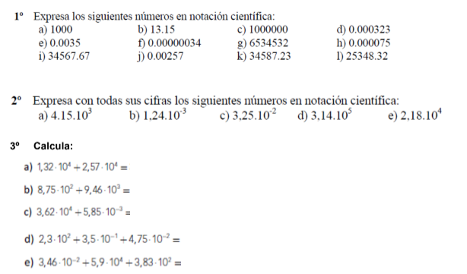
Appendix 3
Write the following numbers in scientific notation:
Write the following scientific notations in full:
Do these calculations:

