Slide 1

Self-knowledge and self-esteem: A journey into our inner self ….
https://www.youtube.com/watch?v=pdjaxS4ME2A

Slide 2

Self-knowledge and self-esteem: A journey into our inner self ….
1.1. The concept of self-knowledge
Know thyself
This phrase is attributed to Chilon the Lacedaemonian, one of the seven sages of antiquity, is engraved in the oracle of Delphi and was widely used by Socrates.
Its meaning is timeless and clear and indicates the challenge, the requirement and the need to know ourselves.

Slide 3
Self-knowledge and self-esteem: A journey into our inner self ….
1.1. The concept of self-knowledge
● Once we get to know ourselves, we are called to identify and deal with our shortcomings, but also to set our limits.
● Self-knowledge is how we see ourselves and therefore the image we project to others.
● Accepting our shortcomings can lead to an effort of self-improvement and development.
●We often do not admit our weaknesses and avoid expressing our true feelings in order to maintain our supposed dignity, for fear of being exposed.
● But we do blame ourselves due to the stress and pressure which could maintain this false image can create.

Slide 4
Self-knowledge and self-esteem: A journey into our inner self ….
1.2. The concept of self-knowledge
Self-esteem
The way one sees successes but also failures.
The awareness of deserving to be loved and accepted by own environment.
The feeling that I am worthy of what I am, not of what I have achieved.
It enhances the maximum possible utilization of one’s potential leading to fulfilment of one’s desires on a practical level
It is the basis of mental balance and helps the individual to maintain satisfactory interpersonal relationships.
The impression that each person has of her/his value.

Slide 5
Self-knowledge and self-esteem: A journey into our inner self ….
1.3. Self-knowledge and self-esteem
Self-esteem
Example
↓
I do not mind at all that I am overweight
Self-concept/self-knowledge
Example
↓
I am overweight

Slide 6
Self-knowledge and self-esteem: A journey into our inner self ….
1.3. Self-knowledge and self-esteem
The - Self
Self -Knowledge
Social Self
Self - esteem
Self - Concept

Slide 7
Self-knowledge and self-esteem: A journey into our inner self ….
1.4. Characteristics of people with high self-esteem
They accept negative criticism from others.
They take initiatives and dare to try new activities.
They take on their responsibilities.
They are composed, self-controlled and balanced.
They feel autonomous and not dependent on their social environment.
They know how to manage and eventually overcome stress, sadness, & anger.

Slide 8
Self-knowledge and self-esteem: A journey into our inner self ….
1.5. Characteristics of people with low self-esteem
Characteristics of people with low self-esteem
They are overwhelmed by their failures.
They adapt their lives to the desires and demands of those around them and create dependent relationships.
They are characterized by touchiness.
They focus on the negative aspects of a situation.
They do not dare to express their needs / demands or claim what they want.
They suffer from concentration, sleep and eating disorders.
Their attitude towards others is strict and they focus mainly on their shortcomings, without leniency

Slide 9
Self-knowledge and self-esteem: A journey into our inner self ….
1.6. Ways to boost self-esteem
Ways to boost self-esteem:
Record your successes.
Reward yourself daily for what you have accomplished.
Do not compare yourself with others.
Try to express your needs, without having to apologize.
Try to socialize with positive people.
Take time to do things that please you e.g. take a walk etc.
Focus on your positive elements.
Learn to set small, realistic goals. Even the smallest achievements can help boost self-esteem.

Slide 10
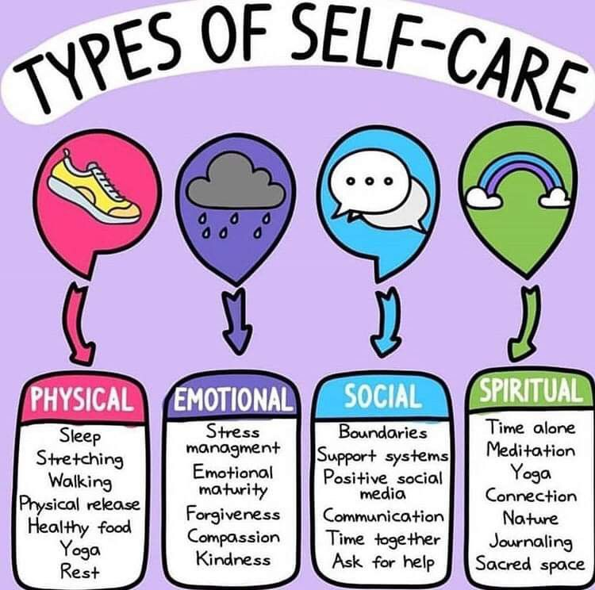
Self-knowledge and self-esteem: A journey into our inner self ….
Ways to boost self-esteem

Slide 11

Self-knowledge and self-esteem: A journey into our inner self ….
1.6. Ways to boost self-esteem
https://www.youtube.com/watch?v=l_NYrWqUR40

