Slide 1
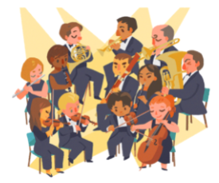
The Orchestra
for… beginners

Slide 2
PART I
The Orchestra for… beginners
Topic: Evolution of the Orchestra
Worksheet I

Slide 3
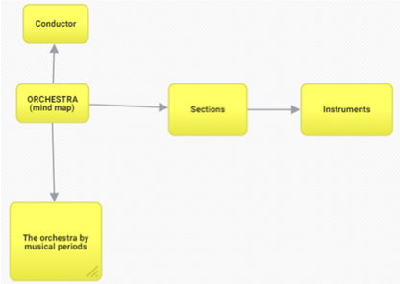
A mind map about the orchestra…

Slide 4
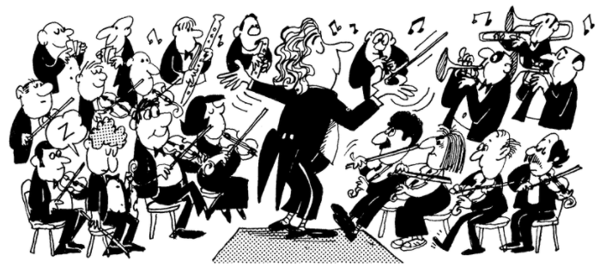
Musicians, Musical Instruments, Conductor

Slide 5
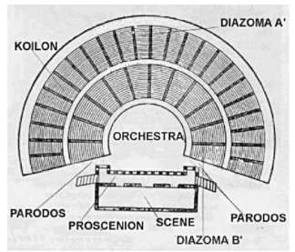
The first encounter with the term
In Ancient Greece the term "orchestra" ["ὀρχήστρα"] referred to the space in front of the stage where the Chorus danced and sang. This is where we first meet the idea of an orchestra. We are in an auditorium and that means one of only two things. Either it is time for the Olympics or we are watching a play. Theatre was one of the most venerated traditions for the Greeks. They absolutely loved it. Since the chorus sang much of the plot, music was an integral part of theatre.

