Slide 1
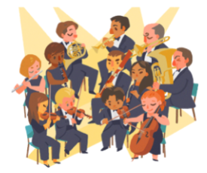
The Orchestra
for… beginners

Slide 2
Topic: The orchestra of the 20th century
Worksheet V
The Orchestra for… beginners
PART V

Slide 3
Features of the 20th century
The 20th century was dominated by significant events that defined the modern era: Spanish flu pandemic, World War I and World War II, nuclear weapons, nuclear power and space exploration, nationalism and decolonization, technological advances, and the Cold War and post-Cold War conflicts.
These reshaped the political and social structure of the globe.
The 20th century saw a massive transformation of humanity's relationship with the natural world. Global population, sea level rise, and ecological collapses increased while competition for land and dwindling resources accelerated deforestation, water depletion, and the mass extinction of many of the world's species and decline in the population of others. Man-made global warming increased the risk of extreme weather conditions.
Einstein, Darwin, Freud and Marx were just some of the thinkers who profoundly changed Western culture.

Slide 4
The Orchestra of the 20th century
Modern orchestras are a bit smaller than in the Romantic Era (symphony and other very large orchestras still exist). Some may focus on the unique (or even bizarre) sounds of individual instruments.The orchestra of the 20th century emphasized mainly percussion and the individual timbres of the instruments.
The modern symphony orchestra varies in size, but typically has a strength of about 100. The largest lot of these are from the strings, which contain some 60 to 70 players. This typically comprises some 16 first and 16 second violins, 14 violas, 14 cellos and 8 - 10 double basses. However these numbers are sometimes reduced when playing 17th century pieces to simulate a 17th century orchestra.
Next come the woodwinds which are usually composed of 2 flutes, a piccolo, 2 oboes, one cor anglais, two clarinets, 1 bass clarinet, 2 bassoons and a double bassoon. Then there is the brass section, which normally consists of 2 trumpets, 3 trombones (2 tenor and 1 bass), a tuba and 4 horns.
Instruments were added to the percussion family (xylophone, glockenspiel, bells, vibraphone, celesta, marimba, etc.)
New ways of playing the instruments were explored and their extreme tonal ranges were explored.

Slide 5
