Slide 1

Energy balance & weight control
1.1. Energy requirements of the body
The human body, in order to function properly, needs energy, which it receives from food:
→ to perform its vital normal functions, such as breathing, heart function and digestion of food.
→ for its physical activities (eg. walking, reading, swimming, gymnastics, etc.).
→ for its maintenance and development, as well as for the support of additional physiological needs related to pregnancy and lactation.

Slide 2
Energy balance and weight control
1.2. Forms of energy and its transformations in the body
Electrical energy, for the communication of the brain with the various parts of the body.
Chemical energy, for the creation of body molecules and cells or lipid molecules where it is stored.
Thermal energy, to maintain body temperature.
Kinetic energy, during body movements.
Heat, emitted from our body to the environment.
Food energy is stored in their molecules and is released in the body when they are broken down during the digestion process. This initial energy is called biological, which is then converted into other forms of energy.

Slide 3
Energy balance and weight control
1.3. Units of energy measurement
● From a technical point of view, one calorie is the energy required to raise the temperature of one gram of water by one degree Celsius (equivalent to 1.8 degrees Fahrenheit).
● The units of measurement of the energy present in food as well as the energy that the body needs, are the calorie (cal) and the joule (J).
● When referring to the energy content of food, usually a much larger unit, which is 1000 times greater than one calorie, is used, which is called kilocalorie (kcal). However, in a non-scientific context, kilocalories are often referred to as calories.
● For the conversion from kcal to kjoule and vice versa the following relationships apply:
l kcal = 4,2 kj and 1 kj = 0,24 kcal

Slide 4
Energy balance and weight control
1.4. Energy of food nutrients (Food energy)
The amount of energy that the body absorbs through food intake, is the body's fuel. Each food contains a certain amount of energy, which depends on its composition of nutrients, which are substances that the body can not synthesize, but needs, to function properly.
Calorific value of nutrients
↓
• Carbohydrates (4 Kcal/gr)
• Protein (4 Kcal/gr)
• Fat (9 Kcal/gr).
• Alcohol (7 Kcal/gr) (it is not considered a nutrient, because the body does not need it for survival).
Empty calories
↓
Vitamins, minerals/trace elements and water, do not give us energy.

Slide 5
Energy balance and weight control
1.4. Energy of food nutrients
→ For example, if a food contains 5 g. of carbohydrates or protein, it provides 20 calories from carbohydrates or protein [5g x 4 (kcal / g)], while a food with 5 g. of fat provides 45 calories [5g x 9 (kcal / g)]
→ Therefore, if the composition of a food in carbohydrates, fat and protein is known, then the energy (calories) of a certain amount of food can be easily calculated.
→ Each food contains a certain amount of energy, which depends on its composition of nutrients.
→ This corresponds to the total amount of energy from carbohydrates, fat and protein contained in the amount of food.

Slide 6
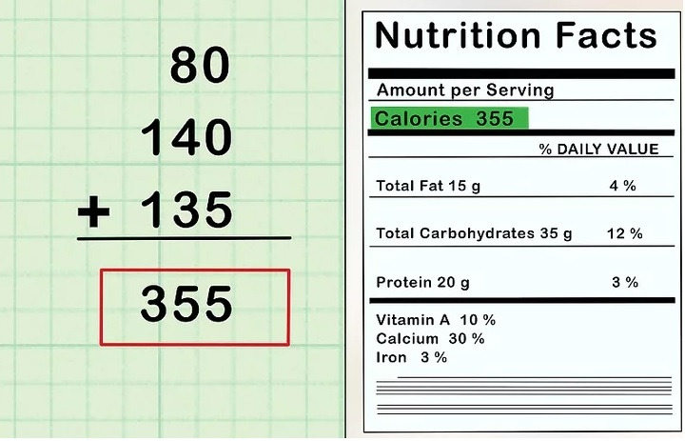
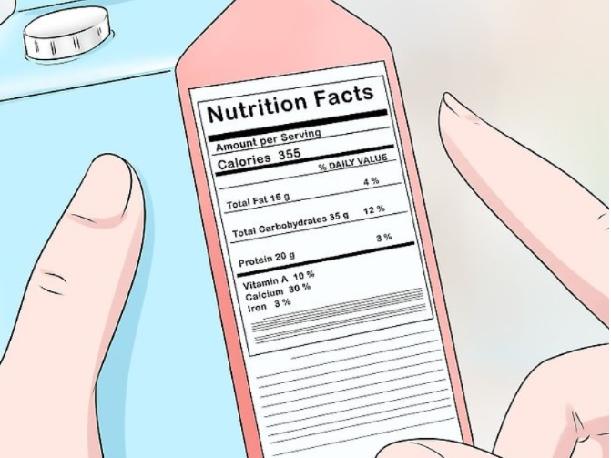
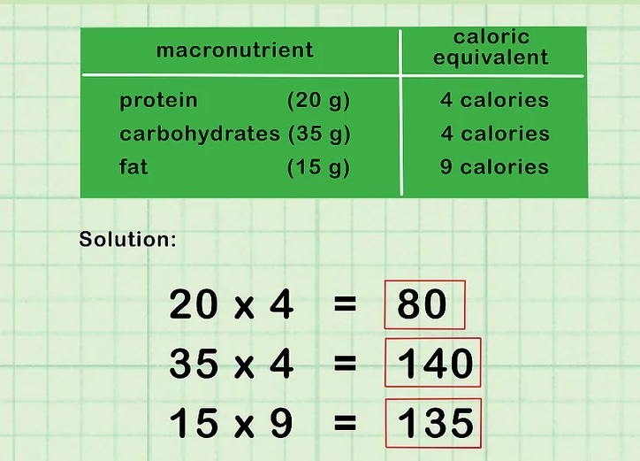
Energy balance and weight control
1.4. Energy of food nutrients

Slide 7
Energy balance and weight control
1.4. Energy of food nutrients
1.4.1. Macronutrients & micronutrients
Macronutrients
Large quantities of the following are required:
→ Protein
→ Carbohydrates
→ Fat
→ Water
Micronutrients
Smaller quantities of the following are required:
→ Vitamins
→ Minerals

Slide 8
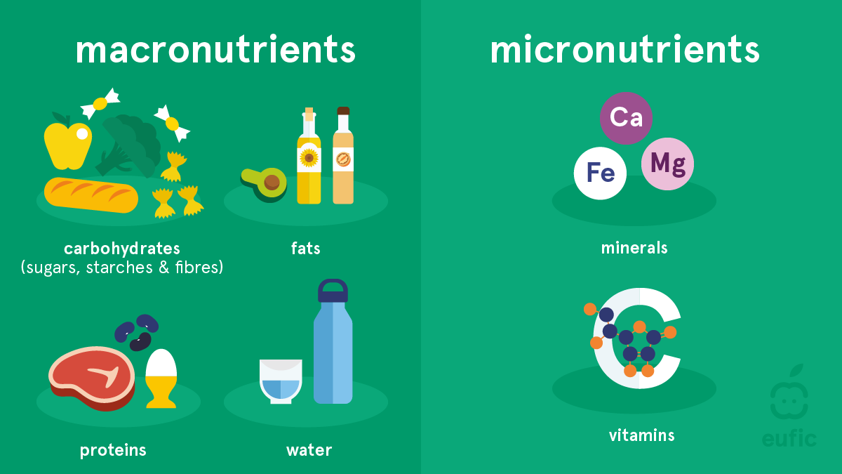
Energy balance and weight control
1.4. Energy of food nutrients
1.4.1. Macronutrients & micronutrients

Slide 9
Energy balance & weight control
1.4. Energy of food nutrients
1.4.2. The role of nutrients
Proteins
• They provide energy.
(1gr → 4kcal)
•They build cells & tissues.
• They synthesize hormones, enzymes
&
antibodies.
Minerals
• They are necessary for important body functions to be performed / metabolic regulators.
• They are responsible for structural components.
Water
• Metabolic regulator.
• Structural component
Carbohydrates
• They provide energy.
(1gr → 4kcal)
Fats
• They provide energy.
(1gr → 9kcal)
• They protect the various organs of the body.
• They help keep the body temperature constant.
Vitamins
•. They are necessary for important body functions to be performed/ metabolic regulators.

