Slide 1

Energy balance & weight control
2.1. Daily energy requirements of the body
To calculate the daily needs of both adults and adolescents in energy, it is necessary to know the 3 basic parameters that affect their energy requirements.
→ Basal metabolism
60 – 65%
→ Thermogenic effect of food
5 – 10%
→ Daily physical activity
25 – 35%

Slide 2
Energy balance & weight control
2.1. Daily energy requirements of the body
2.1.1. Basal metabolism
Basal metabolism: the energy (calories) that the body consumes when it is at rest.
Basal metabolism (Β.Μ.)
Basal metabolism: the minimum amount of energy required by the body to perform important functions, such as respiration, body temperature regulation, heart function, blood circulation, maintenance of muscle tone, and function of glands and cells.

Slide 3
Energy balance & weight control
2.1. Daily energy requirements of the body
2.1.1. Basal metabolism
Factors that affect basal metabolism:
→ Fever: Fever increases the basal metabolism. For every degree Celsius of rise in temperature, our basal metabolism increases by 12%.
→ Starvation / malnutrition: conditions such as chronic malnutrition or crash diets cause a decrease in basal metabolism.
→ Ambient temperature: adaptation to very low or very high temperatures increases basal metabolism.
→ Stress: hormones secreted in times of stress / tension result in an increase in basal metabolism.
→ Body surface area. Basal metabolism increases when there is greater heat loss from the body (people with larger body surface area e.g. tall people have a higher metabolic rate).
→ Body composition: Basal metabolism depends on a person's muscle mass. The greater the muscle mass, the better the metabolism works.
→ Age: Basal metabolism decreases in adults by 2-8% per decade of life and this is mainly due to the loss of muscle mass.
→ Growth: People who are in the developmental period have an increased basal metabolism. An increase in metabolism is observed during pregnancy.
→ Thyroxine levels: Hormones produced by the thyroid gland, are the main regulators of basal metabolism.
→ Gender: Men have an increased basal metabolism compared to women due to their body composition.

Slide 4
Energy balance & weight control
2.1. Daily energy requirements of the body
2.1.1. Basal metabolism
There are several ways in which someone can calculate their basal metabolism. In particular, two of the formulae used to calculate basal metabolism are listed.
Formula 1
Basal metabolism (kcal/hour) = Body weight (kg) x 24
Formula 2
Age | Β.Μ ( Kcal / day ) men | Β.Μ ( Kcal / day) women
10 - 18 | (17.5 Χ Β) + 651 | (12.2 Χ Β) + 746
18 - 30 | (15.3 Χ Β) + 679 | (14.7 Χ Β) + 496
30 - 60 | (11.6 Χ Β) + 879 | (8.7 Χ Β) + 829
> 60 | (13.5 Χ Β) + 487 | (10.5 Χ Β) + 596
Β = Σωματικό βάρος σε κιλά

Slide 5
Energy balance & weight control
2.1. Daily energy requirements of the body
2.1.2. Physical activity
→ In addition to basal metabolism, the body needs energy to perform all the physical activities (mental and physical), related to lifestyle, such as work, reading, exercise and sleep. Therefore, a significant percentage of the body's daily energy needs are consumed to perform physical activities.
→ Physical activity is any movement of the body, which is performed due to muscle contraction and which results in spending energy. Physical activity can be of an organized or unorganized form.
Physical activity

Slide 6
Energy balance & weight control
2.1. Daily energy requirements of the body
2.1.2. Physical activity
The energy spent on human physical activity depends on the type of activity and its duration. The energy required for physical activity is calculated by multiplying basal metabolism by the corresponding percentage of the form of physical activity.
Form of daily physical activity | Energy requirements of physical activity
Sedentary life | 20% of Β.Μ.
Light physical activity | 40% of Β.Μ.
Moderate physical activity | 60% of Β.Μ.
Vigorous physical activity | 70% - 120% of Β.Μ.

Slide 7
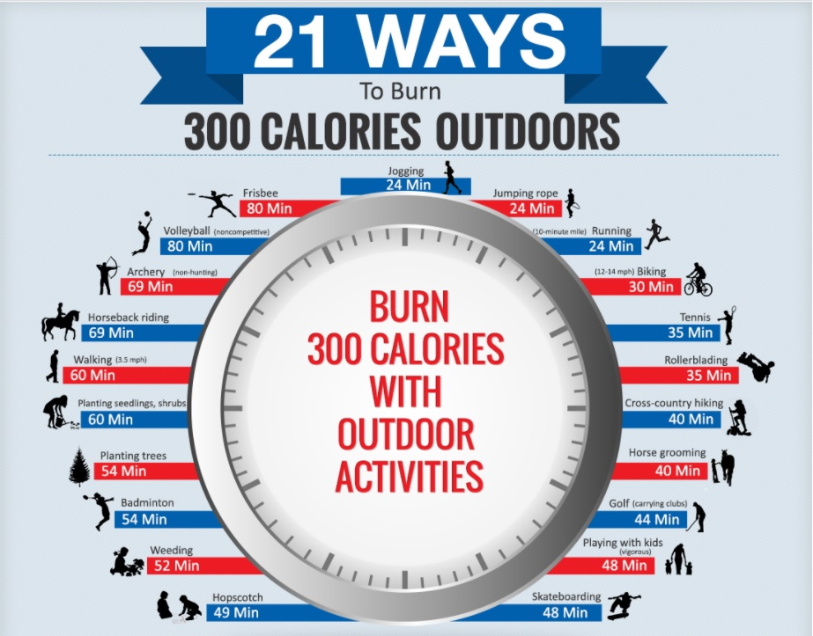
Energy balance & weight control
2.1. Daily energy requirements of the body
2.1.2. Physical activity

Slide 8
Energy balance & weight control
2.1. Daily energy requirements of the body
2.1.2. Physical activity
Sedentary life
It includes activities with minimal intensity physical exercise (such as writing, cooking, etc.), as well as some light activities, such as slow walk and driving.
Light physical activity
It refers to a lifestyle which, in addition to very light activities (eg slow walk, driving, etc.), includes some others, such as housework, carrying some weight and brisk walk.
Moderate physical activity
It refers to a lifestyle which, in addition to light or very light activities, includes several activities such as dancing, cycling, gardening and possibly some vigorous activities such as climbing stairs, running and sports such as football and basketball.
Vigorous physical activity
It refers to a lifestyle that includes high-energy activities. People who do such type of activity, are all those who do heavy labour, as well as those who are intensively engaged in sports.

Slide 9
Energy balance & weight control
2.1. Daily energy requirements of the body
2.1.3. Thermic effect of food
Thermic effect of food
→ Thermic effect of food, is the energy used by the body for the digestive process after each meal.
→ This process involves the breakdown of food into nutrients, its absorption, utilization and storage in the body. It starts and ends 1-3 hours after each meal.
→ To calculate the thermic effect of food, 10% of the sum of the two aforementioned parameters is calculated, that is, basal metabolism and physical activity.
Thermic effect of food = 0.1 Χ (basal metabolism + physical activity)

Slide 10
Energy balance & weight control
2.1. Daily energy requirements of the body
2.1.4. Example of calculating daily energy requirements
Total daily energy requirements:
Β.Μ + physical activity + thermic effect of food
Example
Calculation of the daily energy requirements of an eighteen-year-old boy, weighing 70 kg and doing light activity.
• Basal metabolism (Β.Μ.) = (17.5 X 70) + 651 = 1876 Κcal
• Physical activity: 40% του Β.Μ = 1876 X 0.4 = 750.4 Κcal
Thermic effect of food = 0.1 X (1876+750.4) = 262.6 Κcal
Total daily energy requirements: 1876 +750.4 + 262.6 = 2889 Κcal

Slide 11
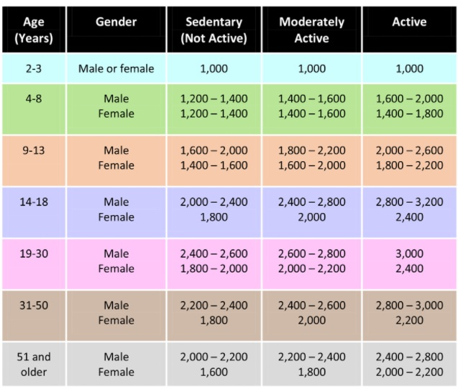
Energy balance & weight control
2.1. Daily energy requirements of the body
2.1.5. General guide to energy needs by age group
Daily calorie needs based on age, gender and activity level.

Slide 12
Energy balance & weight control
3.1. Energy balance
Energy balance
→ The term energy balance is used when energy input is equal to energy expenditure.
→ Energy intake includes energy in calories obtained from the consumption of various foods and beverages.
→ Much of the body's energy is spent on basal metabolism (involuntary functions), while the rest of the energy is spent on physical activity (voluntary functions).
1. Energy Intake> Energy Expenditure → I get fat 2. Energy Intake = Energy Expenditure → Normal weight 3. Energy Intake <Energy Expenditure → I lose weight

Slide 13
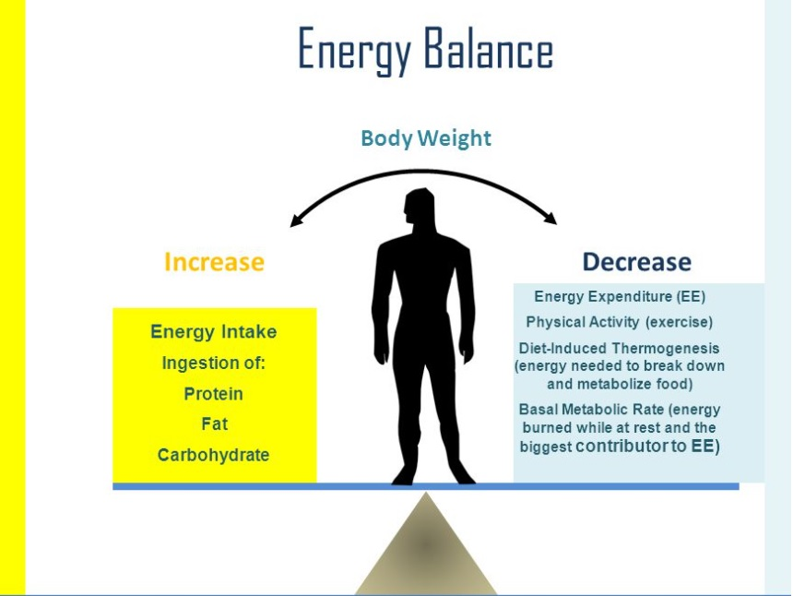
Energy balance & weight control
3.1. Energy balance

Slide 14
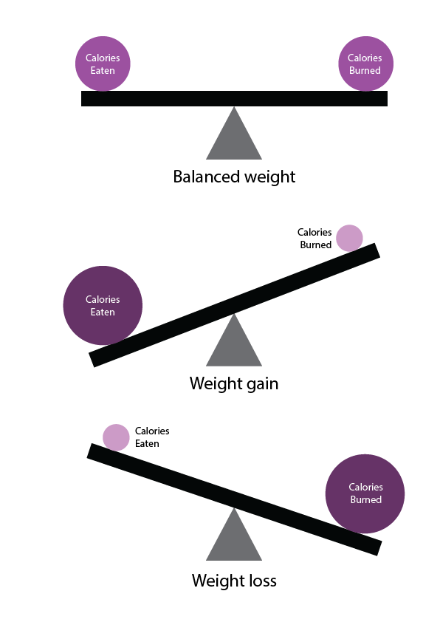
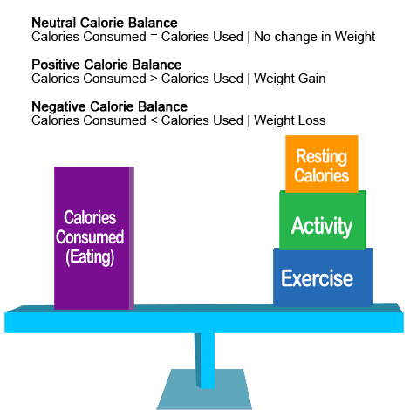
Energy balance & weight control
3.1. Energy balance

