Slide 1

ENTREPRENEURSHIP & INNOVATION
Innovation
Entrepreneurship means
→ boldness, imagination and creation .
Entrepreneurship means
→ transforming uncertainty into certainty and action.
Entrepreneurship means
→ scientific knowledge & smart ideas that are turned into actions.

Slide 2
ENTREPRENEURSHIP & INNOVATION
Innovation
Innovation is a success factor for business and a driving force for economy.
Conditions for innovation
Creation of centers of excellence - innovation
Financing of innovative research activities by large enterprises.
Promoting new businesses that stand out for their flexibility and efficiency.

Slide 3

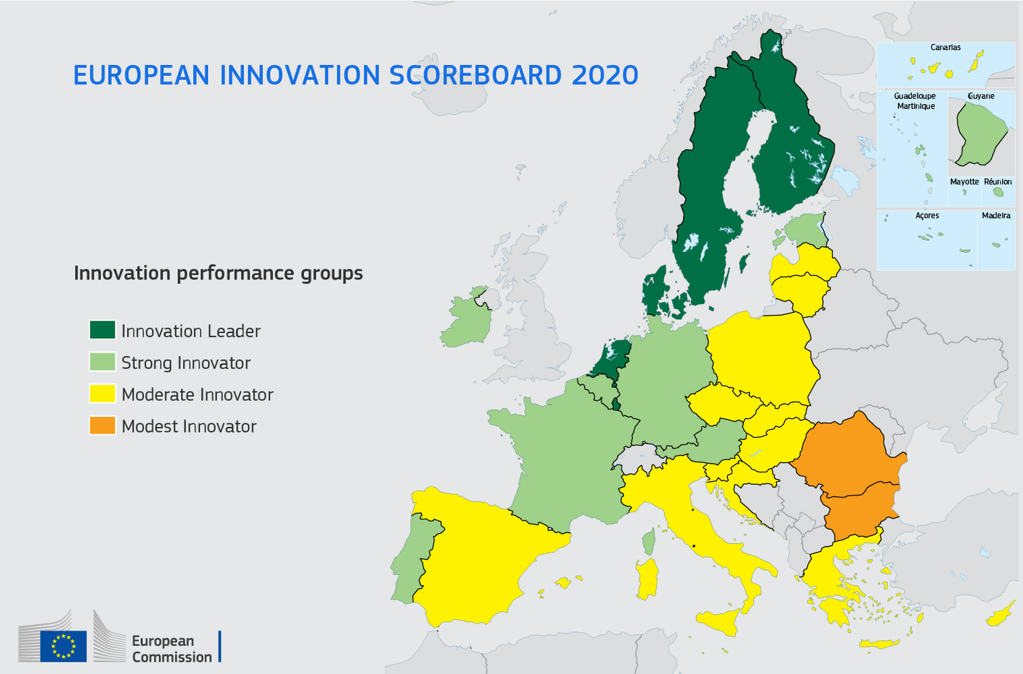
ENTREPRENEURSHIP & INNOVATION
Innovation

Slide 4
ENTREPRENEURSHIP & INNOVATION
Innovation
Greece boasts the human resources required to join the group of innovative countries.
In the age of technology and new economy, new ideas are of great importance.
Ideas that can be transformed into goods & services.
There are also new ideas in patents, which promote innovation and the creation of new products & new businesses.
Patenting of ideas is of great importance, i.e. the exclusive use of the idea and its commercial application. “Patenting an idea is more important than the idea itself."

Slide 5
ENTREPRENEURSHIP & INNOVATION
Innovation
It increases their productivity and profitability.
It increases the flexibility of the production process.
It helps maintain or increase market share.
It can create new markets.
Implementing innovation offers a competitive advantage to businesses, because:

Slide 6
ENTREPRENEURSHIP & INNOVATION
Innovation
Innovation factors:
business environment
research and development
shaping a culture of innovation
human resources
way of organization & operation

Slide 7
ENTREPRENEURSHIP & INNOVATION
Innovation
Internal factors that hinder innovation
Traditional organization
Family nature, small size etc.
Introversion & lack of competitiveness
Fear of failure
Limited collaboration, exchange of expertise, exports, etc.
Lack of funding
It applies to small and medium-sized businesses due to limited financial resources.
Innovation requires capital.

Slide 8
ENTREPRENEURSHIP & INNOVATION
Innovation
External factors hindering innovation:
Constant changes in the institutional framework
Bureaucracy
Lack of sufficient research & technology
Lack of innovative entrepreneurship culture

