Slide 1
Creative Commons Scenarios
Activity obtained from https://maricopa.instructure.com/courses/805732/modules

Slide 2
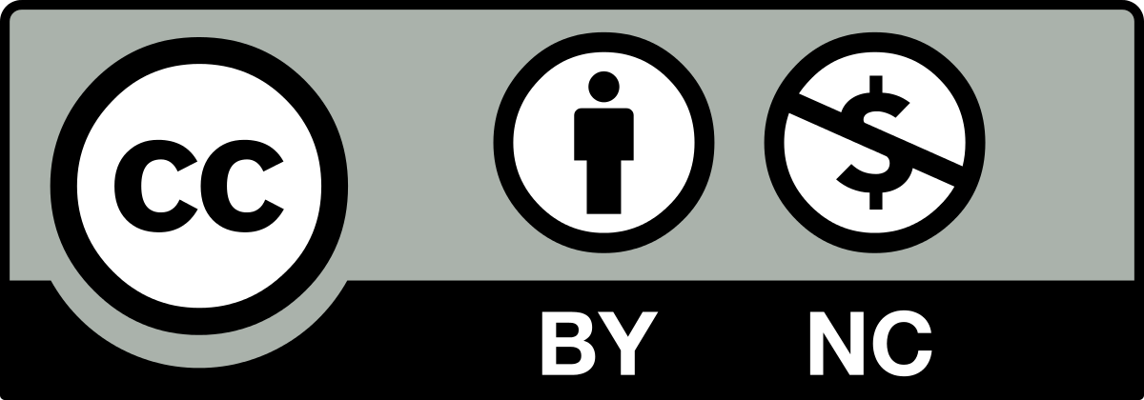
Scenario #1
Determine whether the subsequent use of the CC-licensed work is acceptable or unacceptable. If it is unacceptable you are encouraged to explain why.
Original Work: A .pdf file of an open composition textbook, CC BY-NC
Subsequent Use: An institution’s English department likes the book so much that they adopt it for use in their first-year composition classrooms. The digital document is distributed via the institution’s website. In order to accommodate those students who either don’t like to read things on a screen or don’t have consistent access to the technology, a print version is made available for a small fee at the bookstore.
- Acceptable
- Unacceptable
The purpose of the work is what is at issue in the NC situation, so since the purpose is non-profit education this use is likely acceptable. Additionally, it may be the case that the fee is only recouping the cost for printing, which would be fine.

Slide 3

Scenario #2
Determine whether the subsequent use of the CC-licensed work is acceptable or unacceptable. If it is unacceptable you are encouraged to explain why.
Original Work: An article on a publicly-visible website, CC BY
Subsequent Use: An educator, developing a textbook to be sold, pastes text from the article into one of the book’s chapters with appropriate quotation and the original author’s name, title of work, and CC license, along with the name of the website that the material was taken from.
- Acceptable
- Unacceptable
The material is used in compliance with its explicit license.

Slide 4
Scenario #3
Determine whether the subsequent use of the CC-licensed work is acceptable or unacceptable. If it is unacceptable you are encouraged to explain why.
Original Work: A text file on a faculty website containing an overview of research methods, CC BY
Subsequent Use: An instructor from the same institution incorporates the text of the document into a large presentation about research methods, including a linked URL on the very last slide.
- Acceptable
- Unacceptable
Using the original text without explicit citation of the author's name, title of work, and CC license would likely be considered a breach of the terms of the license.

Slide 5
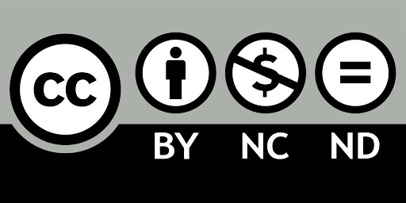
Scenario #4
Determine whether the subsequent use of the CC-licensed work is acceptable or unacceptable. If it is unacceptable you are encouraged to explain why.
Original Work: A digital recording of a song, CC BY-NC-ND
Subsequent Use: An instructor plays the song as soothing background music, not an “educational repurposing,” during a final exam, with the artist’s name, song’s name, album’s name, and license projected on the screen.
- Acceptable
- Unacceptable
With CC licenses, such things as "educational repurposing" aren't relevant. The original work can be so used as long as it's attributed, unchanged, and not monetarily profited from.

Slide 6

Scenario #5
Determine whether the subsequent use of the CC-licensed work is acceptable or unacceptable. If it is unacceptable you are encouraged to explain why.
Original Work: A digital file of a presentation, CC BY-ND
Subsequent Use: An educator downloads the file, changes the content of several slides, and
uploads it with appropriate attribution, including the name of the original author, the title of
the work, and the license.
- Acceptable
- Unacceptable
"ND" means "no derivatives," so the material can be freely downloaded and used but not modified in any way.

Slide 7

Scenario #6
Determine whether the subsequent use of the CC-licensed work is acceptable or unacceptable. If it is unacceptable you are encouraged to explain why.
Original Work: A digital file (.doc) containing a writing assignment prompt, CC BY-SA
Subsequent Use: An instructor downloads the file, edits it, adds to it, and then distributes the
new file under a CC BY-NC-SA license.
- Acceptable
- Unacceptable
The whole purpose of "SA" ("share alike") is that any derivative work is licensed no more strictly than the original work.

